Slide 1



Season of Creation 2025:
“Peace with Creation”
Post-Primary Assembly
Notes:
Assembly overview: This assembly explores the theme of “Peace with Creation” through the lens of how peace, justice and care for creation are interconnected.
You will find notes with suggestions under each slide, however you may wish to edit the slides and tailor the assembly to your better suit your own school ethos and focus for the year ahead.
As pupils enter and settle, you may wish to play a hymn for creation/peace, for example: Make Me a Channel https://youtu.be/DdGLaF1AmGY?si=LIyc6WK1DHmEoF9p , Calming Nature Music https://youtu.be/HQvKPn67z-k?si=MZttf2BL9tgEQwGQ

Slide 2
A Prayer for Our Earth from Pope Francis
Bring healing to our lives,
that we may protect the world and not prey on it,
that we may sow beauty, not pollution and
destruction.
Touch the hearts
of those who look only for gain
at the expense of the poor and the earth.
Teach us to discover the worth of each thing,
to be filled with awe and contemplation,
to recognise that we are profoundly united
with every creature as we journey towards
your infinite light.
We thank you for being with us each day.
Encourage us, we pray, in our struggle
for justice, love and peace.
Amen
All-powerful God, you are present in the whole
universe and in the smallest of your creatures.
You embrace with your tenderness all that exists.
Pour out upon us the power of your love,
that we may protect life and beauty.
Fill us with peace, that we may live
as brothers and sisters, harming no one.
O God of the poor,
help us to rescue the abandoned and forgotten
of this earth, so precious in your eyes.
Notes:
Welcome pupils to this assembly and the Season of Creation. You may choose to light a candle to mark God’s presence before saying the above prayer for our Earth (taken from Pope Francis’ encyclical, Laudato Si’).
Reader notes: The Season of Creation is a time when Christians all around the world come together to pray and take action to protect our planet. This years theme, Peace with Creation, reminds us that we cannot experience peace if the Earth and those who share it as their home are suffering. Today we will reflect on our duty to care for all of Creation, acting for justice and peace in our world.

Slide 3
Notes:
Reader notes: The symbol for this year’s Season of Creation is called the “Garden of Peace”. Can anyone think of why the symbol has been given this name? What do you notice about the two parts of the symbol? What might they represent?
You may wish to guide the pupils towards the following symbols in your reflection:
- Left side of the tree: barren, roots digging into dry soil, desolate landscape.
- Right side of the tree: lush and green, firmly rooted in a flourishing landscape.
- Dove: symbol of peace and reconciliation, renewal. Carrying an olive branch in its beak, flying from a war-torn, overexploited land to one that is fertile, thriving and welcoming.
As stewards of Creation, God has called us to plant Gardens of Peace with our actions. When you picture a Garden of Peace, what does it look like? Is it a place in nature? A place where you feel safe? A place of happiness? For Christians, a Garden of Peace is more than just somewhere safe and quiet. It is a place where all of Creation can flourish together without harm, conflict or damage to the environment. Are we living in a Garden of Peace today?

Slide 4
Scripture Reflection
“The fruit of justice will be peace;
and the effect of justice, quietness and trust forever.
My people will abide in peaceful dwelling places,
in secure homes, and in undisturbed places of rest.”
Isaiah 32:17-18
Notes:
Reader notes: The prophet Isaiah speaks hopefully of a peaceful Earth. In Laudato Si’, Pope Francis reminds us that “the cry of the Earth and the cry of the poor are one and the same”. This means that justice and peace cannot be separated. Our world cannot have peace if Creation is exploited and hurt, or if people are living in poverty or conflict.

Slide 5
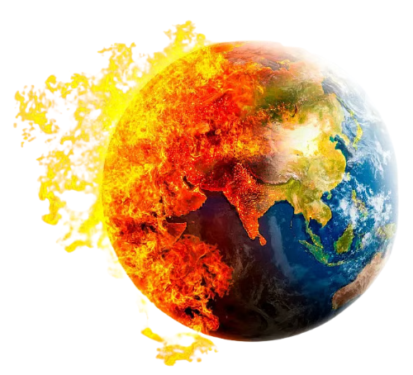
There has been a 73% average decline in the population sizes of mammals, birds, amphibians, reptiles, and fish in just 50 years (1970-2020).
Glaciers are retreating almost everywhere around the world. The global polar bear population will decline by more than 30% over the next 35 to 40 years, and it is predicted that polar bears in the Arctic could go extinct by 2100.
It has been estimated that, by 2030, climate change could push more than 120 million more people into poverty.
More than 1 billion people could be forced to leave their home, and even their country, due to extreme weather events by 2050.
75% of people living below the poverty line rely on agriculture and other natural resources to make a living. Climate change is reducing harvests, meaning families are unable to eat and earn an income.
2024 was the hottest year on record. So far in 2025, heatwaves caused over 2,300 deaths in Europe, around 65% more than would have occurred without human-induced climate change.
Notes:
Feel free to edit statistics/focus as you see fit. You may choose to read them aloud or give pupils a few minutes to read and reflect in silence.
Reader notes: Are we living in a world that is at peace with Creation? What do these statistics say about the world we are creating?
The peaceful Earth that Isaiah hoped for is crying out for our attention – climate change, pollution, species loss, poverty are breaking that peace. This is not the world that God intended.
What would a world at peace with Creation in 2025 look like?
Links to statistics:
https://science.nasa.gov/climate-change/evidence/
https://earth.org/polar-bears-at-risk-of-starvation-as-arctic-ice-sheets-melt-scientists-warn
https://news.un.org/en/story/2019/06/10412611
There could be 1.2 billion climate refugees by 2050. Here’s what you need to know | Zurich Insurance
https://www.un.org/en/climatechange/science/causes-effects-climate-change
https://science.nasa.gov/climate-change/evidence/

Slide 6

Can we live in peace with Creation?
Notes:
Reader notes: Sometimes we might feel hopeless as we reflect on the sufferings of our world, but it is never too late to take action. It is more important than ever that we work together to find peace with Creation again.
Link to video: https://vimeo.com/showcase/11571494/video/1055243262

Slide 7
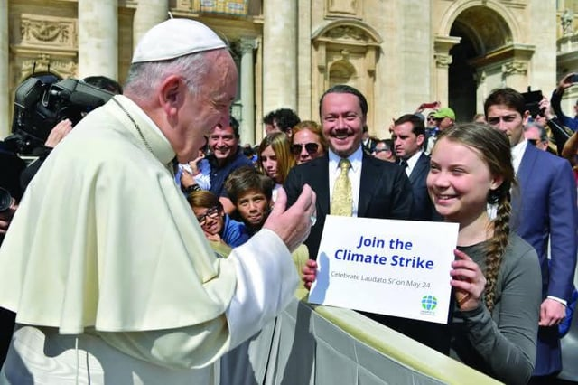
“The one thing we need more than hope is action. Once we start to act, hope is everywhere.” – Greta Thunberg
Notes:
Reader notes: Peace with Creation isn’t just a hope, it’s an action. As a school community, we can choose to be part of the problem, or part of the solution? What will your choice be? Even the smallest of actions can make a difference.
Additional video (time permitting): Laudato Si’ animation: https://youtu.be/IG-8fQ1-qN0?si=LIRhOKivb91OlcR4

Slide 8
How our school lives in peace with Creation…
Notes:
Optional slide to celebrate your school’s efforts towards caring for the environment/plan for the year ahead. You could invite pupils to give examples, create a display board, show pictures.

Slide 9
Let us pray together
1. We pray for anyone who is suffering in our world: that communities affected by climate change, conflict or disasters may find peace, hope and justice. Lord, bring peace to Creation.
2. We pray for all living creatures: that the animals, plants, and ecosystems placed in our care can thrive, showing the beauty of God’s creation. Lord, bring peace to Creation.
3. We pray for leaders around the world: that they may use their power to make just and wise decisions to protect our Common Home and ensure peace for future generations. Lord, bring peace to Creation.
4. We pray for our school community: that we may be good stewards of God’s creation – protecting our environment, caring for nature and showing peace in our actions towards each other. Lord, bring peace to Creation.
5. We pray for ourselves: that we remain hopeful in our actions, trusting in God’s guidance as we promote peace with His Creation. Lord, bring peace to Creation.
Notes:
Invite pupils to lead the Prayers of the Faithful

Slide 10
“Once we start to think about the kind of world we are leaving to future generations, we look at things differently; we realise that the world is a gift which we have freely received and must share with others.”
- Pope Francis, Laudato Si’
Notes:
Final reflection from Laudato Si’ to conclude the assembly.
You may play a closing hymn for peace as pupils reflect/exit the assembly, for example “Make Me a Channel” https://youtu.be/DdGLaF1AmGY?si=LIyc6WK1DHmEoF9p , “A Prayer for the Earth” https://youtu.be/VJz0ZuxxMI0?si=dWAXPlQPX7hLA9gS , “Peace Like a River” https://youtu.be/7it5W1FVtTs?si=aJ-0Ukr7feV0weve

