Slide 1

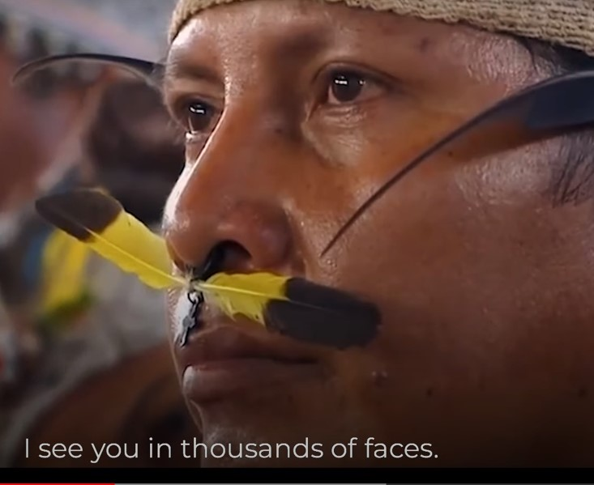
ADVENT
LITURGY
2022
Notes:
Leader:
In the name of the Father, and of the Son, and of the Holy Spirit, Amen.
The four weeks of Advent are a time of preparation and of waiting – waiting for the return of Christ at the end of time; and waiting to celebrate once again the birth of Jesus in Bethlehem.
So, we gather to begin our time of waiting and preparation.
Together we will share our story of God who - before time began – loved us, chose to come among us, and knew that we would gather here today.
It is a story that ends in light but begins in darkness…

Slide 2
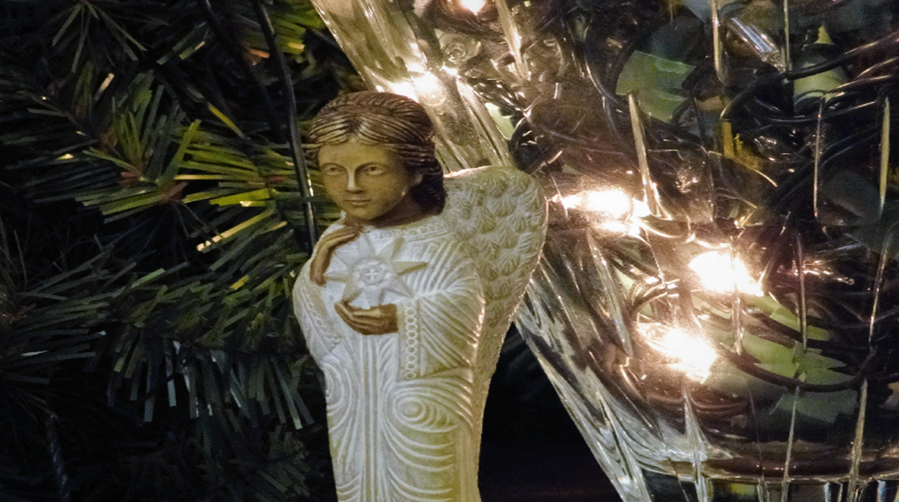
Opening prayer
Lord Jesus, light in the darkness,
shine in our hearts today.
As we await your coming,
empower us to build
a just and peaceful world,
ready for your return.
Like the first Christians, we pray:
“Maranatha!” which means,
“Come, Lord Jesus!”
Notes:
Leader: We pray together:
All: Lord Jesus, light in the darkness,
shine in our hearts today.
As we await your coming,
empower us to build a just and peaceful world,
ready for your return.
We pray the prayer of the first Christians:
“Maranatha!” which means, “Come, Lord Jesus!”

Slide 3
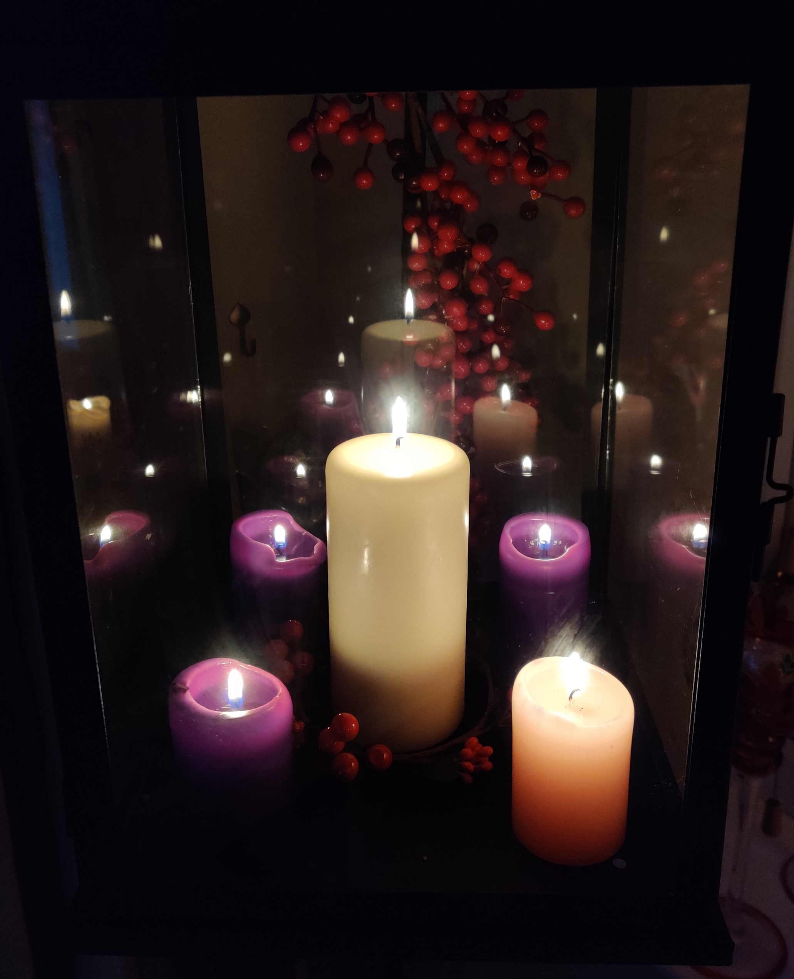
The first candle: watching and ready to serve
Wake us up, Lord!
The night is nearly over.
Free us from greed and selfishness.
Lead us out of inequality and injustice,
to your kingdom of justice and mercy,
to a transformed world,
where peace is built on understanding, not weapons, and everyone can
live their lives to the full.
Amen.
Notes:
(If you have an Advent wreath/set of candles, the leader or a young person comes forward to light the first purple candle)
Leader: (As the first purple candle is lit) Let us pray together…
All: Wake us up, Lord!
The night is nearly over.
Free us from greed and selfishness.
Lead us out of inequality and injustice,
to your kingdom of justice and mercy,
to a transformed world,
where peace is built on understanding, not weapons,
and everyone can live their lives to the full.
Amen

Slide 4
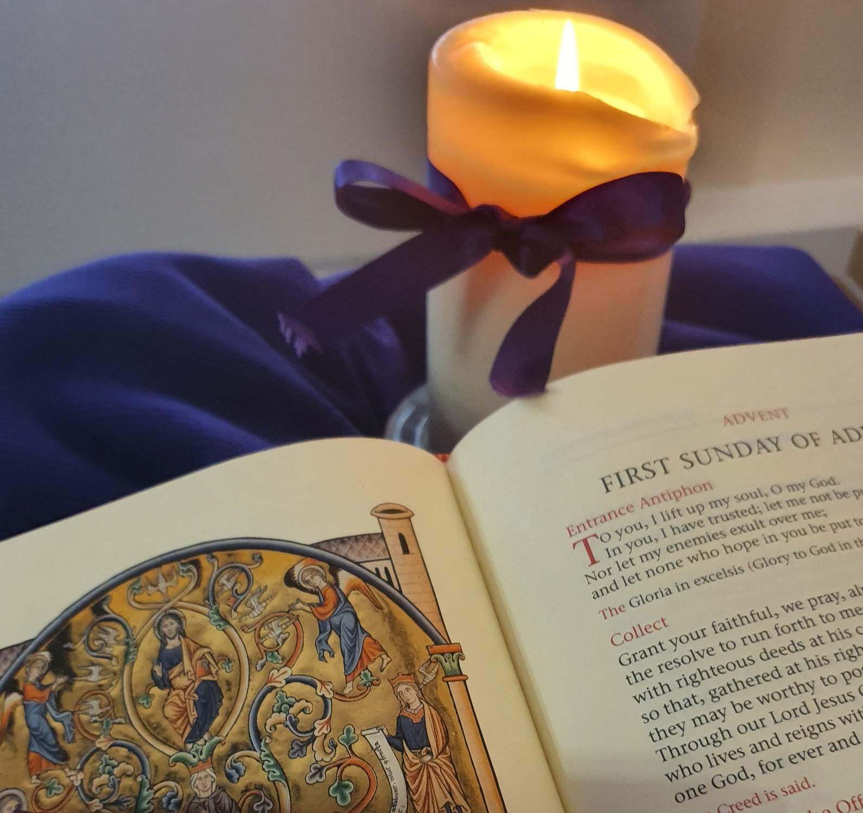
The first candle: watching and ready to serve
What I say to you then, I say to all: Watch!
Mark 13:37
Notes:
Scripture reading (from Mark 13:32-37):
Jesus said to his disciples: “You do not know when the master of the house is coming - it might be in the evening or at midnight or before dawn or at sunrise. If he comes suddenly, he must not find you asleep. What I say to you, then, I say to all: ‘Watch!’”
Leader: We are called to watch. To watch out for signs that our Lord is very close. Signs of hope. And to be awake, ready to serve.

Slide 5
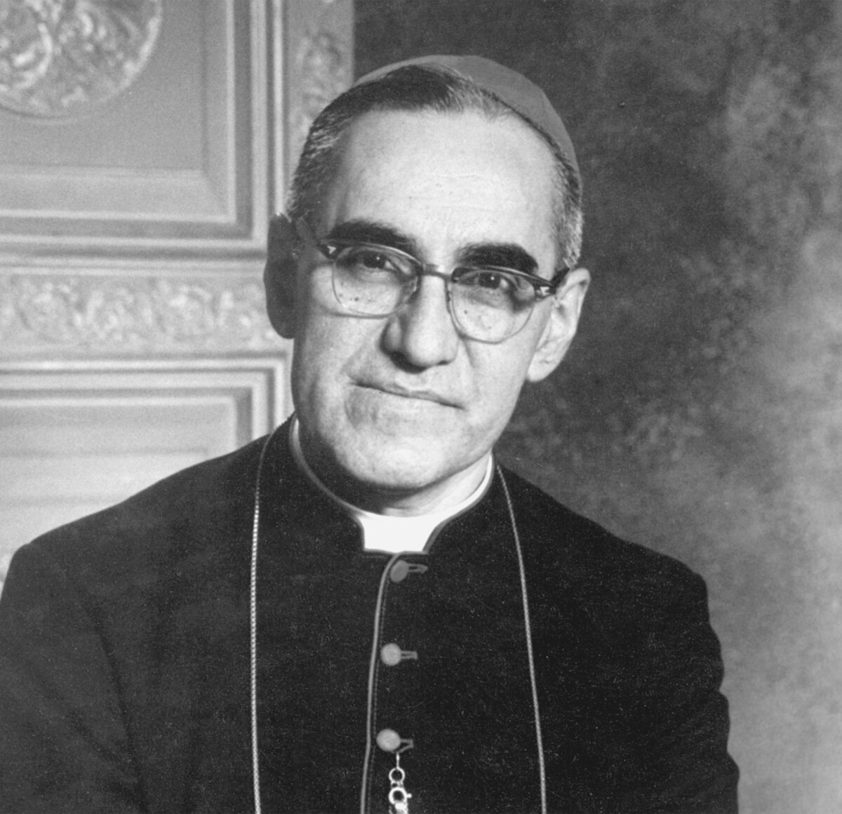
The first candle: watching and ready to serve
A story of service
Archbishop Oscar Romero.
REFLECT:
How have I served others?
How could I serve others in future?
Lord, wake us up!
Let us live as people of the light.
Amen.
Notes:
Leader: Let’s hear a story of service. (Either read the story or watch the video clip.)
STORY: Oscar Romero became an Archbishop in El Salvador during a time of great unrest. He was popular with the rich people, who held all the power, and were oppressing the poorest farming communities. When his friend, Father Rutilio, was killed while serving in one of the rural parishes, Romero changed. He became a man whose whole life was given in service of the poorest people. He spoke up for peace and justice, despite threats to his life. In 1980, Romero was shot while saying Mass. Now he is known as Saint Oscar Romero.
VIDEO: Oscar Romero: A life for God and the poor (watch from 1:24 > 4.52).
https://www.youtube.com/watch?v=IPMJ9UgkBgQ&t=2s
Leader: Romero gave his life in service of God and the poorest people. Let’s take a moment to reflect: How have I served others? How could I serve others in future?
Pause – You may wish to add a few examples here to help pupils reflect. Some quiet music could be played.
Let us pray together:
Lord, wake us up! Let us live as people of the light. Amen.
As you move to the next slide, the leader / young person comes forward to light the second purple candle.

Slide 6
The second candle: willing to change
Wake us up, Lord!
Open our eyes to the dignity of all people
and our ears to the cry of the earth.
Let us walk in solidarity with the poor
and cleanse our world from oppression.
Let us shout for justice for all
and renew our hope for change.
Amen
Notes:
Leader: (As the second purple candle is lit) Let us pray together:
All: Wake us up, Lord!
Open our eyes to the dignity of all people
and our ears to the cry of the earth.
Wake us up, Lord!
Let us walk in solidarity with the poor
and cleanse our world from oppression.
Wake us up, Lord!
Let us shout for justice for all
and renew our hope for change.
Amen

Slide 7
The second candle: willing to change
John the Baptist appeared;
he preached in the wilderness of Judaea and this was his message: ‘Repent, for the kingdom of heaven is close at hand.’
Matthew 3:1-3
Notes:
Scripture reading (from Matthew 3:1-12)
In due course, John the Baptist appeared; he preached in the wilderness of Judaea and this was his message: ‘Repent, for the kingdom of heaven is close at hand.’
This was the man the prophet Isaiah spoke of when he said: ‘A voice cries in the wilderness,: Prepare a way for the Lord, make his paths straight.’
Leader: We are reminded that John called people to change their ways. Change is not always easy. But it is needed, if we are to improve our world, and ourselves.

Slide 8
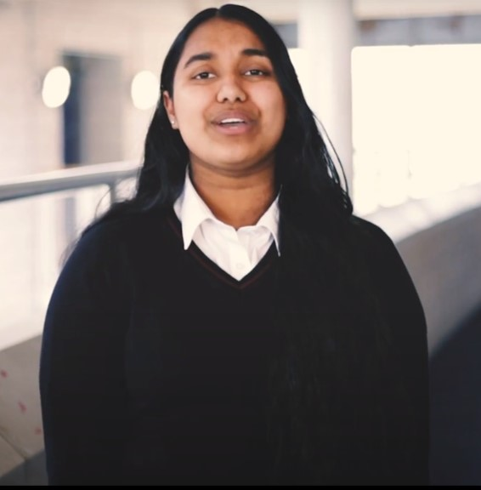
The second candle: willing to change
A story of change
Be the change!
REFLECT:
Am I willing to change?
What do I need to change in my life?
Lord, wake us up!
Let us live as people of the light.
Amen.
Notes:
Leader: Let’s watch a video about change.
VIDEO: Faith in Action Award - Love never fails: Be the change (2:24)
https://www.youtube.com/watch?v=3OX2dKsd5V4
Leader: The student in the video said: “I believe, to change the world for the better, we all need to make a small change.” There were a few examples of small changes that some young CAFOD supporters have made. Perhaps one of them sparked an idea for you? Let’s take a moment to reflect: Am I willing to change? What do I need to change in my life?
Pause – You may wish to add a few examples here to help pupils reflect. Some quiet music could be played.
Let’s pray together:
All: Lord, wake us up! Let us live as people of the light. Amen
The leader or a young person can be invited to light the third candle (pink, for joy)

Slide 9
The third candle: rejoicing in hope
Lord, wake us up!
Stir within us a desire
to fight for the integrity of creation
and to treasure the immense
beauty of the earth.
Be with us, Lord,
that we may be people of hope and joy.
Amen.
Notes:
Leader: (as the third – a pink – candle is lit)
Let us pray together:
All: Lord, wake us up!
Stir within us a desire to fight for the integrity of creation
and to treasure the immense beauty of the earth.
Be with us, Lord, that we may be people of hope and joy.
Amen.

Slide 10
The third candle: rejoicing in hope
Let the wasteland rejoice and bloom,
let it bring forth
flowers like the jonquil,
Let it rejoice and sing for joy…
Look, your God is coming…
Isaiah 35:1-2, 4
Notes:
Scripture reading (from Isaiah 35:1-6, 10)
“Let the wasteland rejoice and bloom,
let it bring forth
flowers like the jonquil,
Let it rejoice and sing for joy…
Strengthen all weary hands,
Steady all trembling knees,
And say to faint hearts,
‘Courage! Do not be afraid.
Look, your God is coming…”
Leader: The prophet Isaiah says that, even the earth rejoices at the presence of God. Today we know that the earth is suffering a climate crisis. But we can restore creation, if we work together.

Slide 11
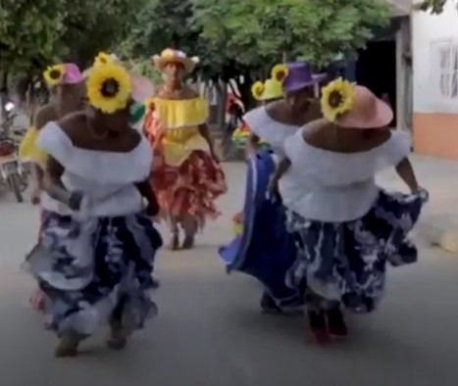
The third candle: rejoicing in hope
A story of joy
Dancing towards peace.
REFLECT:
What has brought me joy this week?
How can I bring joy to someone else this week?
Lord, wake us up!
Let us live as people of the light.
Amen.
Notes:
Leader: Let’s listen to a story full of joy (Either read the story or show the video)
STORY: Colombia has experienced many long years of conflict. But young people in the remote town of Arenal are still pursuing peace. TamboArte is a CAFOD-supported group of talented performers celebrating their shared cultural heritage through learning and performing traditional dance. The project and their joyful performances are also bringing their fractured community back together. Dance with TamboArte provides a safe space for young people to come together and share, and to learn to understand one another. These brave young people are moving away from violence in Colombia and joyfully dancing towards peace instead.
VIDEO:
Hands on Magdalena Medio: Dancing towards peace https://www.youtube.com/watch?v=kPM28IkNgaw (1:14)
Leader: Let’s take a moment to reflect:
What has brought me joy this week?
How can I bring joy to someone else this week?
Pause – You may wish to add a few examples here to help pupils reflect. Some quiet music could be played.
Let us pray together:
All: Lord, wake us up! Let us live as people of the light. Amen.
The leader or a young person can be invited to light the fourth candle.

Slide 12
The fourth candle: God is with us
Lord, wake us up!
As we prepare to celebrate your birth,
we pray once more
for the light to remain with us.
May we be greedy, not for material possessions, but for justice and truth.
May we be enflamed with a love
that wipes out prejudice
and respects others as children of God.
Amen
Notes:
Leader: (As the fourth – purple – candle is lit) Let us pray together…
All: Lord, wake us up!
As we prepare to celebrate your birth
we pray once more for the light to remain with us.
May we be greedy, not for material possessions, but for justice and truth.
May we be enflamed with a love that wipes out prejudice and respects others as children of God.
Amen

Slide 13
The fourth candle: God is with us
‘Joseph son of David,
do not be afraid
to take Mary home as your wife…
The virgin will conceive and give birth to a son and they will call him Emmanuel, a name which means ‘God is with us’.
Matthew 21:20-24
Notes:
Scripture reading (from Matthew 1:18-24)
The angel of the Lord appeared to Joseph in a dream and said, “Joseph, son of David, do not be afraid to take Mary home as your wife, because she has conceived what is in her by the Holy Spirit. She will give birth to a son, and you must name him Jesus, because he is the one who is to save his people from their sins.”
All this took place to fulfil the words spoken by the Lord through the prophet: “The virgin will conceive and give birth to a son, and they will call him Emmanuel, a name which means ‘God-is-with-us’. When Joseph woke up, he did what the angel of the Lord had told him to do.

Slide 14
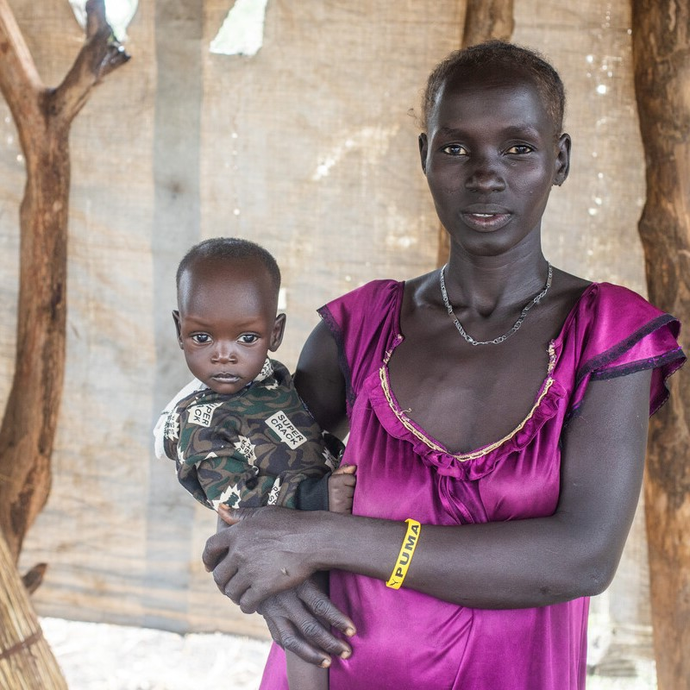
The fourth candle: God is with us
A story of God with us
You are always with us.
REFLECT:
Where have I noticed God’s presence this week? Where can I be God’s presence to others in the coming week?
Lord, wake us up!
Let us live as people of the light.
Amen.
Notes:
Leader: Let’s think about what it means for God to be with us. (Either read the story or show the video)
STORY: We may think that God is invisible. But when we are in need, we might encounter God in the people who reach out to us.
This year, South Sudan has been affected by the world food crisis. The region of Yirol East, where many are already hungry, has seen an influx of people forced from their homes by conflict, floods and rising prices to search for food.
Nyanguet Ket and her family narrowly escaped death when their village was attacked. They hid in a swamp for two days before escaping to Yirol East with no possessions. There, she received a piece of land given by her new neighbours, as well as emergency food and farm tools and seeds through the Caritas network that CAFOD belongs to.
Nyanguet said: “We escaped here for refuge. The reception here was great. The host community host us well. I have a piece of land that I am cultivating now. I am really pleased now I have moved out of trouble. My children and I feel safe here now.”
Nyanguet is grateful for the incredible generosity of her neighbours, welcoming her family and so many others, despite facing hunger themselves.
VIDEO: You are always with us – Indigenous language prayer from Peru (2:28)
https://www.youtube.com/watch?v=y6PYVZG7ie8
Leader: Let’s take a moment to reflect: Where have I noticed God’s presence? Where can I be God’s presence to others?
Pause – You may wish to add a few examples here to help pupils reflect. Some quiet music could be played.
Let us pray together:
All: Lord, wake us up! Let us live as people of the light. Amen.

Slide 15
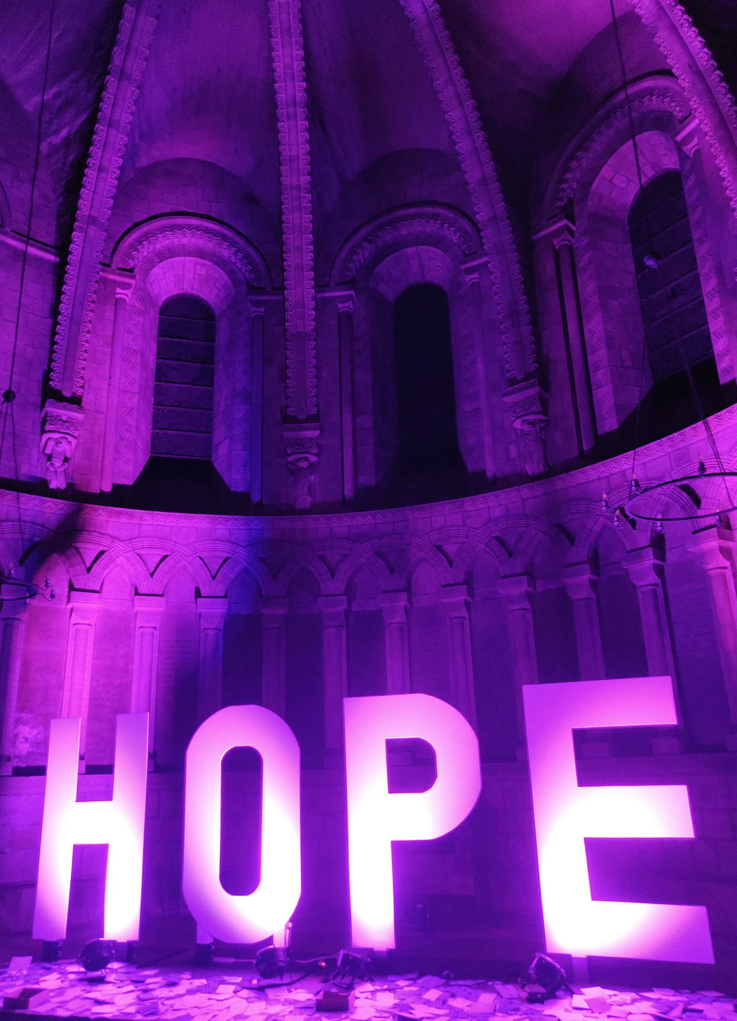
We desire to bring the light of hope to others this Advent.
Notes:
Leader: Now, to bring together all our reflections, as a symbol of our desire to bring the light of hope to others this Advent, I invite you to… (EITHER light a tea-light at the front of the hall OR attach a pre-made paper candle to the display).
Quiet music or a suitable hymn (eg. Christ be our Light by Bernadette Farrell) can be played.

Slide 16
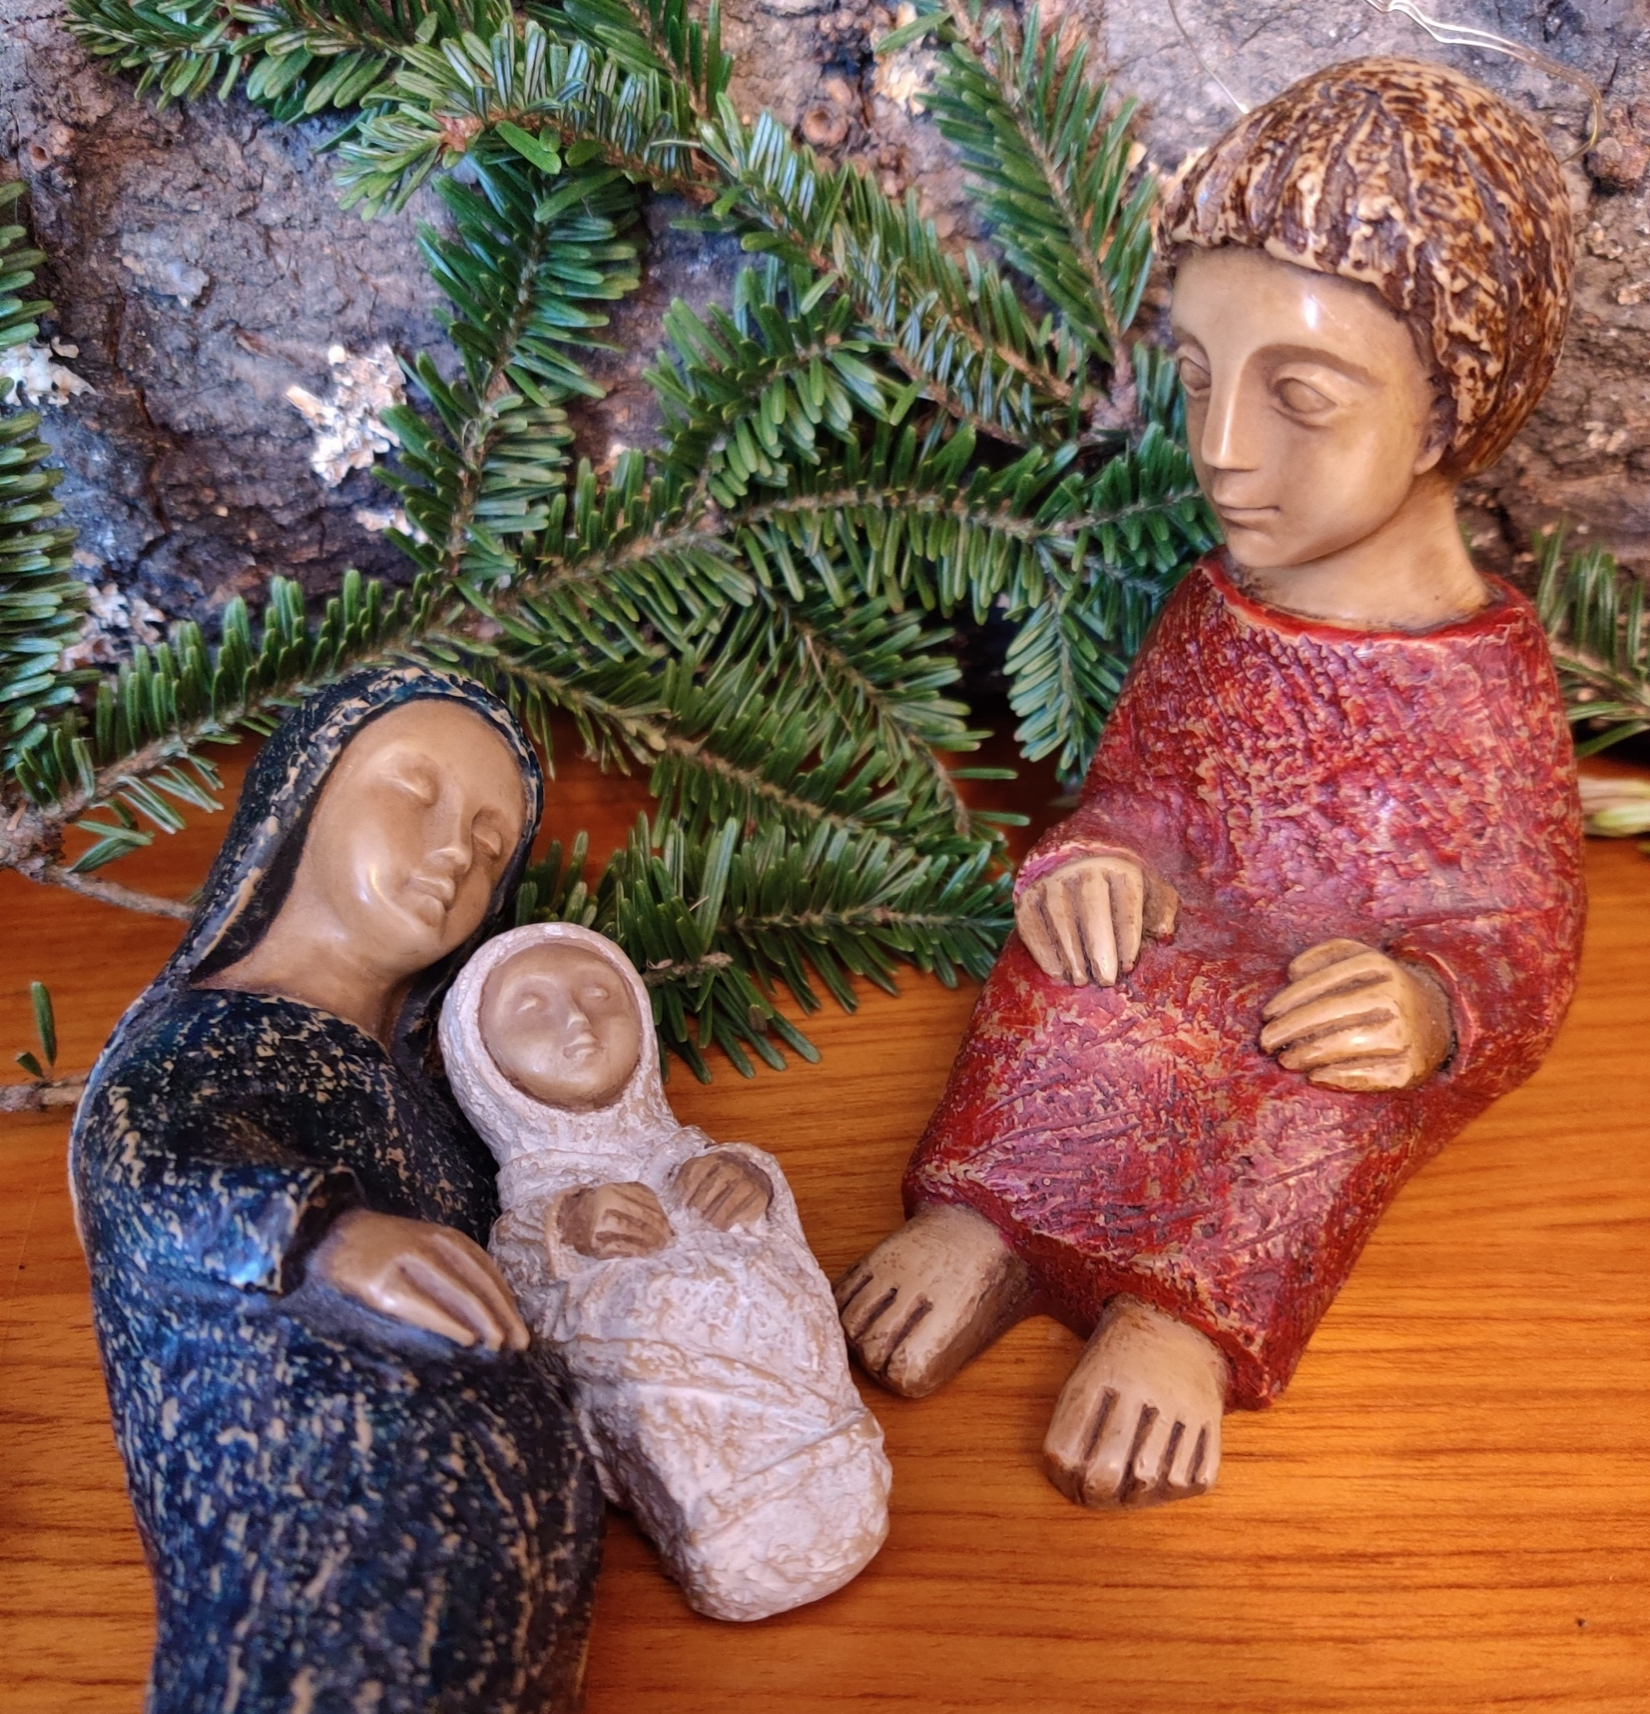
Final prayer
Lord Jesus,
may your birth lead us all
from war into peace,
from fear into hope,
from sadness into joy,
from death into life,
from hatred into friendship,
from darkness into light.
Come, Lord Jesus!
Notes:
Leader: Let’s pray together our closing prayer:
All: Lord Jesus,
may your birth lead us all
from war into peace,
from fear into hope,
from sadness into joy,
from death into life,
from hatred into friendship,
from darkness into light.
Come, Lord Jesus!
Leader: We go out, taking with us the light of the world.
All: In the name of the Father, and of the Son, and of the Holy Spirit. Amen.

Slide 17
We shall not cease from exploration.
And the end of all our exploring,
will be to arrive where we started
and know the place for the first time.
T S Eliot

