Slide 1


Slide 2
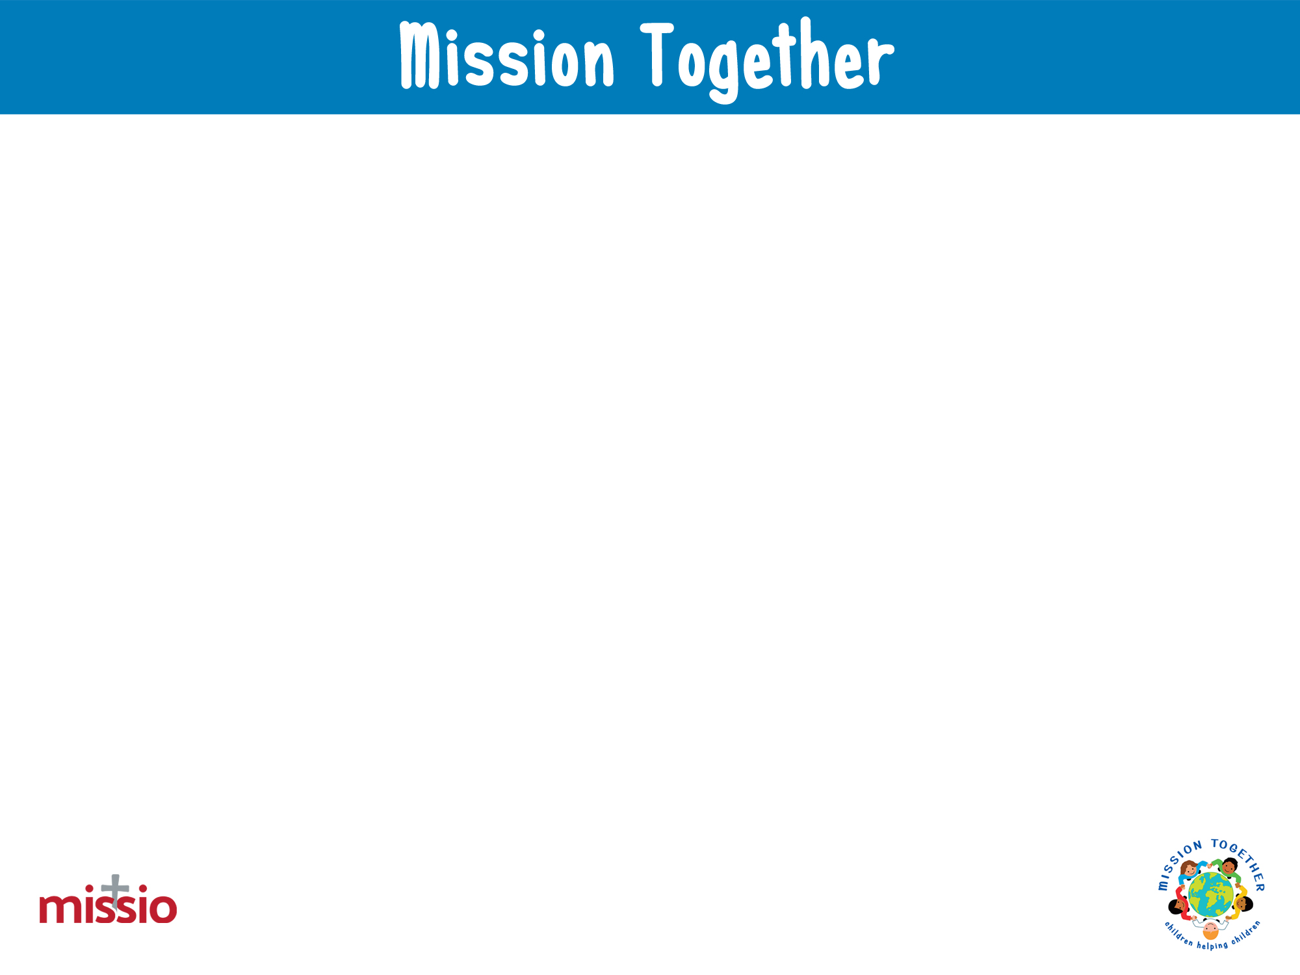
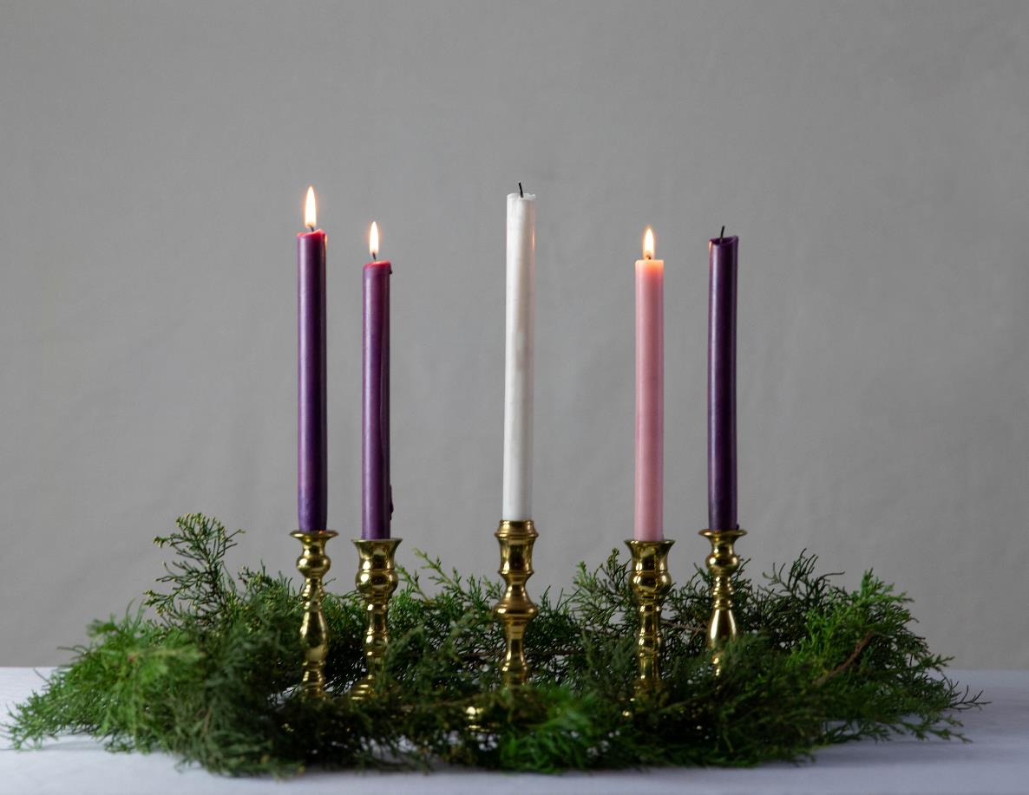
We gather
for our Advent Week Three Liturgical Prayer
Photo by KaLisa_Veer on Unsplash
Opening hymn – We are Waiting

Slide 3
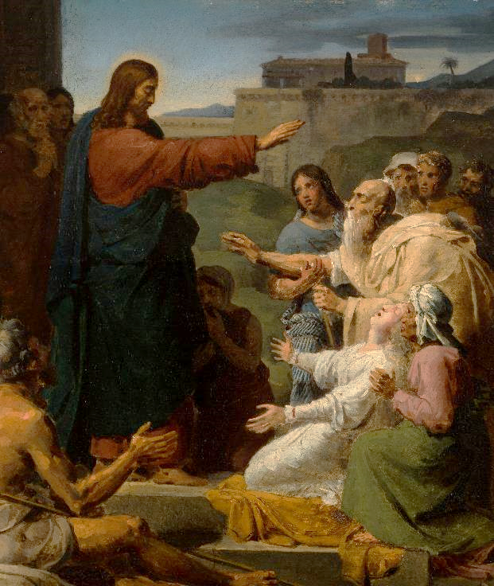
We hear God’s Word
A reading from the prophet Isaiah
Say to people who are afraid and confused,
“Be strong. Don’t be afraid. Look, your God will come and he will judge your enemies. He will make them pay for the wrongs they did. He will come and save you.”
Then the blind people will see again. Then the deaf will hear. Crippled people will jump like deer. And those who can’t talk now will shout with joy. Springs of water will flow in the desert. Streams will flow in the dry land. The people the Lord has freed will return to Jerusalem. Their happiness will last forever. Their gladness and joy will fill them completely.
The Word of the Lord
R/ Thanks be to God
Jesus healing the blind and the lame (1817), François-Louis Dejuinne
S.D. Cason Catholic Gallery

Slide 4
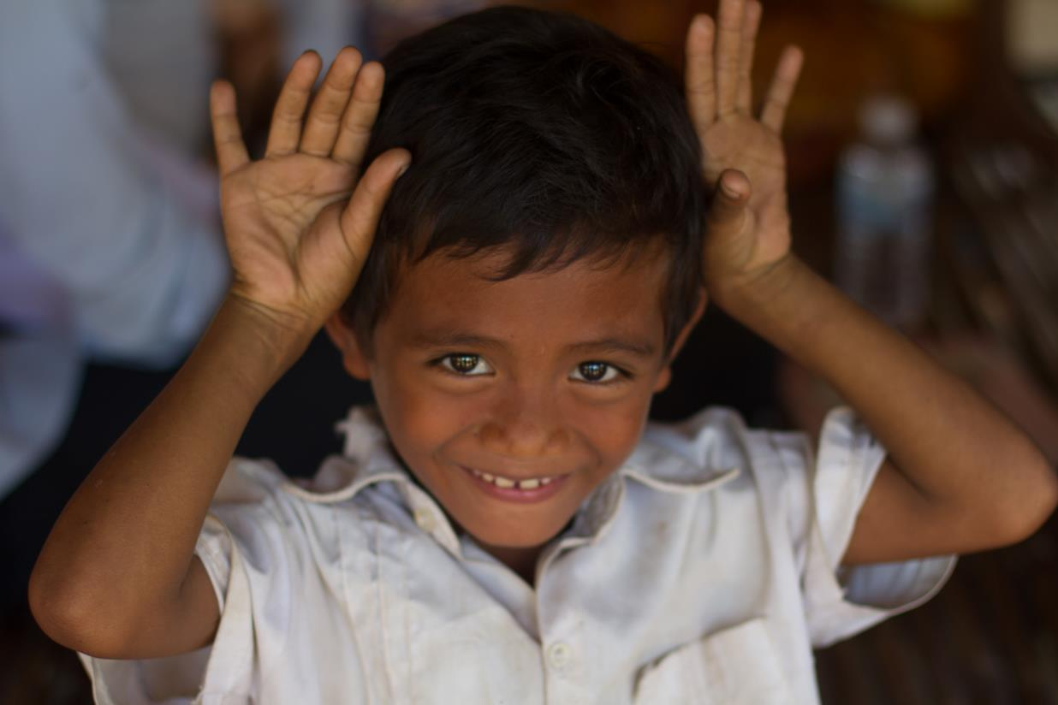



©Missio, Cambodian boy at a Mission Together supported project

Slide 5
We respond
The response to our prayer is: Hear our prayer.
Heavenly Father, in Advent and at Christmas we learn what it means to be joyful and thankful. Help us to always appreciate your love for us, the love of our families and friends, our home, the food we eat, the world we live in, and so much more. Lord, in your mercy. R/ Hear our prayer.
Heavenly Father, in Advent and at Christmas we learn what it means to be joyful and generous. Help us to share what we have with others; our toys, our time, our faith, our friendship, so that nobody feels left out, unloved, or in need. Lord in your mercy. R/ Hear our prayer.
Heavenly Father, in Advent and at Christmas we learn what it means to be joyful and faithful. Help us to share the Good News of Jesus’ birth with our family and friends, through our words, our actions, and our prayers. Lord in your mercy. R/ Hear our prayer.
Heavenly Father, in Advent and at Christmas we learn what it means to be joyful and to
belong to your global family. Help us and all your children around the world, especially
those who live in poverty and difficulty, to celebrate joyfully the birth of our saviour, Jesus
Lord, in your mercy. R/ Hear our prayer.
Let us now say the Mission Together prayer.

Slide 6
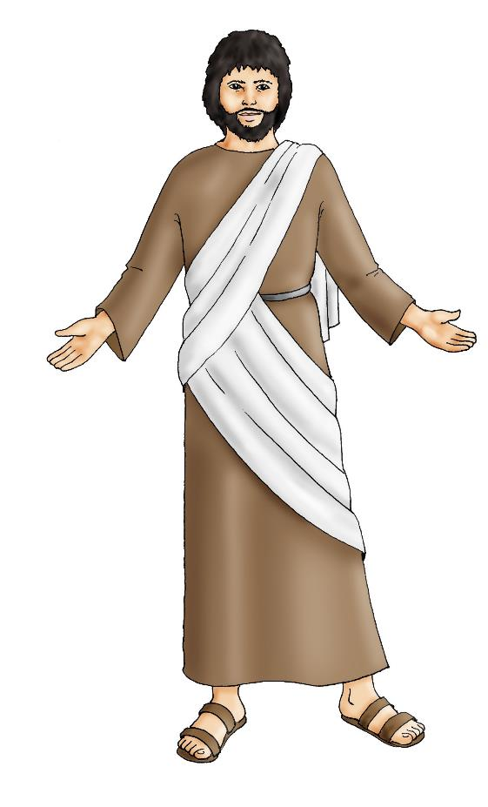
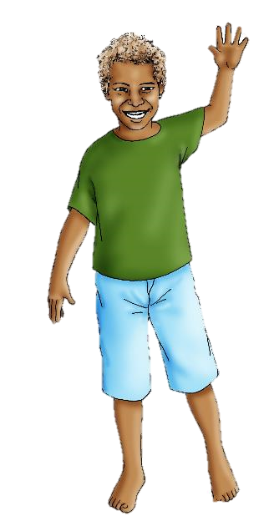
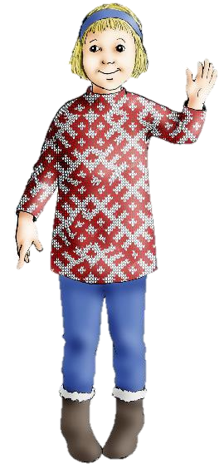
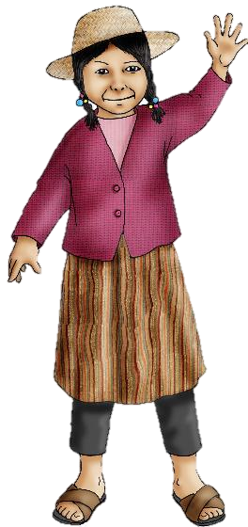
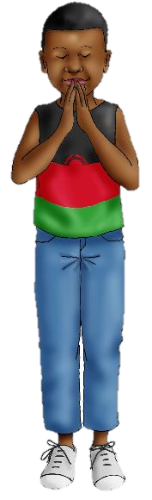
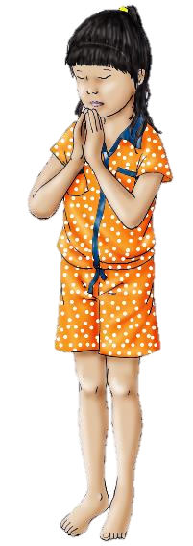
We are sent
May all children
In the world
Share love
Share friendship and live
In the peace
Of God’s love,
Now and forever.
Amen.
Closing hymn – Maranatha

