Slide 1



  Welcome to this year’s annual Advent calendar for teachers and chaplains to use in secondary schools.
  We are the Catholic Agency for Overseas Development, reaching out to people living in poverty with practical help, whatever their religion or culture. We also campaign for global justice, so that every person can live a full and dignified life.
  This calendar tells stories of people that we work with and of young people who support this work. Each day reflects on scripture from the Mass of the day and gives a question to ponder, a prayer and an action.
  Start on bauble '27' for 27 November!
Notes:
Picture credit: Thom Flint

Slide 2
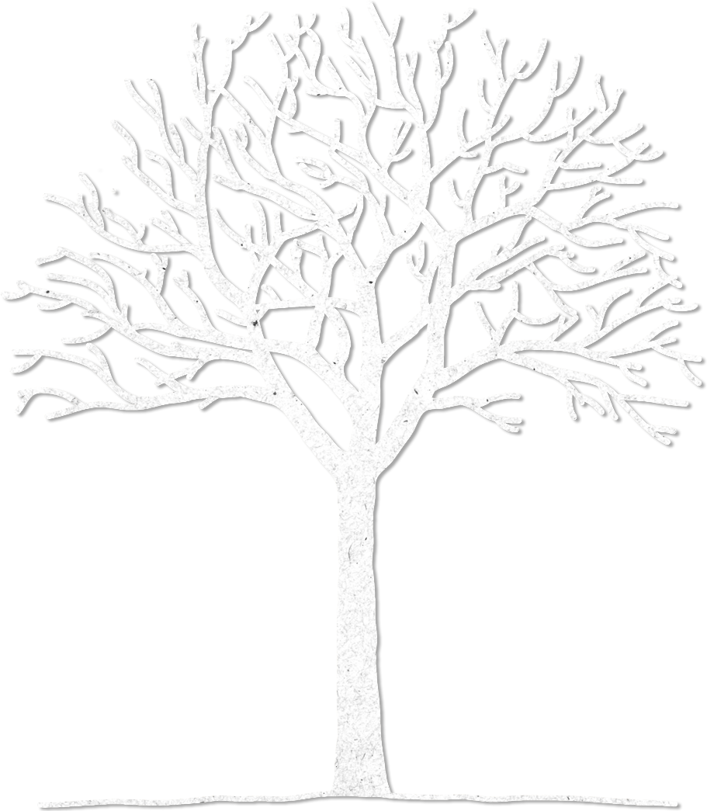

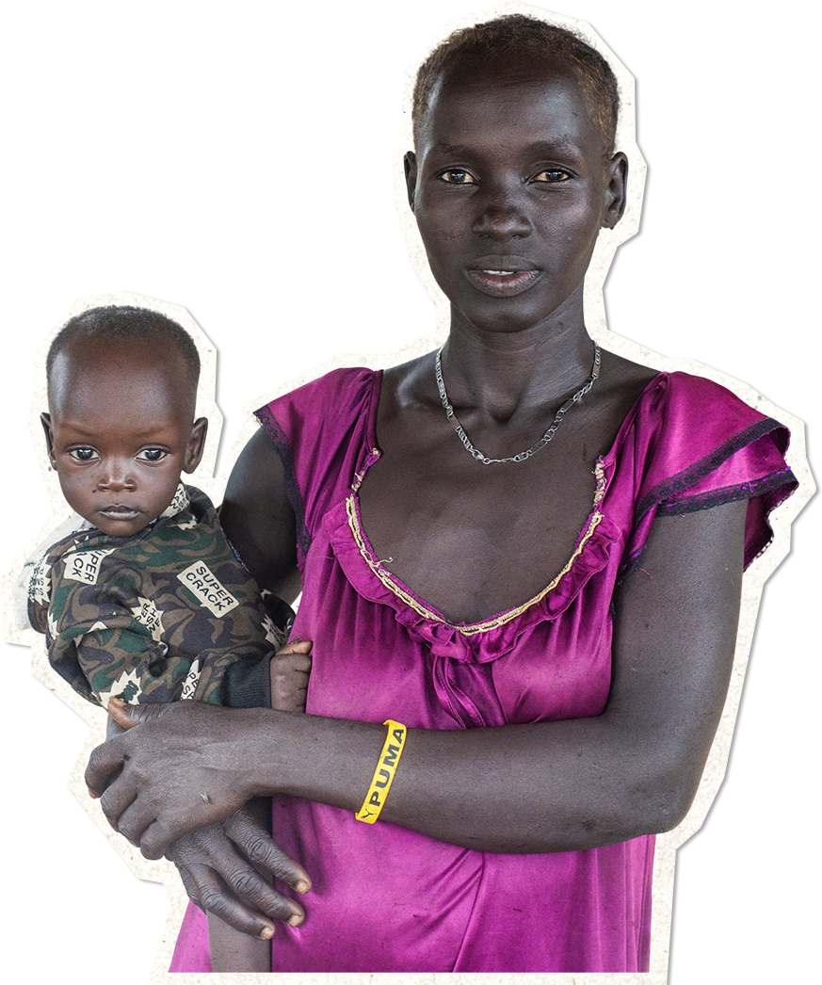


21
19
8
Advent calendar 2022
4
5
29
20
23
11
28
2
17
25
9
30
15
12
7
3
18
24
6
22
27
1
13
16
14
10
“Hope in him,
hold firm and take heart.
Hope in the Lord!”
Psalm 26:14
Notes:
Picture credit: Achuoth Deng

Slide 3
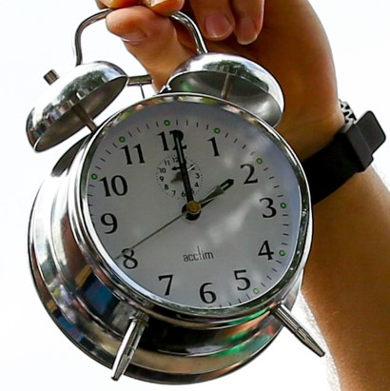
Sunday 27 November
First Sunday of Advent
“Stay awake, because you do not know the day when your master is coming.”
Matthew 24:42
  Wake up!
  In the UK, our new year will see the coronation of a new king. It will be a glittering, memorable occasion, attended by heads of state.
  But today is the first day of the Church’s new year.
  In the four weeks of Advent, we prepare for the return of our eternal King – Jesus – at the end of time. We also reflect on his birth in a borrowed stable in poverty, and the hope and challenges that gives us.
27
Notes:
Picture credit: Eleanor Church

Slide 4
  The start of Advent is about eagerly awaiting the Lord’s return at the end of time - staying awake!
  Like the servants in today’s reading, we can become sleepy as we await Jesus’ return. Or we can stay awake, always ready to serve.
  So, what are you waiting for?
  Lord, wake us up! Help us to serve you in our sisters and brothers, so that we are ready for your return.
  Amen
“Stay awake, because you do not know the day when your master is coming.”
Matthew 24:42
27
Use our World Gifts Christmas poster to replace cards in class this year.
Notes:
Picture credit: Eleanor Church

Slide 5
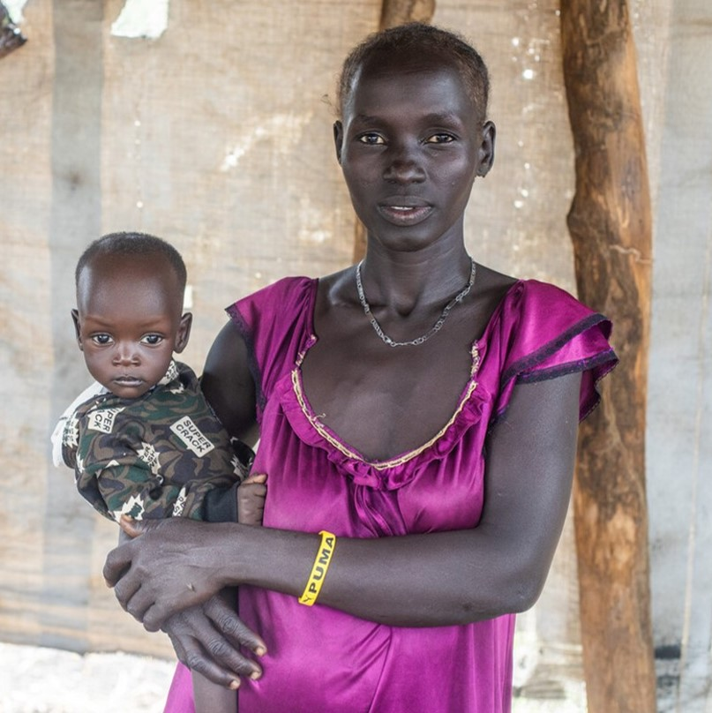
Monday 28 November
“The glory of the Lord
will be… refuge and
shelter from the storm...”
Isaiah 4:5-6
  Seeking shelter
  This year, South Sudan has been one of the East African countries affected by the world food crisis.
  The region of Yirol East, where many are already hungry, has seen an influx of people forced from their homes by conflict, floods and rising prices to search for food.
  Nyanguet Ket and her family narrowly escaped death when their village was attacked. They hid in a swamp for two days before escaping to Yirol East with no possessions.
28
Notes:
Picture credit: Achuoth Deng

Slide 6
  Through the Caritas network, CAFOD has supported Yirol East families with farming tools and seeds for planting, as well as distributing emergency food for new families arriving with nothing.
  “We escaped here for refuge. The reception here was great. The host community host us well. I have a piece of land that I am cultivating now. I am really pleased now I have moved out of trouble. My children and I feel safe here now.”
  Lord, comfort everyone today who is seeking refuge from the storms of life.
  Amen
“The glory of the Lord
will be… refuge and
shelter from the storm...”
Isaiah 4:5-6
28
Say this prayer for refugees or make up your own to say today.
Notes:
Picture credit: Achuoth Deng

Slide 7
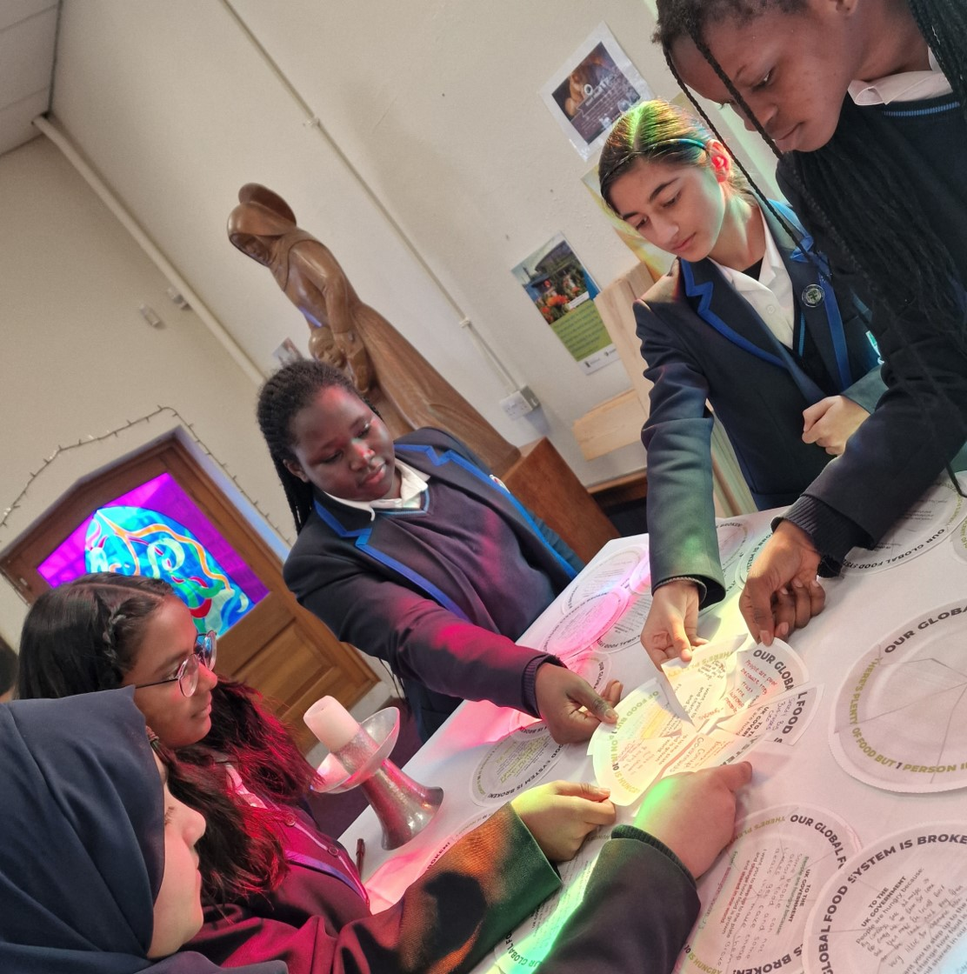
Tuesday 29 November
“In his days justice shall flourish
and peace till the moon fails.”
Psalm 71
  May justice flourish
  Were you part of our Step up to the Plate campaign this year? These students in Ilford, London were!
  Thousands of you put your faith into action and called on our leaders to reform the global food system, so that it supports the poorest communities on our planet.
  The world food crisis continues… but our resolve to stand up for justice also continues, and there will be new opportunities to campaign in the coming year.
29
Notes:
Picture credit: Ursuline Academy Ilford

Slide 8
  The first days of Advent look ahead to the fulfilment of today’s psalm, when Christ returns at the end of time, justice flourishes and there is peace forever.
  But we don’t have to wait to live in God’s kingdom – Jesus said that it is all around us. We’re called to live justly and peacefully right now!
  How will you help justice to flourish?
  Holy Spirit, inspire me with a spirit of compassion and true justice to spread your kingdom wherever I go.
  Amen.
“In his days justice shall flourish
and peace till the moon fails.”
Psalm 71
29
Share this animation to explain to others how our global food system is broken.
Notes:
Picture credit: Ursuline Academy Ilford

Slide 9
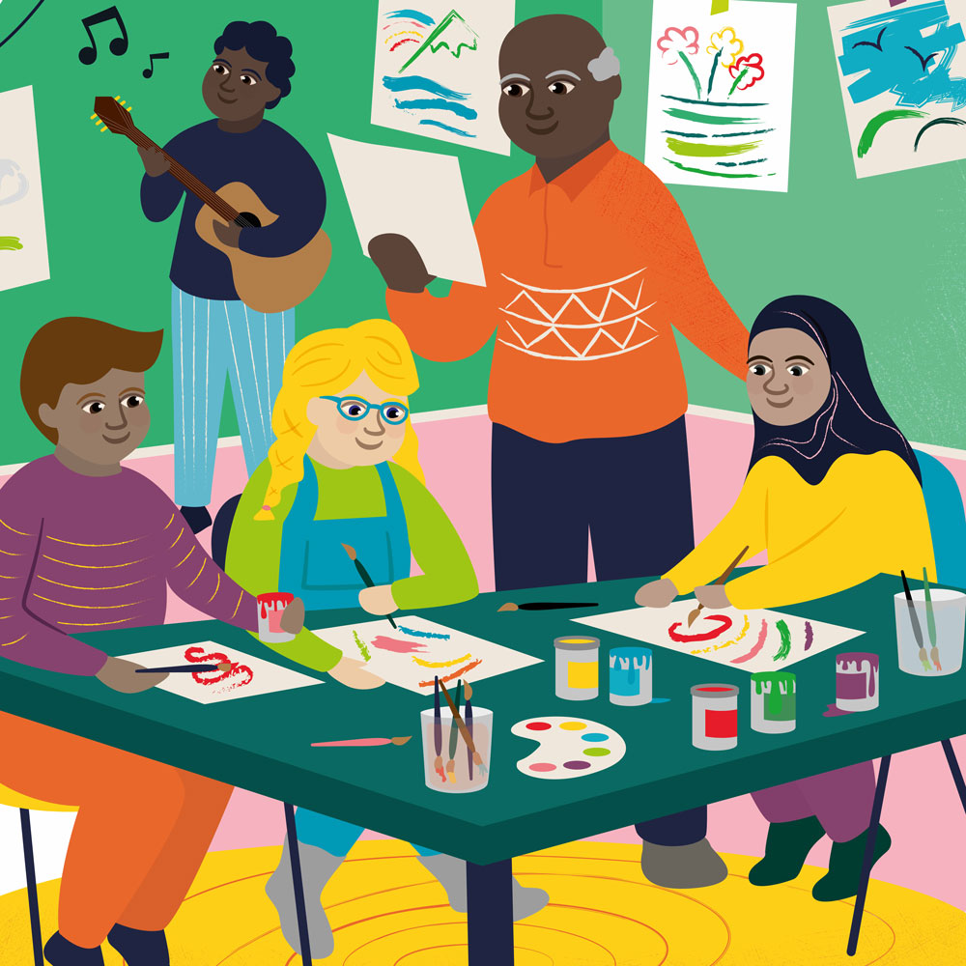
Wednesday 30 November
Saint Andrew
“The Lord God will wipe away the tears from every cheek.”
Isaiah 25:8
  World Gifts
  World Gifts are available all year, but some schools fundraise to give them as Christmas presents - like the gift of Therapy through play.
  This gift can provide children who have experienced war and conflict with space and support to deal with their traumatic experiences and to make new friends.
  Maria, who runs sessions in Boryslav, Ukraine says: “Many children start painting with black paint, really scary things. But then they start to add other colours.”
30
Therapy through play £20

Slide 10
  The prophet Isaiah promises that God will wipe away tears. God uses our hands to wipe away tears and to offer support.
  CAFOD’s global network supports communities struggling due to injustice and extreme poverty.
  You can be part of this work through World Gifts.
  Lord, help me to be aware of other people’s sorrows today. Help me to bring comfort and hope this Advent.
  Amen.
“The Lord God will wipe away the tears from every cheek.”
Isaiah 25:8
30
Therapy through play £20
Decide which of the World Gifts your class might buy as you prepare for Christmas.

Slide 11
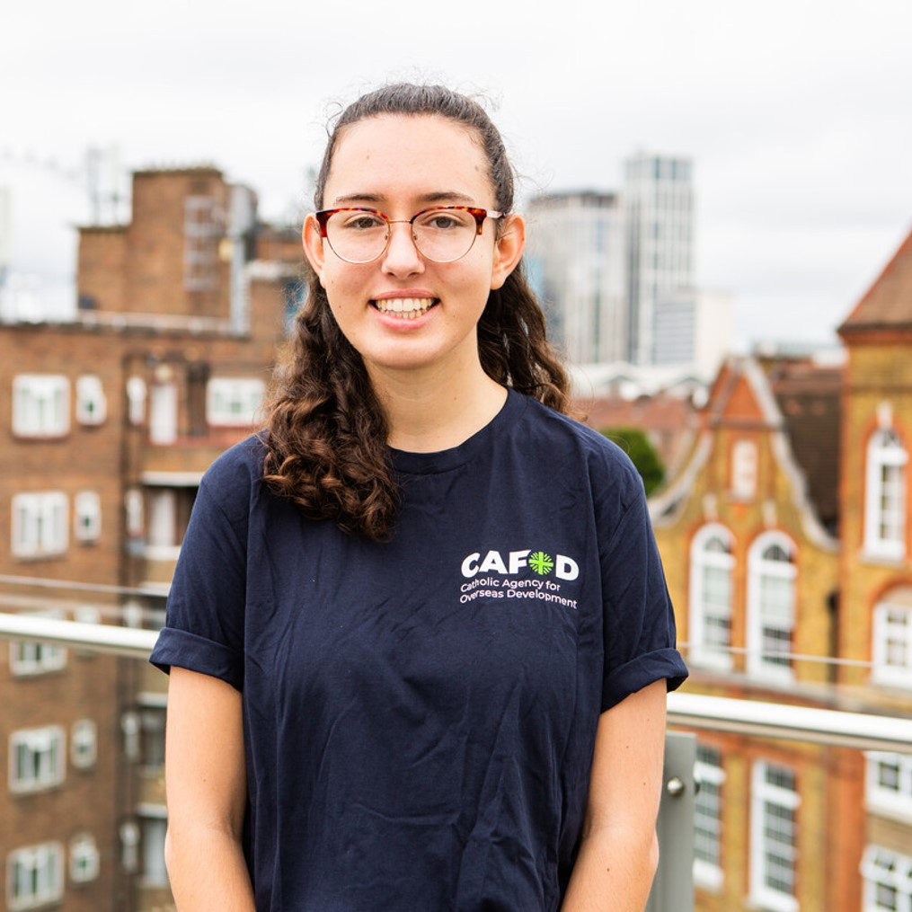
Thursday 1 December
“Everyone who listens to these words of mine and acts on them ..”
Matthew 7:24
  Taking action
  Emma Parlane was one of the eight young adults on CAFOD’s gap year programme last year.
  Emma volunteered at St. Cassian Youth Retreat Centre, Kintbury as part of her commitment. She felt that she gained a lot too.
  "This year has given me time and space to reflect on the importance of placing God at the centre of everything we do and building relationships with those around us.”
  Emma
1
Notes:
Picture credit: Thom Flint/CAFOD

Slide 12
  Today’s gospel reminds us that when we act on the words of Jesus, what we do has a firm foundation.
  How can you put Jesus' words into action during Advent? And in your life choices?
  Lord, make us always ready to act on your words, “whatever you did to the least of these… you did it to me”.
  Amen.
“Everyone who listens to these words of mine and acts on them ..”
Matthew 7:27
1
Find out about CAFOD gap years and consider your own future.
Notes:
Picture credit: Thom Flint/CAFOD

Slide 13
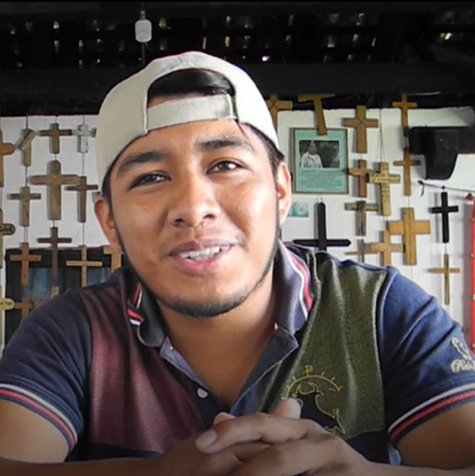
Friday 2 December
“He touched their eyes…
and their sight returned”
Matthew 9:29-30
  Seeing with new eyes
  Gerson works in Guatemala, with CAFOD’s support.
  He says: "The most important challenges we face are food insecurity and access to water."
  "One of the ways for families to move forward and not have food shortages is for them to produce their own food using native seeds.”
  Gerson trains communities in new skills to better grow, market and sell their produce.
2
Notes:
Picture credit: Montserrat Fernandez

Slide 14
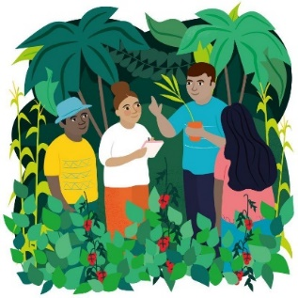
  We can all learn something new.
  If Jesus touches our hearts as he touched the eyes of the blind men in today’s reading, who knows what new possibilities we might see?
  Lord, touch my heart today so that I can see the wonders you are able to do through me. Amen.
“He touched their eyes…
and their sight returned”
Matthew 9:29-30
2
Find out about our Forest School World Gift.
Notes:
Picture credit: Montserrat Fernandez

Slide 15
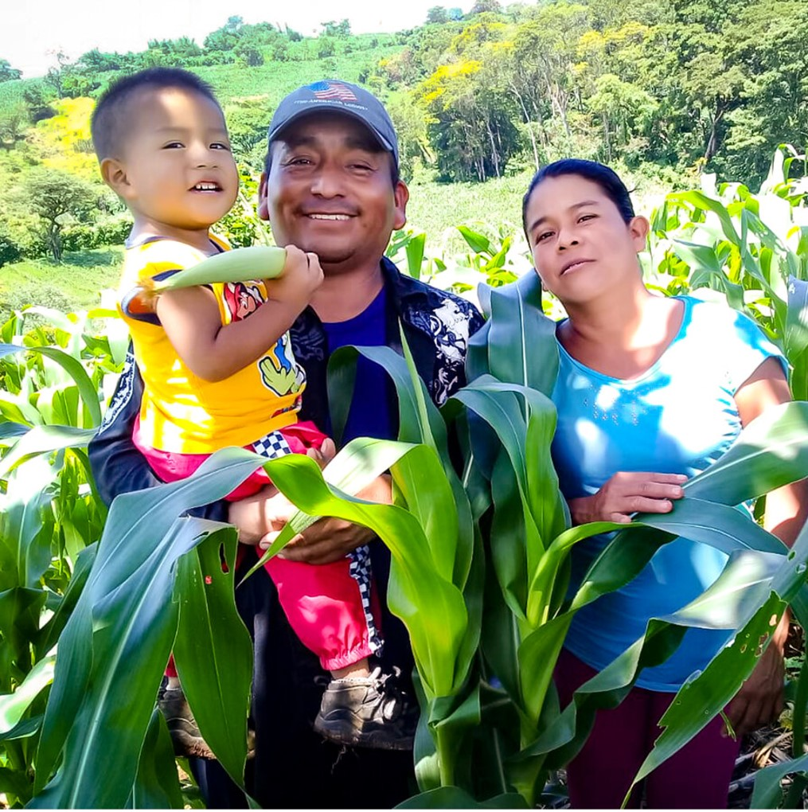
Saturday 3 December
“He will send rain for the seed you sow in the ground, and the bread the ground provides will be rich and nourishing.”
Isaiah 30:23
  Seeds of hope
Edelmira and Martir are farmers in rural El Salvador. Some years ago, a local organisation advised them on growing native seeds adapted to local conditions, less likely to rot if there is too much rain.
The climate still affects their crops, but the native seeds are much more fruitful than the ones that they were using before.
“The benefit of these seeds is that you don’t need to use chemicals. You get a bigger crop and the plants are stronger.”
3
Notes:
Picture credit: Solidarity Service Association CVX

Slide 16
  Martir says, “We trust the seeds”.
  Next summer, you can join CAFOD in taking action to help make fair and just access to seeds a reality for all farmers around the world.
  Lord, help me to sow seeds of justice through my actions.
  Amen.
“He will send rain for the seed you sow in the ground, and the bread the ground provides will be rich and nourishing.”
Isaiah 30:23
3
Set up a reminder to visit cafod.org.uk after Easter and take part in our campaign.
Notes:
Picture credit: Solidarity Service Association CVX

Slide 17
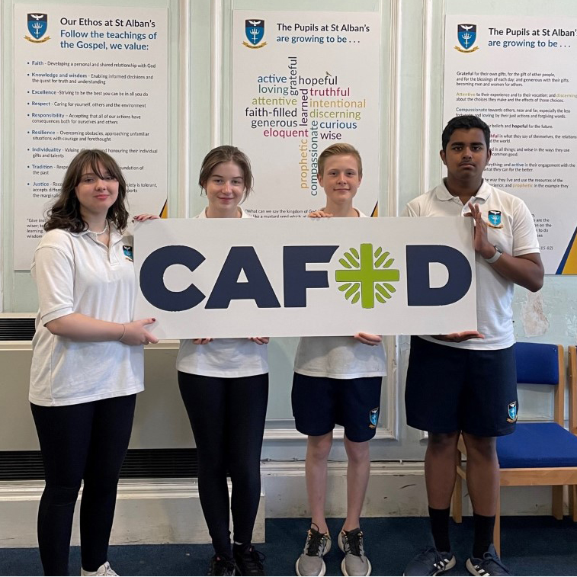
Sunday 4 December
Second Sunday of Advent
“A voice cries in the wilderness: Prepare a way for the Lord.”
Matthew 3:3
  Speaking up!
  Students at St Alban’s, Pontypool took part in a challenge to make a presentation to fellow pupils, aiming to win £1000 for their chosen charity.
  Afterwards, everyone voted on which charity they thought most deserved their support.
  These four Y9 pupils researched and presented about CAFOD’s Ukraine Humanitarian Appeal and won £1000 to donate. Well done!
4
Notes:
Picture credit: St Alban’s, Pontypool

Slide 18
  Today’s gospel tells us that John the Baptist was a voice crying in the wilderness, preparing the way for the Lord’s coming.
  We may feel our voice echoes in a wilderness and is ignored, but the students at St Alban’s showed that no one is too young to speak up.
  How will I influence people today?
  Lord, John the Baptist prepared the way for your coming. Help me to prepare too.
  Amen.
“A voice cries in the wilderness: Prepare a way for the Lord.”
Matthew 3:3
4
Consider doing a CAFOD short talk in your parish for Lent or Harvest next year.
Notes:
Picture credit: St Alban’s, Pontypool

Slide 19
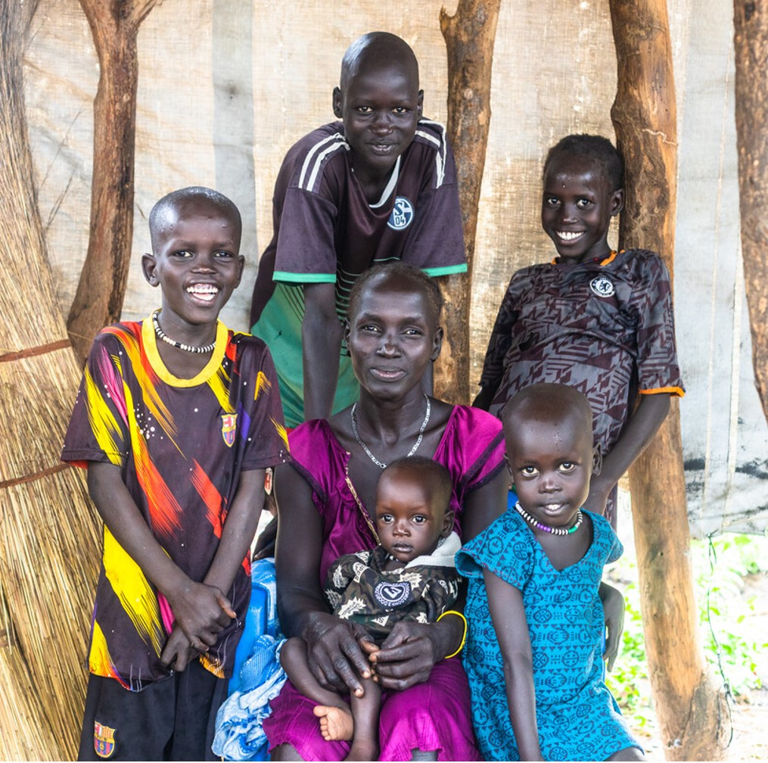
Monday 5 December
“We have seen
incredible things today.”
Luke 5:26
  Simply incredible!
  We met Nyanguet Ket earlier in this calendar, on 28 November.
  After her family fled violence in their village, she received farm tools and seeds to plant on a piece of land given by her new neighbours in the Yirol East area of South Sudan.
  Nyanguet’s family now faces more challenges, after no rain for months, followed by too much rain.
  But CAFOD partners are training people in eco-friendly techniques for farming in the changing climate.
5
Notes:
Picture credit: Achuoth Deng

Slide 20
  Meanwhile, Nyanguet is grateful for the incredible generosity of her Yirol East neighbours, welcoming her family and so many others, despite already facing hunger themselves.
  In today’s gospel, people say they have seen incredible things.
  What simple but incredible things are you grateful for this Advent?
  Lord, thank you for your gifts. Teach me to share them.
  Amen.
“We have seen
incredible things today.”
Luke 5:26
5
Tell one person today about something you are grateful for in the past year.
Notes:
Picture credit: Achuoth Deng

Slide 21
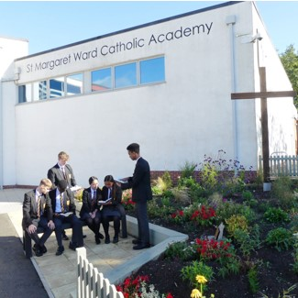
Tuesday 6 December
“‘Console my people,
console them,’
says your God.”
Isaiah 40:1
  Consolation
  Students at St Margaret Ward College, Stoke on Trent, are building a prayer garden where people can reflect, pray and find peace and consolation.
  Some students held a service here for one of their friends who died.
  “Our prayer garden is a small place with a big spiritual impact on you.”
  Younes, Y11
  This is already a beautiful space, but they plan to enclose it with new benches and to do more planting.
6
Notes:
Picture credit: St Margaret Ward Catholic Academy

Slide 22
  In today’s reading God wants to console his people through the prophet Isaiah. God also wants to console them through us.​
  I may not be able to build a garden to console someone today, but I could share a kind word or a smile.
  How will I console people today?
  Lord, open my eyes today to see every person, made in your image, as my sister or brother.
  Amen.
“‘Console my people,
console them,’
says your God.”
Isaiah 40:1
6
As a class, decide a message of hope you can share at #MessagesOfHope.
Notes:
Picture credit: St Margaret Ward Catholic Academy

Slide 23
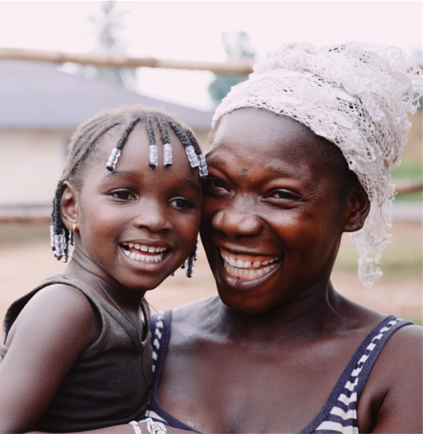
Wednesday 7 December
“Shoulder my yoke, and learn from me...”
Matthew 11:28-30
  Miles of commitment
  During Lent, CAFOD asked schools to ‘Walk against hunger’ to help some of the 200 million children at risk of malnutrition.
  Children like Lombeh, who almost died as a baby but now is strong and healthy, after her mum was helped by sisters at a CAFOD-supported clinic.
  Schools in England and Wales walked over 180,000 kilometres – more than four times around the world. Amazing!
7
Notes:
Picture credit: Thom Flint

Slide 24
“Shoulder my yoke, and learn from me...”
Matthew 11:28-30
  In today’s gospel, Jesus tells us that his yoke (an ancient way to carry a burden) is easy and light. In other words, if we are trying to follow Jesus, the things we do will feel less difficult.
  Thousands of you ‘shouldered your yoke’ during Lent to walk and fundraise to help children gain access to food. Thank you!
  Next Lent, will you join The Big Lent Walk? More details coming soon!
  Lord, help me to be generous of heart and always to dare to care.
  Amen.
7
Remind yourself of Lombeh’s story by watching our video
Notes:
Picture credit: Thom Flint

Slide 25
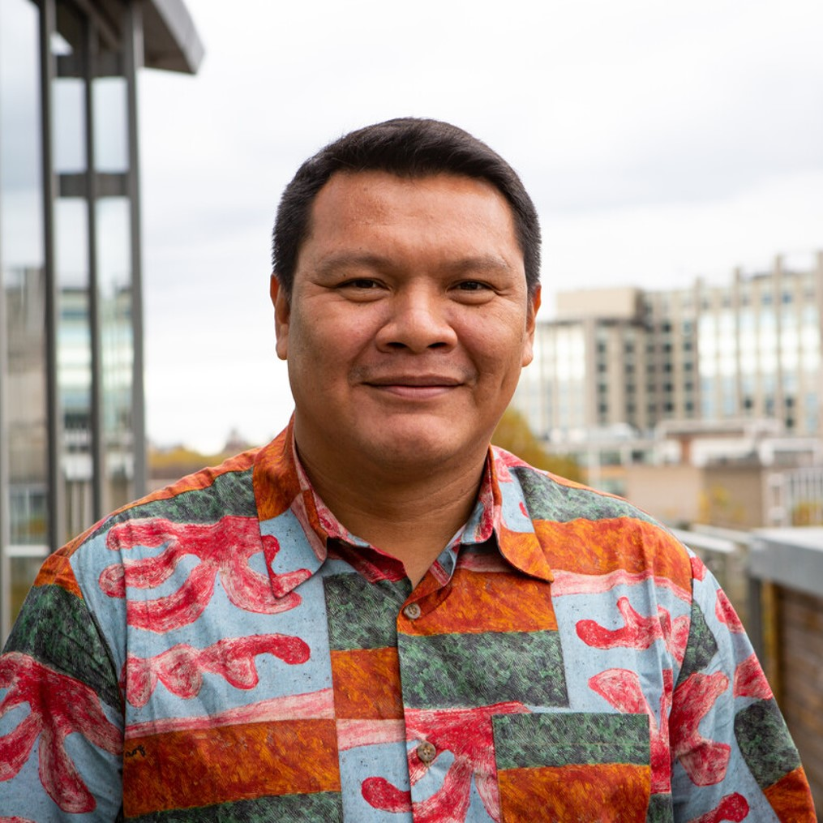
Thursday 8 December
The Immaculate Conception
“Mary, do not be afraid...”
Luke 1:26-38
  Free to say yes
  Today’s feast celebrates that Mary was ‘conceived without sin’.
  In other words, from her first moment of life, even before she was born, Mary lived totally for God.
  No-one else is as single-hearted and single-minded as Mary. But perhaps you know someone who inspires you by the way they live?
8
Notes:
Picture credit: Louise Norton

Slide 26
  CAFOD works with local experts (who we call 'partners') all over the world who inspire us daily with their dedication to the people in their communities.
  People like Mauricio, from CAFOD partner HAY*, bravely working to protect the rights of indigenous people and the Amazon rainforest.
  Today’s reading tells us not to be afraid. God will help us go beyond our fears to serve others, as Mauricio is doing.
  Lord, I give my own fears to you. Show me how to help others too. Amen
  *Hutukara Yanomami Association
“Mary, do not be afraid...”
Luke 1:26-38
8
Decide how you will mark Human Rights Day this Saturday.
Notes:
Picture credit: Louise Norton

Slide 27

Friday 9 December
“I, the Lord your God… lead you
in the way that you must go.”
Isaiah 48:17
  Finding the way
  In the last year, more than 380 schools registered to work towards the LiveSimply Award - taking steps to live simply, sustainably and in solidarity with the world's poorest communities.
  Each of those schools is making a plan for how they will achieve their award.
  The plan will be part of their school mission to follow Christ and let God lead them.
9
Notes:
Illustrations: Kieran O’Brien

Slide 28
  Advent is a good time to think:
  Where is God leading me?
  What does God want me to do?
  Lord, lead me in the way that I should go.
  Amen.
“I, the Lord your God… lead you
in the way that you must go.”
Isaiah 48:17
9
Find out about the LiveSimply Award for schools.
Notes:
Illustrations: Kieran O’Brien

Slide 29
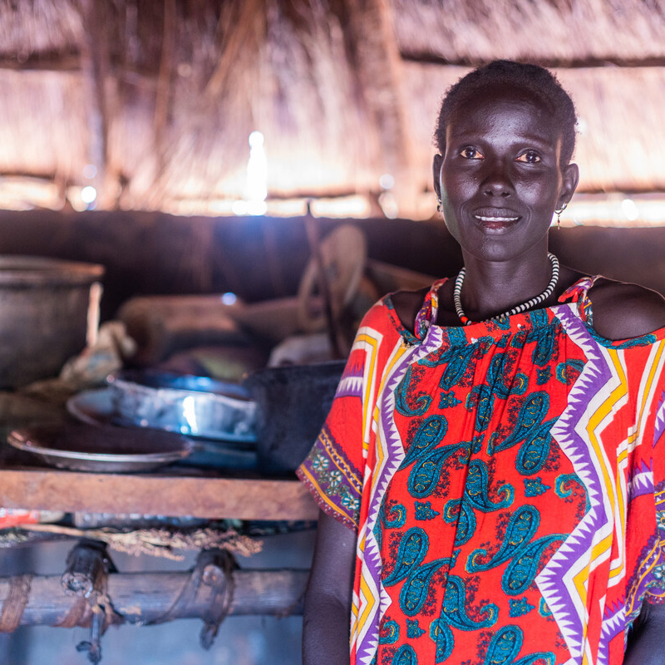
Saturday 10 December
Human Rights Day
“O Lord, rouse up your might, O Lord, come to our help.”
Psalm 79:2
  Cry to God
  Today’s psalm cries to God for help. It is a cry that still resounds around the world today.
  Aker lives in a community in South Sudan that has welcomed families who have been forced to flee. But severe lack of rain, due to climate change, has destroyed the crops that Aker’s own family depend on.
  Aker says: “I pray a lot for God’s mercy to provide and bless my family.”
10
Notes:
Picture credit: Achuoth Deng

Slide 30
  Our local experts are currently supporting Aker and her family with emergency food aid.
  God does not abandon us in times of difficulty but hears all who call.
  Let’s open our own ears to the cry of those whose right to food and water is not being respected. Let these cries move us to take action.
  Lord, help me to be the answer to someone’s prayers today. Amen.
“O Lord, rouse up your might, O Lord, come to our help.”
Psalm 79:2
10
Remind yourself of our World Food Crisis film for Harvest Fast Day.
Notes:
Picture credit: Achuoth Deng

Slide 31
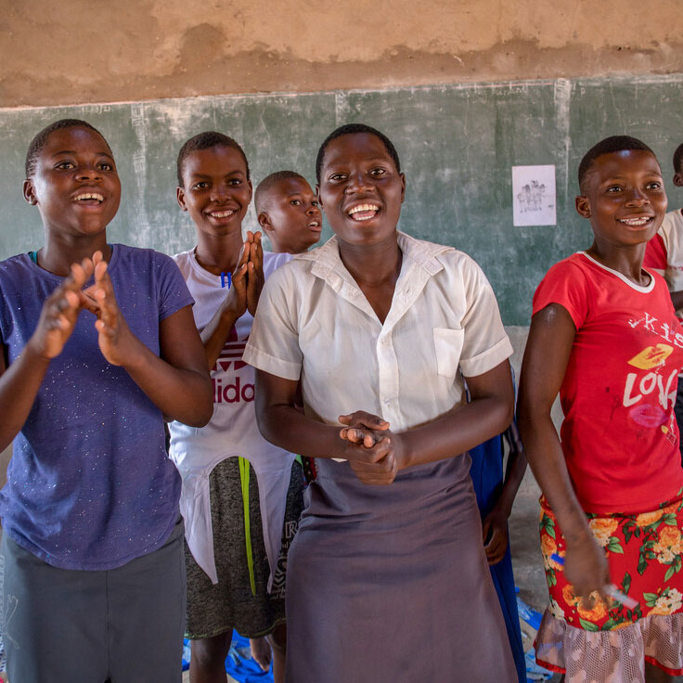
Sunday 11 December
Third Sunday of Advent
Gaudete (Rejoice) Sunday
“Joy and gladness will go with them…”
Isaiah 35:10
  Singing joy!
  In Zimbabwe, Isabell, a social worker, runs “Singing to the Lions” workshops for children who have experienced loss, missed out on school or face other challenges.
  Workshops include counselling, group therapy and team activities.
  Isabell says, “We are teaching the children… not to keep quiet but to sing to the lions (challenges) they are facing. To scare the lions of their lives away.”
11
Notes:
Picture credit: Cynthia Matonhodze

Slide 32
  Farisal (centre), said: “I really enjoyed dancing to music, singing and throwing a ball to each other. I enjoyed hanging out with others and having no troubles on my mind.”
  Today is ‘Rejoice Sunday’. It’s a reminder that even a brief taste of joy can lift someone’s heart and help them to cope during a dark time in their life.
  What has brought you joy this Advent? How can you share it?
  Lord, help me bring joy!
  Amen.
“Joy and gladness will go with them…”
Isaiah 35:10
11
Order World Gifts by 15 December for free postal delivery by Christmas.
Notes:
Picture credit: Cynthia Matonhodze

Slide 33
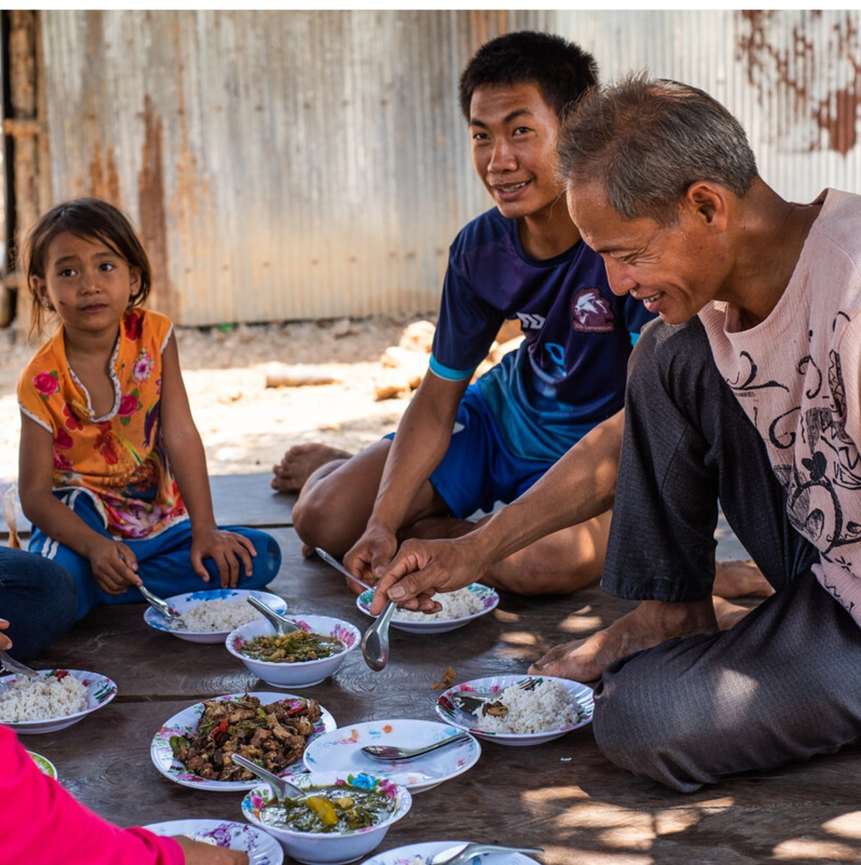
Monday 12 December
“I see him,
but not in the present,
I behold him,
but not close at hand.”
Numbers 24:17
  Looking to the future
  Whenever CAFOD works with communities overseas, we also consider the impact on creation and on future generations.
  That’s why we support KBO* - an organisation training farmers in Cambodia affected by the climate crisis to grow food sustainably and set up self-help groups.
  Min Sarith (right) said, “You are unlikely to be alone if you join a self-help group. Individuals can't make it happen but when we are together nothing is impossible.”
  *Karuna Battambang Organisation
12
Notes:
Picture credit: Tom Chheat/KBO (Karuna Battambang Organisation)

Slide 34
  In today’s reading, the prophet Balaam sees a future leader who would save his people. Centuries later, Jesus was born.
  Min Sarith sees a future being able to provide for his family without harming the environment.
  It can take courage to trust that a vision will be fulfilled.
  What is your vision for the future?
  Lord, give us clear vision and strong trust in you.
  Amen.
“I see him,
but not in the present,
I behold him,
but not close at hand.”
Numbers 24:17
12
Is CAFOD's agenda for change similar to your vision for the world?
Notes:
Picture credit: Tom Chheat/KBO (Karuna Battambang Organisation)

Slide 35
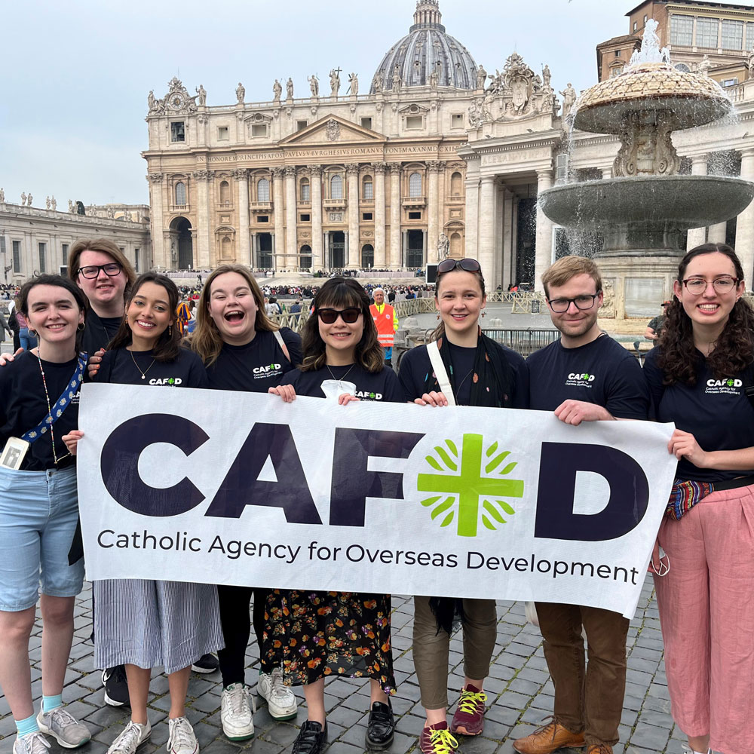
Tuesday 13 December
“The son answered ‘I will not go’ but afterwards thought better of it and went…”
Matthew 21:31
  Willing volunteers
  In July, eight young adults completed their gap year with CAFOD.
  In April, they had visited Caritas International headquarters in Rome to learn how being part of this Catholic network means that CAFOD can reach remote communities all over the world.
  "It was an amazing experience to learn more about how… we’re all part of the global Catholic church and it’s our right but also our privilege to help other people..." Emma
13
Notes:
Picture credit: Arianne McIntyre/CAFOD

Slide 36
  In today’s reading, the brother who at first refused to work, later changes his mind and goes to work in his father’s vineyard.
  Advent is a good season to remember the times we have not done what we ought to have done… and to get on with it!
  As our gap year volunteers discovered, actions count.
  What have I neglected to do?
  Lord, I’m sorry I sometimes avoid your call. Help me to change course and serve others as you did. Amen.
“The son answered ‘I will not go’ but afterwards thought better of it and went…”
Matthew 21:31
13
Find out if your school or parish has an Advent reconciliation service.
Notes:
Picture credit: Arianne McIntyre/CAFOD

Slide 37
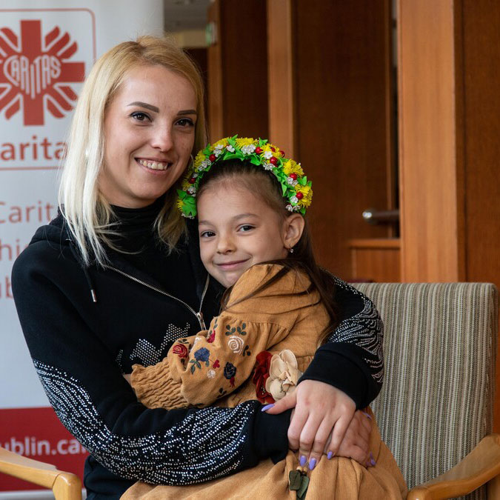
Wednesday 14 December
“I will hear what the
Lord God has to say, a voice that speaks of peace.”
Psalm 84:9
  Hope for peace
  CAFOD is part of the Caritas network, working with organisations like Caritas Lublin in Poland, 100km from the Ukraine border.
  This year, many schools in England and Wales prayed and fundraised with CAFOD to help people fleeing the war in Ukraine.
  Their efforts helped people like Olena and her five-year-old daughter. They received cash to help pay rent after fleeing Kherson and arriving at Caritas Lublin.
14
Notes:
Picture credit: Caritas Poland

Slide 38
  Today’s psalm reminds us that God has a voice that speaks of peace.
  God may want to speak peace to our own hearts or to tell us how we can be peace to someone else.
  Where can you find space to listen to God today?
  Lord, speak peace to my heart today.
  Amen
“I will hear what the
Lord God has to say, a voice that speaks of peace.”
Psalm 84:9
14
Continue to pray with us for peace in Ukraine.
Notes:
Picture credit: Caritas Poland

Slide 39
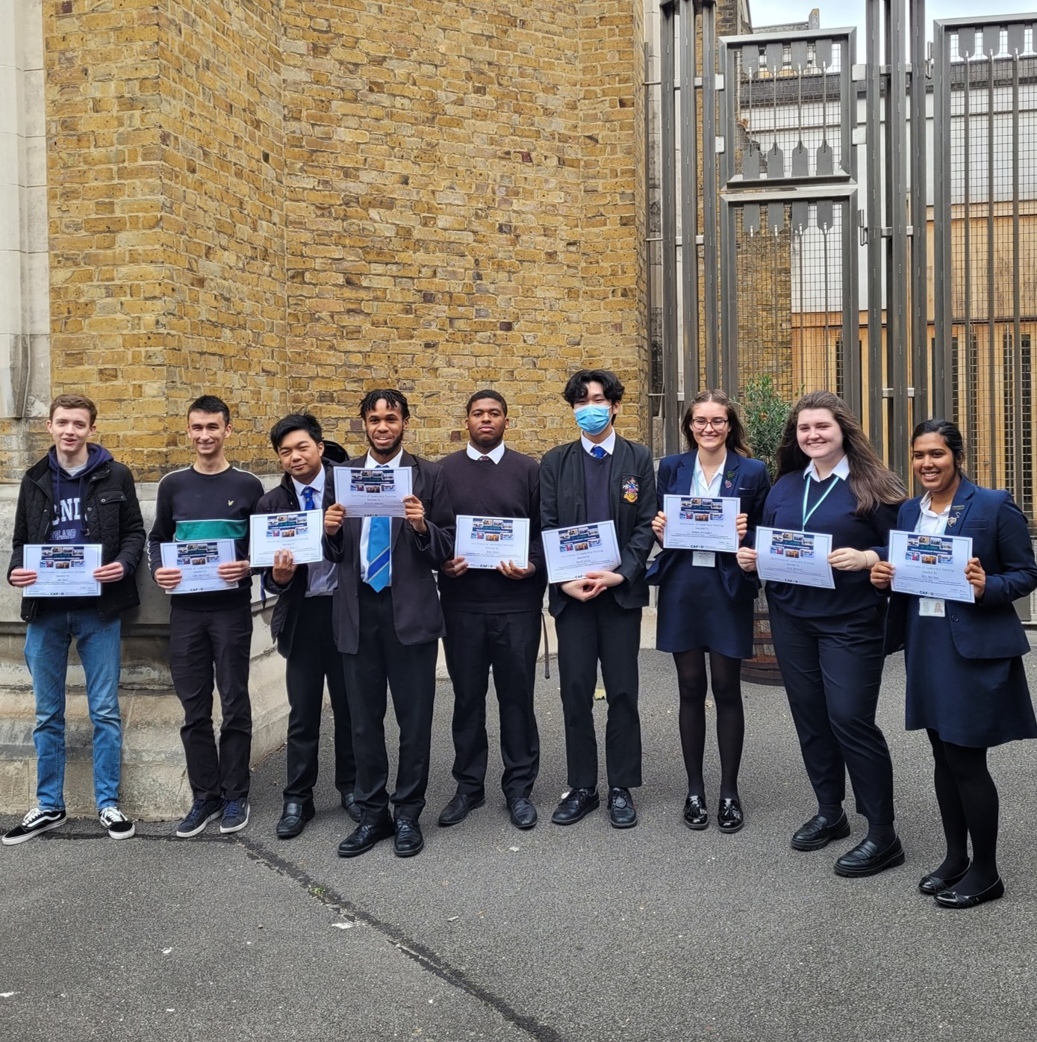
Thursday 15 December
“My covenant of peace with you will never be shaken…”
Isaiah 54:10
  Young leaders
  The photo shows just a few of this year’s graduates from CAFOD’s young leadership programme.
  270 young people in 41 schools committed to spend time in training meetings and webinars, learning new skills, meeting new people, campaigning and fundraising.
  One student said the programme “....opened our eyes to the global issues that CAFOD are trying to solve and showed us ways that we can help. Often we feel that our efforts may be insignificant, but they’re not.”
15
Notes:
Picture credit: CAFOD

Slide 40
  Today’s Mass readings are all about God’s loving commitment to be faithful to his people, fulfilled in the mission of John the Baptist and the birth of Jesus.
  What promise or commitment can I make for the coming year?
  Lord, this Advent, help me to fulfil the promises I make.
  Amen.
“My covenant of peace with you will never be shaken…”
Isaiah 54:10
15
Write a new year’s resolution and put it somewhere visible.
Notes:
Picture credit: CAFOD

Slide 41
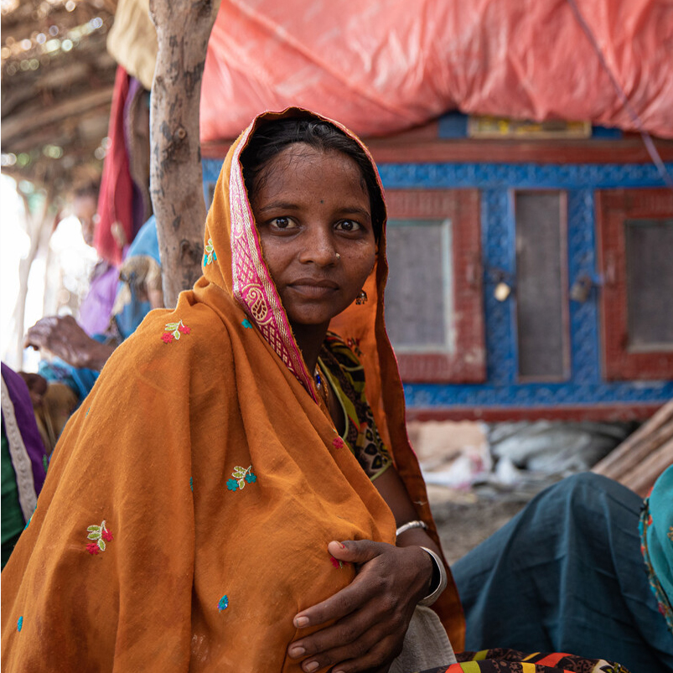
Friday 16 December
“…these same works of mine testify that the Father has sent me.”
John 5:36
  Pakistan floods
  Last summer, rains in Pakistan flooded more than a third of the country.
  CAFOD worked with Community World Service Asia (CWSA) providing cash for food and access to basic healthcare through mobile health units in some of the worst affected areas.
  Salma, 22, is pictured inside a makeshift tent being used as a waiting area for a mobile health unit as it visited a flood-affected village.
  Salma’s son, her first child, was born during the heavy rains.
16
Notes:
Salma is a pseudonym.
Picture credit: Arete/ Insiya Syed/ DEC

Slide 42
  Salma’s husband is a labourer, currently jobless due to the floods. She hopes he can resume work when the waters recede so that they can afford healthy food to sustain Salma and her baby.
  The work of CWSA’s mobile health units was a sign of hope to people in flooded villages that they were not forgotten by the world.
  What work will you do today?
  Lord, let my work and all that I do be a sign of your love.
  Amen.
“…these same works of mine testify that the Father has sent me.”
John 5:36
16
Find out what happens in an emergency at CAFOD.
Notes:
Salma is a pseudonym.
Picture credit: Arete/ Insiya Syed/ DEC

Slide 43
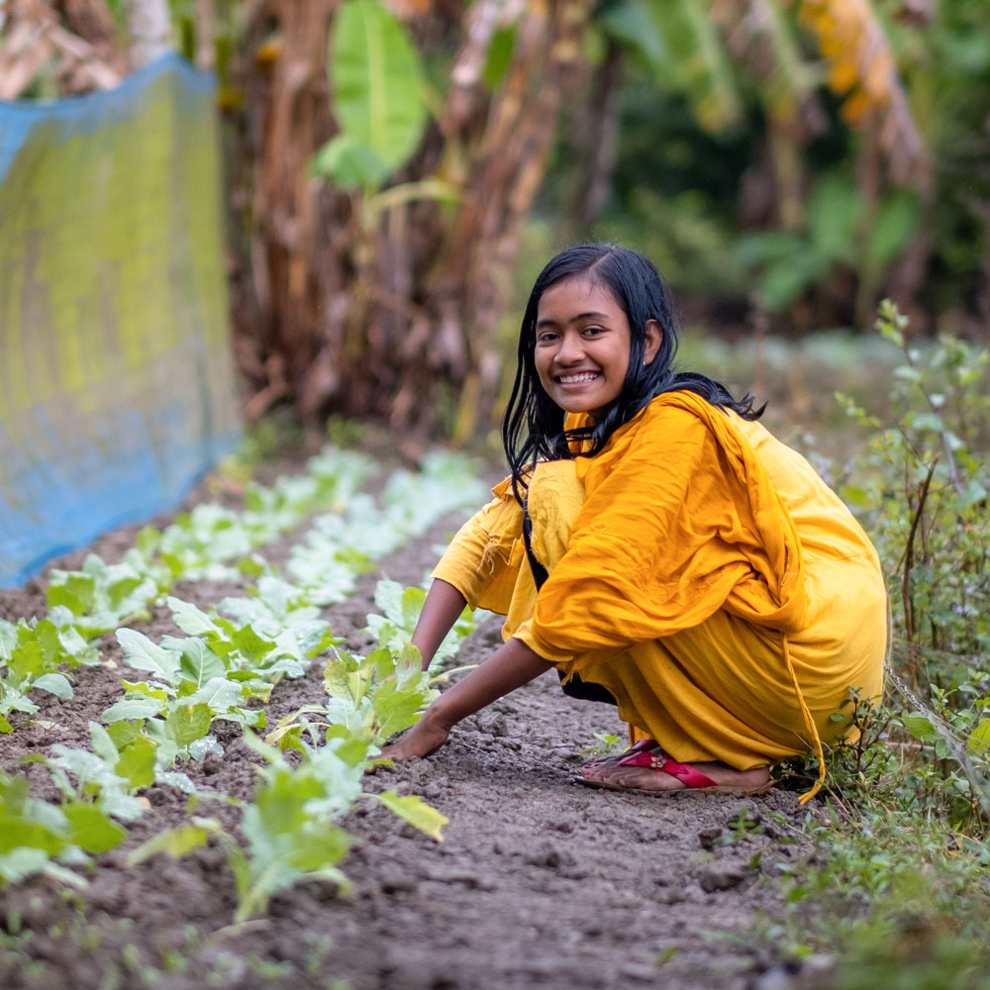
Saturday 17 December
“Jacob (was) the father of Joseph the husband of Mary, of whom Jesus was born, who is called the Messiah.”
Matthew 1:16
Waiting in faith
  Today’s gospel is a long list of the ancestors of Jesus, from Abraham to King David, and all the way to Joseph. An odd reading!
  But Matthew wanted to show his Jewish audience that Jesus was the promised Messiah, awaited for generations, sharing their heritage.
  Our faith is rooted in those faithful Jewish people who waited in faith for God’s promises to be fulfilled.
17
Notes:
Picture credit: Amit Rudro

Slide 44
  Around the world today, millions of people are waiting to be able to live life to the full, as Jesus promised, but are prevented from doing so by injustice and extreme poverty.
  The good news is that, with CAFOD, you are already part of changing that, one community at a time!
  Communities now flourishing, like the eco-village in Bangladesh, home of Dristy, who you'll meet in our Lent resources next term.
  Jesus, help me to live life to the full and help others do the same.
  Amen
“Jacob (was) the father of Joseph the husband of Mary, of whom Jesus was born, who is called the Messiah.”
Matthew 1:16
17
More good news! See what CAFOD campaigns have achieved over the years.
Notes:
Picture credit: Amit Rudro

Slide 45
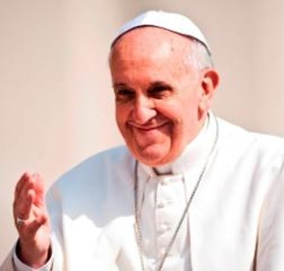
Sunday 18 December
Fourth Sunday of Advent
International Migrants’ Day
“…all this took place to fulfil the words spoken by the Lord…”
Matthew 1:24
  Living Word
  The Bible is a place we can go to seek wisdom about how to live.
  For example, Pope Francis said:
  “Biblical revelation urges us to welcome the stranger; it tells us that in so doing, we open our
  doors to God, and that in the faces of others we see the face of Christ.”
18
Notes:
Picture credit: Mazur/Catholicnews.org.uk

Slide 46
  In today’s gospel, Joseph is asked to open the doors of his home to Mary, and become guardian to Jesus.
  Joseph did, literally, open his doors to God. And his life changed completely as a result.
  Will I be ready to open the doors of my heart today?
  St Joseph, pray for me to accept what God calls me to do and to respond as generously as you did.
  Amen.
“…all this took place to fulfil the words spoken by the Lord…”
Matthew 1:24
18
Look out for opportunities to say ‘yes’ today when you are asked to help.
Notes:
Picture credit: Mazur/Catholicnews.org.uk

Slide 47
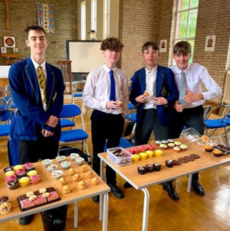
Monday 19 December
“Zechariah was doing his work as a priest in the Temple, taking his turn in the daily service…”
Luke 1:8
  God is with us
  When huge floods overwhelmed much of Pakistan last summer, Mission Leaders at Blessed Trinity, Salford recognised the need and responded, running a bake sale during break time.
  CAFOD is part of the Caritas International network of Catholic agencies. This means we are there as soon as an emergency happens – anywhere – using your fundraising rapidly to help the people who need it most.
19
Notes:
Picture credit: Blessed Trinity, Salford

Slide 48
  In today’s gospel, an angel appears to Zechariah when he is simply doing his duty, taking his turn serving in the temple.
  Simple, ordinary tasks can be transformed by God – all we need to bring is faith and loving service.
  Where can you see God living with us today?
  Emmanuel, thank you for coming to live with us. Help me to see you in my ordinary life.
  Amen
“Zechariah was doing his work as a priest in the Temple, taking his turn in the daily service…”
Luke 1:8
19
Find out how your school can be there, in any emergency, anywhere.
Notes:
Picture credit: Blessed Trinity, Salford

Slide 49
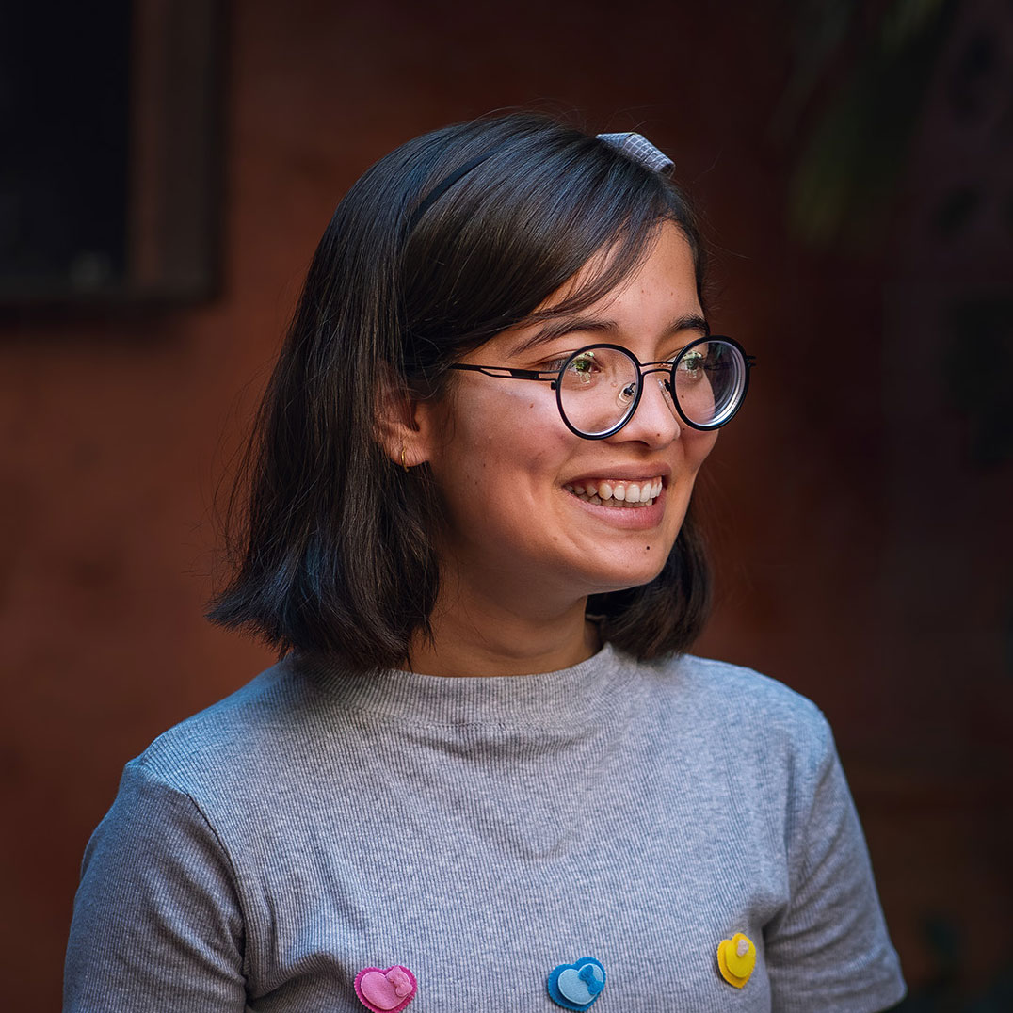
Wednesday 20 December
“Rejoice, so highly favoured! The Lord is with you.”
Luke 1:28
  “The Letter”
  Have you seen the inspiring new free feature film “The Letter”?
  It tells follows five people standing up for creation around the world as they receive an invitation from Pope Francis and travel to Rome to meet with him.
  The youngest, Ridhima Pandey, 14, has helped in groundbreaking lawsuits to hold governments to account for climate inaction. She has also founded an organisation to help young women become climate activists.
20
Notes:
Picture credit: Thom Flint/CAFOD

Slide 50
  In today’s reading, another remarkable young woman – Mary - is told to rejoice and that the Lord is with her.
  We can rejoice too, because the Lord is always with us!
  We can also rejoice at the beautiful creation God has given us to share.
  What am I doing to protect it?
  Lord, help us to restore our planet so that all of life can flourish as you intended.
  Amen
“Rejoice, so highly favoured! The Lord is with you.”
Luke 1:28
20
Watch The Letter on Youtube at the end of term or in the holidays.
Notes:
Picture credit: Thom Flint/CAFOD

Slide 51
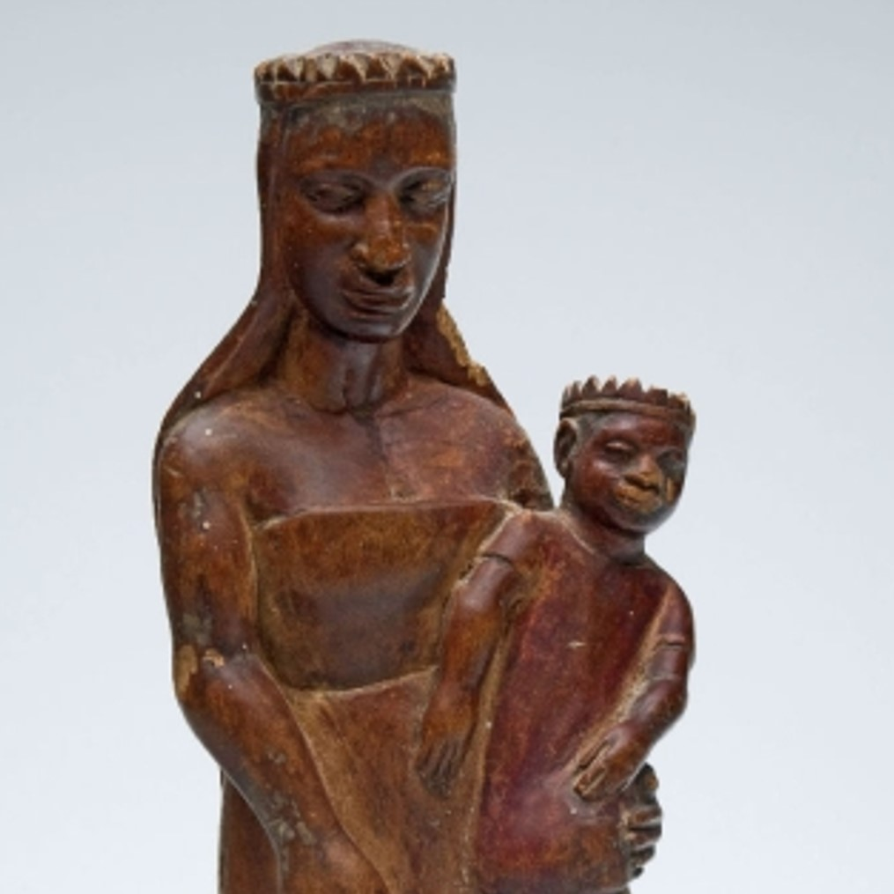
21 December
“Blessed is she who believed that the promise made her by the Lord would be fulfilled.”
Luke 1:45
  I don’t believe it!
  How often do we say “I don’t believe it” or even “I can’t believe it” when something outrageous happens?
  Mary could justifiably have said the same to the angel, Gabriel.
  “Son of God? The power of the Lord will overshadow me? I don’t believe it! What about Joseph?”
  But Mary chose to believe the outrageous promise of the Lord.
21
Notes:
Picture credit: Tropenmuseum, part of the National Museum of World Cultures, Csiraf, CC BY-SA 3.0 <https://creativecommons.org/licenses/by-sa/3.0>, via Wikimedia Commons

Slide 52
  Elizabeth, in today’s reading, tells Mary she is blessed because of her choice to believe the Lord’s word.
  Do you believe the Lord’s promise to you: “I have come in order that you might have life—life in all its fullness”?
  How does it affect the way you live?
  Jesus, thank you for your promises. Help me to believe. Amen.
“Blessed is she who believed that the promise made her by the Lord would be fulfilled.”
Luke 1:45
21
Read and think about a word or phrase from scripture.
Notes:
Picture credit: Tropenmuseum, part of the National Museum of World Cultures, Csiraf, CC BY-SA 3.0 <https://creativecommons.org/licenses/by-sa/3.0>, via Wikimedia Commons

Slide 53
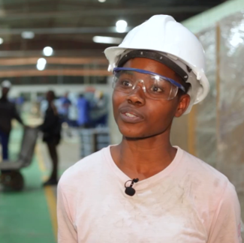
Thursday 22 December
“The Almighty has done great things for me…”
Luke 1:49
  Plans to grow
  Sofia Tembe is now a locksmith, thanks to a CAFOD-funded project in Maputo, Mozambique, which encouraged young women as well as men to become entrepreneurs – planning their own careers.
  As well as training in practical skills, the local organisation that ran the project (Khandlelo) gave each graduate a kit of equipment to help them start their own business.
  “I have plans to grow and do new projects, thanks to the kit that I was able to receive.” Sofia
22
Notes:
Picture credit: Louise Norton/CAFOD

Slide 54
  Sofia and others on her course have gone far beyond their society’s expectations. At first, Sofia’s father questioned her choice of a job more normally done by men. Now he accepts and supports her.
  Mary’s life too exceeded society’s expectations. In today's reading, she says that generations will call her blessed because of the great things God has done for her.
  What limitations do you want to overcome?
  Lord, shape me into the best person I can be. Do amazing things through me.
  Amen.
“The Almighty has done great things for me…”
Luke 1:49
22
Find out about volunteering in your local community or with CAFOD.
Notes:
Picture credit: Louise Norton/CAFOD

Slide 55
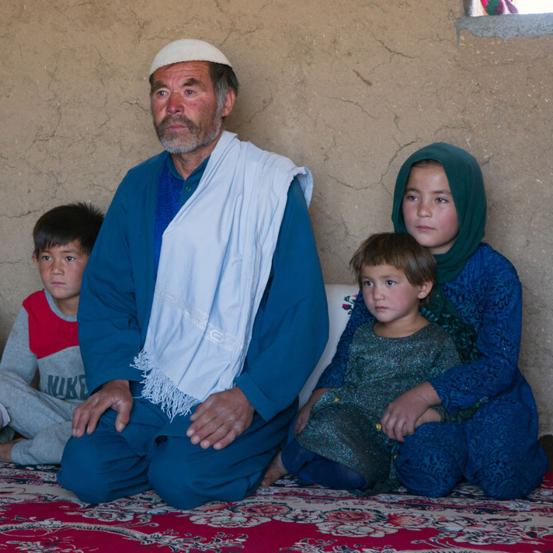
Friday 23 December
“And indeed the hand of the Lord was with him.”
Luke 1:66
  The hand of the Lord
  Maher* lives in Afghanistan with his family. He works as a day labourer but has been unemployed for most of the year. Severe droughts have destroyed farmland, food prices have risen and life is hard.
  “Some days we have been left no choice but to eat grass. This has left my son and wife sick; they are still sick, and the doctor said their intestines have been damaged.”
  But, following the DEC Afghanistan Appeal, Maher and his family are receiving cash to buy the things they need.
23
Notes:
Picture credit: Arete/CAFOD
*Maher is a pseudonym.
DEC is the Disasters Emergency Committee, an association of agencies – including CAFOD - that appeal together when there is a major emergency.

Slide 56
  “I bought essentials for our home like wood, gas, heaters and blankets for my family to use.
  This made me feel safe knowing we will be ready for winter.” Maher
  The hand of the Lord was with John the Baptist as he grew and prepared the way for Jesus.
  And the hand of the Lord is present in all who support their sisters and brothers, like Maher’s family.
  How can I support someone today?
  Lord, thank you for all those who support families living in extreme poverty. Amen.
“And indeed the hand of the Lord was with him.”
Luke 1:66
23
Sing carols to cheer up your local community - use our song sheets!
Notes:
Picture credit: Arete/CAFOD
*Maher is a pseudonym.

Slide 57
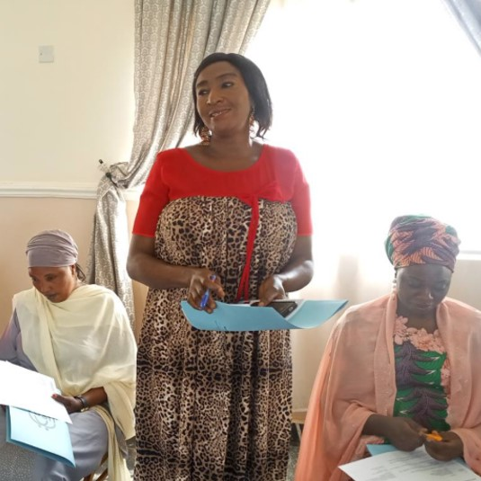
Saturday 24 December
Christmas Eve
“God... from on high will bring the rising Sun to visit us,
to give light to those
who live in darkness...”
Luke 1:78-79
  Light in darkness
  In a part of Nigeria where religious tensions often erupt into violence, CAFOD supports a programme that brings Muslims and Christians together to learn from each other.
  The programme is a ray of light, building respect and trust.
  One participant said: “Before the project, I did not have any Christian friends in my community but now I relate freely with the Christians, and we now visit each other."
24
Notes:
Picture credit: Omolola Mamedu

Slide 58
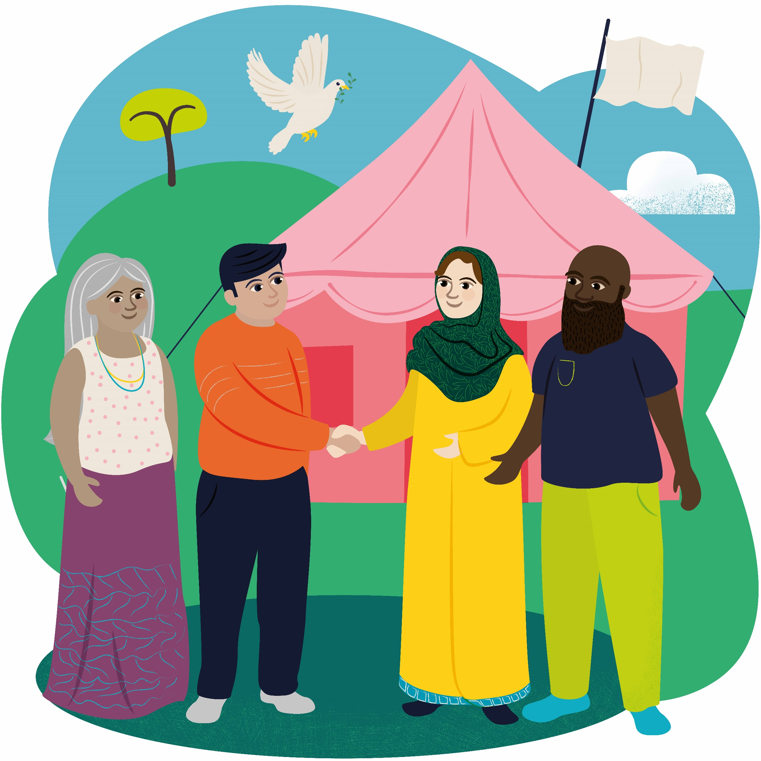
  Our Christmas Eve reading reminds us that “the dawn from on high”- Jesus, Light of the World - was coming to be with us.
  Jesus’ birth in a stable is a powerful sign that God chose to share in our lives – the problems and the joys.
  How will I let his light shine on and through me?
  Lord, thank you for communities that work together to address problems. Help me to build up my local community to do the same. Amen.
“God... from on high will bring the rising Sun to visit us,
to give light to those
who live in darkness...”
Luke 1:78-79
24
Find out about our World Gift, Promoting Peace.
Notes:
Picture credit: Omolola Mamedu

Slide 59
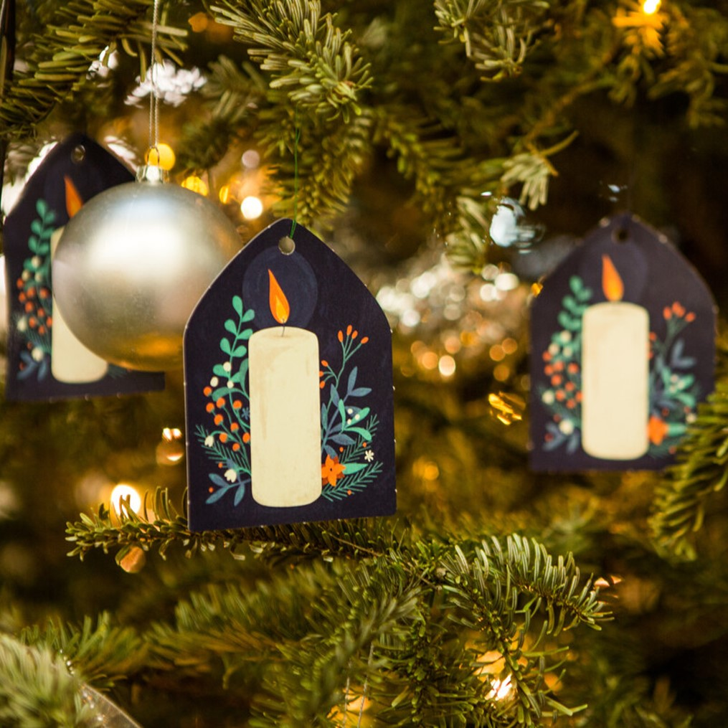
Sunday 25 December
Christmas Day
“The people that walked in darkness has seen a great light.”
Isaiah 9:1
  Light of the world
  The central white candle is lit on the Advent wreath at church today to celebrate Christ’s birth and the hope that it holds for our world.
  The picture shows our Christmas tree at CAFOD head office, Romero House, in London.
  Candlelight is a powerful image.
  Saint Francis of Assisi said:
  “All the darkness in the world cannot extinguish the light of a single candle.”
25
Notes:
Picture credit: Thom Flint

Slide 60
  Today we thank God for the light and hope he gives us in Jesus.
  We pray that God will help us to shine that light into situations of injustice so that, together, we can build a world where everyone can live life to the full.
  Like the shepherds – we rejoice!
  Infant Jesus, you embrace our poverty and transform it. Empower me with hope to live and share your good news for all.
  Amen.
“The people that walked in darkness has seen a great light.”
Isaiah 9:1
25
Say a grace before Christmas lunch to give thanks for all God’s blessings.
Notes:
Picture credit: Thom Flint

Slide 61
Thank you for journeying with us this Advent.
Everyone at CAFOD wishes you a happy and blessed Christmas.
Picture credits: See notes fields of the slides
Notes:
Picture credit: Thom Flint

