Slide 1
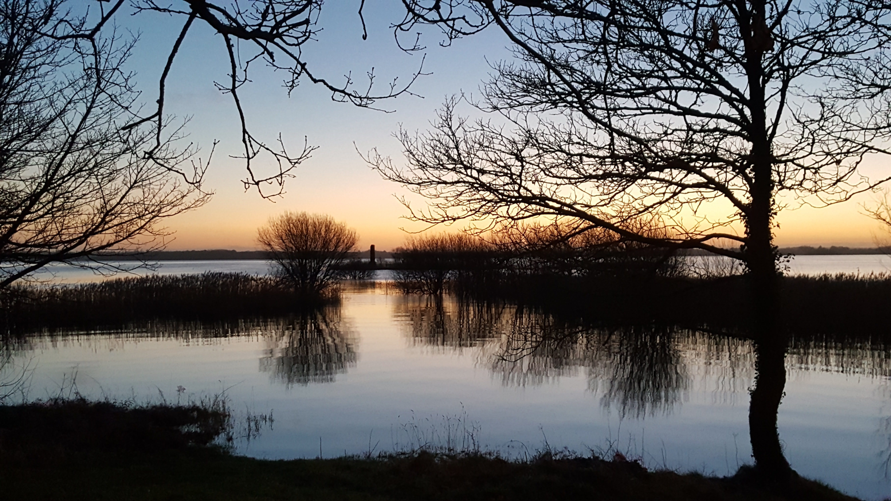
November: Trusting God, Trusting Life, Trusting One Another
November 2022
Notes:
Note: This material deals with sensitive content relating to death and dying. In particular, any student affected directly or indirectly by cancer and/or the death of a loved one might find the material very sad. The religious education teacher will be best placed to decide how best to use it. Care should obviously be taken with students who have experienced the death of a loved one. Conversations can perhaps be had with these students before the class to check that they are happy to participate. The religious education teacher will know how best to manage this sensitively.
There are between three and five lessons here depending on how the material is used and adapted. This material is for senior students but it could be reasonably adapted for junior classes.
The three parts to the PowerPoint are as follows:
The value of life
The importance of community in dying
What Christians believe about hope and dying

Slide 2
Learning Intentions
To explore the idea that life is finite/has an end point but is also full of meaning
To reflect together on how faith helps us understand and deal with death
To examine the concept of hope in terms of service and what Christians believe about eternal life

Slide 3
Success Criteria
Examine the keywords so that the material for the class can be accessed
Reflect on the experience of the finite nature of life
Reflect on the experience of death
Engage with material that demonstrates how universal the experience death is
Explore the concept of hope in terms of service
Explore the concept of hope in terms of Christian understanding of eternal life
Make some life resolutions

Slide 4

Key Terms
Human mortality
Walking together in grief
Comfort
Traditions
Hope
Values

Slide 5
In the Christian tradition, we’re not afraid to discuss death
Remembrance in November is an old practice
On 1 November we celebrate the feast of All Saints
On 2 November we celebrate the feast of All Souls
Blessing of graves
Book of remembrance

Slide 6

Part 1
Life has value
Your life has value

Slide 7
Reflective Exercise
Discuss in pairs what you think this quotation means:
‘Because life is fragile and death inevitable, we must make the most of each day.’ – Thomas S. Monson
Notes:
Introduce the concept of mortality – i.e. that from the moment we are conceived and then born, we are going to die. This doesn’t have to be depressing. In fact, a lot of writers and thinkers believe it can actually make you appreciate and love your life more. Let’s see how.

Slide 8
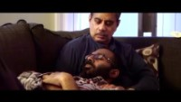
What does that actually look like?
Notes:
Paul Kalanithi was a young and very gifted brain surgeon and writer. He was married to Lucy, and they had a daughter called Cady. He wrote a book called When Breath Becomes Air. The book was published following his death at age 37.
Although Kalanithi was raised as a Christian, he turned away from the faith in his teens and twenties. However, he retained ‘the central values of Christianity – sacrifice, redemption, forgiveness’ and returned to Christianity later in his life.
Here is a trailer for the book. We’ll discuss two of the quotations that you’ll see here when we’re finished.
The link to the video is https://www.youtube.com/watch?v=aetY_zS7Q6M

Slide 9
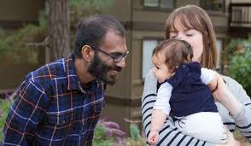
Discuss in pairs
‘Perhaps the dying have most to teach us about life.’
‘The fact of death is unsettling. Yet there is no other way to live.’
Notes:
Invite students, in pairs, to discuss either of these two quotations. Ask them to write down what the quotation means to them.
Then discuss the quotations together as a class.

Slide 10

Bucket list: a number of experiences or achievements that a person hopes to have or accomplish during their lifetime.
Notes:
So death can teach us how to live our lives to the fullest. What does that mean to you?
Introduce the idea of a ‘bucket list’.
Discuss the bucket list on the slide. Which of these things would be important to you? What isn’t there that would be important to you to do or to achieve?

Slide 11

Discussion
As a class, discuss the order you’d put the following things you wish to achieve in life and share reasons for your answer:
  Financial security
  Family happiness
  Making a contribution to your community
  Leaving a legacy/something significant you’ve achieved

Slide 12
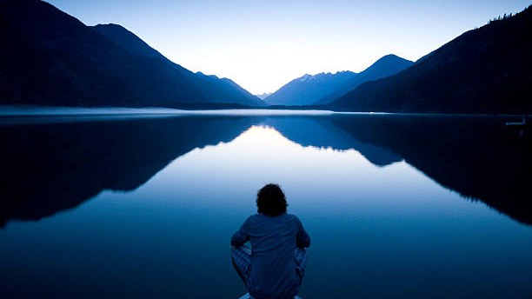
Extension Exercise 1
https://www.istockphoto.com/photos/water-reflection
In our opening slide we read, ‘in the Christian tradition, we’re not afraid to discuss death’. Why do you think this is the case?

Slide 13
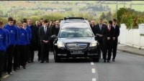
Donal Walsh – livelife.org
Notes:
Introduce this clip with information about Donal Walsh from http://donalwalshlivelife.org/?page_id=74.
(There is mention of suicide here, so it’s important to highlight that Donal’s message was that suicide wasn’t the answer. He died from cancer, a disease he fought. He wanted to live, but he also wanted to challenge young people in particular to really appreciate their lives.)
Video link is https://youtu.be/EHn8elFx5GM

Slide 14
Answer these questions in class:
In this video about Donal Walsh’s funeral:
What are the symbols brought up to represent his life?
What were the symbols on his coffin? What do these symbols mean for Christians?
What sporting figures do you recognise here? Why do you think they were so emotional/moved by being part of his funeral?
Donal believed in God and practised his faith. In what ways might this have influenced his attitudes to his life?

Slide 15
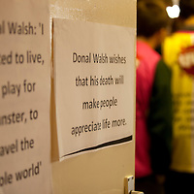
Discuss in pairs this quotation about Donal Walsh’s life:
‘Donal Walsh wishes that his death will make people appreciate life more.’
Notes:
Depending on the group you might want to add this additional question to the discussion, “have you had any experiences in your life that has made you appreciate your life more and life in general more?”

Slide 16

Life has value …
In pairs, using your bibles find any four of the following quotations about the value of human life. Share what you think they mean with your class.
  Genesis 1:27
  Psalm 8:5
  Psalm 139:14
  Isaiah 43:4
  Matthew 10:29-31
  Matthew 6:26
  Ephesians 2:10
  1 John 3:1-2
Notes:
As an alternative, you could give students the quotations to work on in pairs, asking students to organise the quotations in the order they find most appealing/affirming, most convincing or most challenging.

Slide 17

Extension Exercise 2
https://pixabay.com/images/search/reflection/
Write a letter to Donal Walsh’s mother, Elma, who continues to present to schools and parishes on Donal’s life and legacy. In your letter, write about what you have learned about her son and what has inspired you most about his life.

Slide 18

Part 2
When death happens, how do we grieve?
Notes:
Again, sensitivity is required here for students. For students who have suffered recent bereavements it’s important that care is taken to prepare them for this material. Some students may wish to opt out of this part of the material.

Slide 19
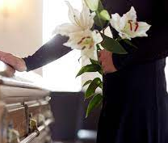
Funerals
Earlier we saw a clip of Donal Walsh’s funeral. We saw the usual things we associate with funerals, particularly in Ireland: the grieving family, the coffin, carrying the coffin, the symbols, the priest and so on.
What has your experience of funerals been, if any?
Notes:
Spend some time discussing with students their own experiences of funerals

Slide 20
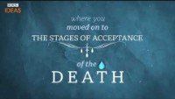
Death and the Irish
Notes:
Kevin Toolin, a writer describes his Irish father’s wake: https://www.youtube.com/watch?v=ALT8zbjnjkY
(There is one mild swear word in the opening minutes – good to maybe say this so that it doesn’t distract.)
The questions that follow in the next slide can be given to students as a handout if you wish for them to complete while watching the video.
Video link is https://youtu.be/ALT8zbjnjkY

Slide 21

Questions:
What prayers are said as Kevin’s father dies? What do these prayers serve to do as the person dies?
What is the role of the community in helping the family come to terms with the death of their loved one?
What aspects of this experience do you recognise? What do you see that is different to what you’ve seen before?
Why, do you think, did women play such a big role in controlling the emotional temperature of the funeral?
“People came in great numbers … and everyone shook your hand saying ‘Sorry for your trouble”. Why is this important to Kevin?
What parts of this man’s account of his father’s death and funeral did you find most moving?

Slide 22

Kevin talks about seeking to bridge the moment of bereavement and loss together …
In small groups, discuss what kind of practical, emotional and spiritual help and support people need when they’ve lost a loved one. Give real-life examples! Be practical in your discussions. What are the things you can do?
  Practical help
  Emotional help
  Spiritual support

Slide 23
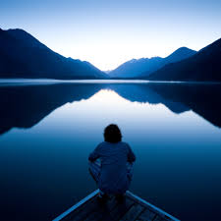
Optional Exercise:
It might be appropriate (depending on your context) for your students to interview another member of the staff who has suffered a bereavement that they’re now comfortable talking about.
Students might ask questions around what he/she felt was helpful; what the experience of the funeral was like; what their own beliefs are around death; what consoles them.
Notes:
Obviously great care should be taken here in terms of the person chosen to share their experiences.
(It would of course be appropriate for the religious education teacher themselves to be interviewed should they feel comfortable. Another alternative might be to ask the local parish priest/school chaplain/curate to be interviewed about their experiences.)

Slide 24
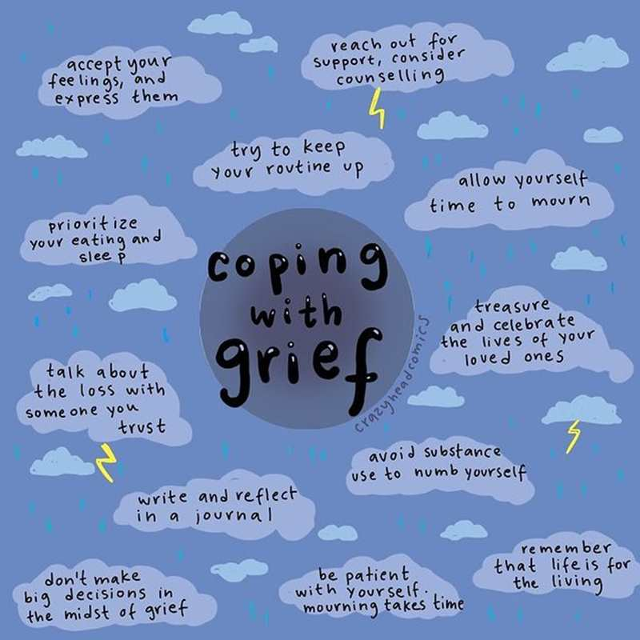
And what about when you’re grieving yourself …
Notes:
Taken from https://www.youngminds.org.uk/young-person/my-feelings/grief-and-loss/.
This can be photocopied and shared. It can be used as a discussion tool within a group, or perhaps an extension idea might be for each student to engage with it personally in terms of ordering this advise into what they think is most important for someone grieving.
Note the final one: remember that life is for living.
Obviously it’s also important to remind the young people that help is available to them when and if they need it, currently or in the future.

Slide 25

Part 3
The reason for our hope

Slide 26
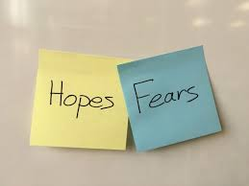
We have …
One of our greatest fears is death: death of those we love and/or our own death. Despite its inevitability, it isn’t easy to think about.
We deal with this fear by looking for hope. We will now explore what hopes Christians have in the face of our fear of death.

Slide 27
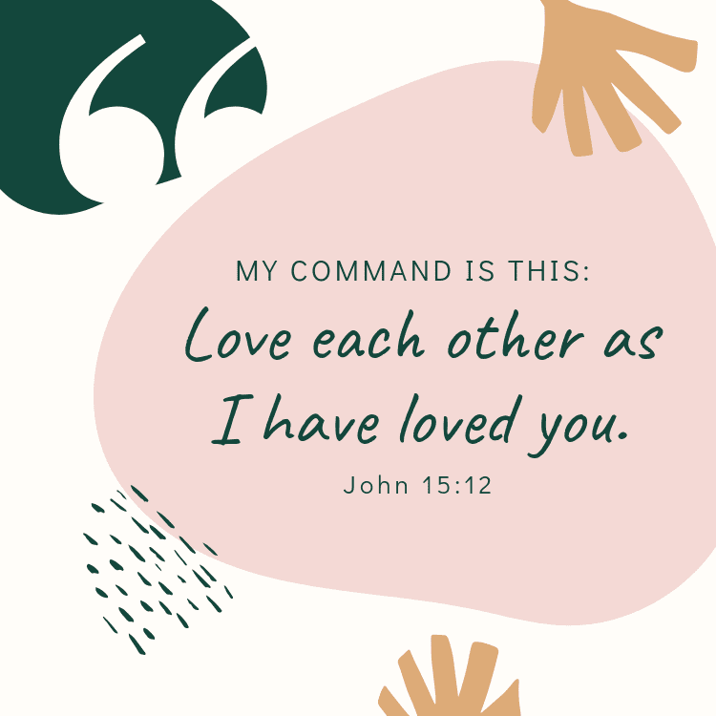
Two reasons for our hope
One another
God
Notes:
We have seen how an awareness of our mortality can give us a rich appreciation of life.
For people of faith – Christians, Muslims and Jews in particular – there is more to it than that. (Note that in Hinduism and Buddhism, suffering and death take on a different meaning. An interesting extension exercise might be in to invite students to compare the beliefs of the main monotheistic faiths with the beliefs about death and suffering found in Buddhism and Hinduism.)
In Christianity, the reason for our hope is twofold:
The importance of community
Our faith in Jesus Christ
Or put simply, one anther and God.

Slide 28

Love One Another
Notes:
This is a fun but very affectionate take on the Bruno Mars song ‘Count on Me’.
As students listen to this song, ask them to write down the ways humans count on one another for help and support. (And not just in terms of death and grieving.)
Video link is https://youtu.be/h9O5_Q-oLrs

Slide 29
Extension Exercise 3
https://www.istockphoto.com/photos/water-reflection
Think back to our reflection on Donal Walsh’s life and death and the death and funeral of Kevin Toolin’s father. List the ways in which the families were supported by the wider community.

Slide 30

The Hospice Movement
Notes:
In our earlier work, we learned about three lives affected by cancer: Paul Kalanithi, Donal Walsh and Kevin Toolin’s father.
One movement is particularly important in Ireland in terms of caring for people affected by cancer – that is the hospice movement. Let’s read a little bit more about this organisation now. (You can access information on the hospice movement from the Irish Catholic Catechism for Adults, pages 165–7 or online, whichever is easier).

Slide 31
Extension Exercise 4:
Notes:
In light of what we’ve learned so far, what kind of ‘love’ are we talking about here in terms of this bible quotation? What other words for ‘love’ could you put in here? (You can an app to do a word cloud here for this exercise.)

Slide 32

But for Christians, love is also about God …
And this happens in two ways:
Meaning for Christians takes place in terms of service to others – when we love others we make our lives meaningful
God welcoming us home to him after we die

Slide 33
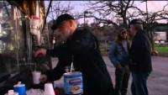
Not words but deeds…..
Notes:
If you prefer to use a different voice e.g. an Irish person, you could use the story of Peter McVerry SJ: https://www.youtube.com/watch?v=bgPpwb2Clx4.
(A more challenging Peter McVerry clip can be found at https://www.youtube.com/watch?v=M-rGqTvzujI.)

Slide 34
And in your school …
Notes:
Here you can provide examples of service in the life of your own school. (Insert your school crest as well as either a list of things your school does and/or pictures in the text box above.) Ask students for other examples from their wider community. You can link this to your vision/mission statement and school ethos as you see fit.
Paraphrasing John 10:10: ‘I have come that you might have life and have life in abundance.’
In the Christian tradition, Jesus tells us that the meaning of our life is to serve others, especially those most in need of our help. This is our hope: that as a community we can support and help one another.

Slide 35

Discuss …
To serve others is to give ourselves and others hope in a brighter future …
Notes:
This is an opportunity to reiterate the importance of service as that which gives us meaning as well as hope in our lives.

Slide 36
Extension Exercise 5
https://www.istockphoto.com/photos/water-reflection
Personal reflection:
Where have found the greatest meaning in your own life? Try to think back to moments of real joy and/or peace. Have these moments taught you anything about hope.

Slide 37
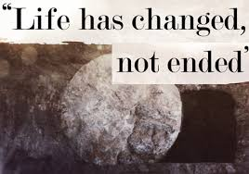
In death life is changed, not ended
Notes:
We turn now to the heart of Christian hope around death, that life is changed not ended (Preface I for the Dead, Roman Missal – 3rd Typical Edition, 2011)
Discuss with students what they think this sentence means?
What do they think the image means? (It’s a picture of the stone outside Jesus’ burial chamber – moved to one side indicating Jesus’ resurrection.)
Note: These slides do not cover the following:
The resurrection of the body
The last judgement
More on these can be found very accessibly in the Irish Catholic Catechism for Adults, Chapter 13.

Slide 38
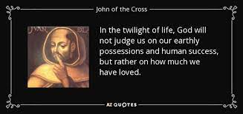
The Idea of God’s Judgement
Notes:
Here it is important of course to share the idea of divine judgement, but care is needed to ensure students also hear of God’s mercy. The John of the Cross quotation captures this well.
Another alternative is to play the video in which Pope Francis consoles a young boy concerned about his father’s death. https://www.youtube.com/watch?v=zgJBJj2VPP4 (A longer version is available at https://www.youtube.com/watch?v=bRbUTfSds0U) Teachers can exercise judgement here as to whether they wish to use this video or not. There are subtitles as the Pope is speaking in Italian and this might not suit all students. Also the young boy in the video is clearly upset and that might trigger discomfort or sorrow in students.
How does this tie in with what we have already learned about community and serving others? In serving others, do we get a taste of what heaven is like? Why is this?

Slide 39

Your Image of Heaven ...
Notes:
If time permits, allow for an art exercise.
If time is more limited, a general discussion in pairs/small groups would be also helpful.

Slide 40
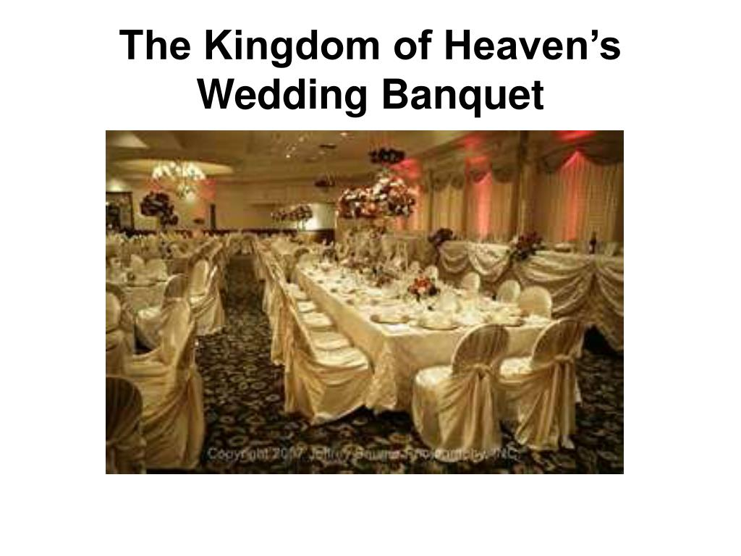
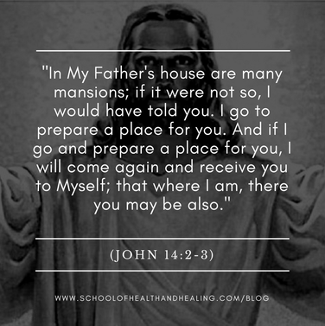
Images of Heaven in the Bible …
Notes:
Discuss what these two images are trying to tell us about what heaven is like.

Slide 41
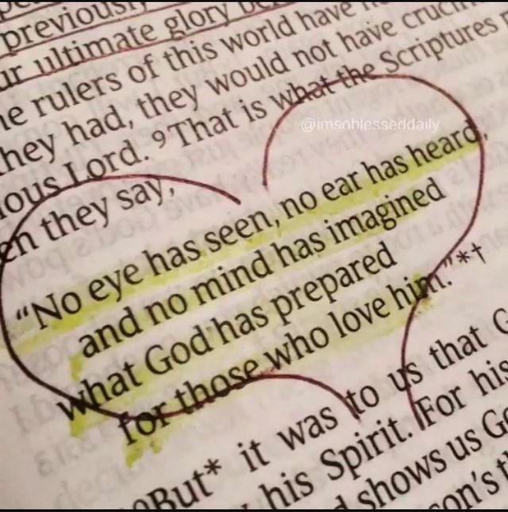
But …
‘No eye has seen, no ear has heard, and no mind has imagined the things that God has prepared for those who love him’ (1 Cor 2:9).
Notes:
Here it is obviously important to distinguish the difference between having a sense of heaven as a physical place and as a spiritual reality.

Slide 42
So what might eternal life be like?

Slide 43
After death, we are ‘held firmly within the conscious love of God and the conscious presence of Jesus Christ’ (Tom Wright, Surprised by Hope).
‘Heaven is another name for God’ (Tom Wright, Surprised by Hope).
Notes:
What might be helpful for people about this idea of resting in God?
Compare these images with your own image or ideas about heaven. What’s similar? What’s different?

Slide 44
Extension Exercise 6
https://www.istockphoto.com/photos/water-reflection
Compare the Christian understanding of life after death with the Muslim and Jewish understanding? What is similar? What is different?

Slide 45
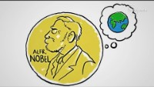
The Story of Alfred Nobel
Notes:
Video link is https://www.youtube.com/watch?v=KlQDvdBMqYE

Slide 46
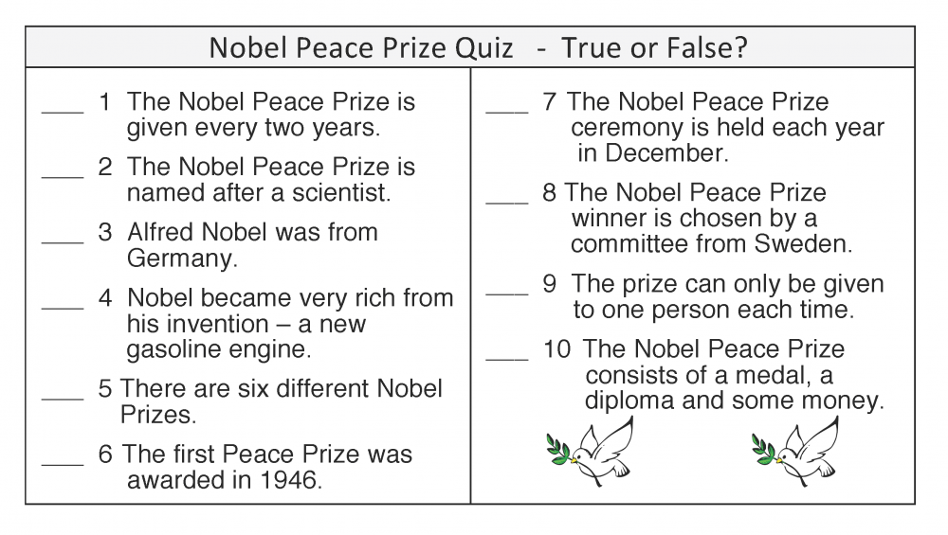
A Quiz!
Notes:
These can be answered in pairs!

Slide 47
Extension Exercise 6(b)
https://www.istockphoto.com/photos/water-reflection
Write your own obituary! What do you want to have achieved? How do you want to be remembered? What will be important to you?

Slide 48
Learning Intentions
To explore the idea that life is finite/has an end point but is also full of meaning
To reflect together on how community is central to our coping with death
To examine the concept of hope in terms of service and what Christians believe about eternal life
Notes:
Check in with students on learning intentions

Slide 49

Concluding Activity
During the course of these lessons on death, dying and grief, we have heard a number of stories relating to cancer. Why not consider ways you might fundraise for a cancer charity in your town?
As part of this fundraising activity, why not consider holding a prayer service for your school community to remember those who have been affected by cancer and their families?

Slide 50
Co-curricular Links
History – remembering how wakes happened in Ireland in the past and how elements of these wakes are still done
Art – drawing images of heaven
English – written expression – literature, the power of the written word (Donal Walsh, Paul Kalanithi)
Irish – Irish traditions, e.g. the wake
Sport – the role of sports people in supporting Donal Walsh’s family
Well-being – the importance of community, self care, care of others

