Slide 1
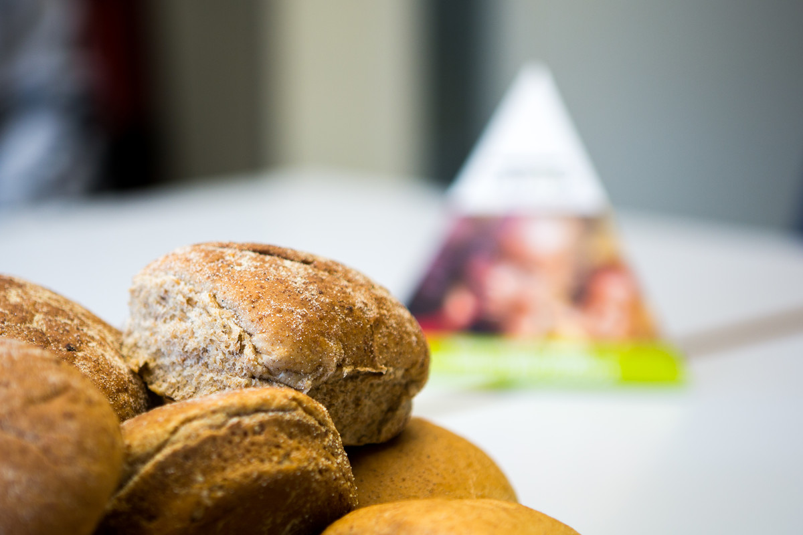

Fasting
Year 7
RE

Slide 2
Read this story and consider the questions.
Callum really, really wanted that new football jersey. His mum had put her foot down saying, “I don’t have a spare £50! You only got a new jersey six months ago; it still fits. And you need a new school blazer.” But Callum’s grandad had a season ticket and had promised to take Callum to a few matches during the summer holidays. Callum didn’t want to be wearing outdated kit.
So, he did a deal with his mum. They agreed he would not ask her to buy chocolate or crisps for his lunchbox for the next two months. Callum reckoned this would save £26 off the shopping bill. He would also give up the Saturday night takeaway every other weekend and have shop-bought pizza instead. That should save another £24. Sorted!
Recall a time when you gave up one thing to get something else.
What motivated you? How did it feel? Was it difficult?
Notes:
Starter (5 mins)
Display this slide while students enter the classroom.

Slide 3
Learning objectives
By the end of this lesson, I will be able to:
define fasting
understand Catholic teaching on fasting, and its foundations in scripture
explain some reasons why Catholics fast in solidarity with people living in poverty
explain how CAFOD Family Fast Day is a response to the Lenten practices of fasting, prayer and almsgiving
understand Pope Francis’ teaching on the dangers of “so-whatism”.
I will also:
• have had an opportunity to respond in a practical way to what I have learned.

Slide 4
What is ‘fasting’?
Fasting: to abstain from (give up) all or some kinds of food or drink for a fixed amount of time, especially as a religious observance.
Notes:
Introduction (5 mins)
Today we are finding out about fasting. What is fasting? (Take some ideas).
Show the definition:
‘Fasting’: to abstain from (give up) all or some kinds of food or drink for a fixed amount of time, especially as a religious observance.
How does fasting relate to the story we just read about Callum? (He ‘fasted’ from chocolate, crisps and takeaways for two months in order to get a football jersey.)
Some people fast from a meal or a type of food during special religious seasons like Ramadan or Lent. Why do they do this? Are they looking to get something? (They want to remove some of the things that distract them from focussing on God, and free their hearts to turn towards God, get to know God better and become better witnesses.)

Slide 5
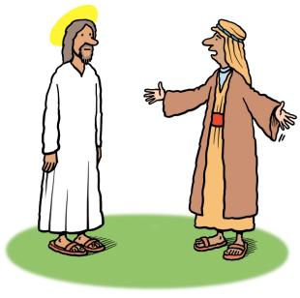
Matthew 9:14-15
Then the disciples of John came to him, saying, ‘Why do we and the Pharisees fast often, but your disciples do not fast?’
And Jesus said to them, ‘The wedding-guests cannot mourn as long as the bridegroom is with them, can they?
The days will come when the bridegroom is taken away from them, and then they will fast.’
Notes:
History of Fasting (1 min)
Where does fasting come from; when did it start? We don’t know exactly, and it probably has more than one origin, but we do know it has been around a very long time. It was already common by the time of Jesus. Matthew’s Gospel says that the Pharisees and the apostles of John the Baptist both fasted (Matthew 9:14). And Jesus began his ministry with a time of prayer and fasting.

Slide 6
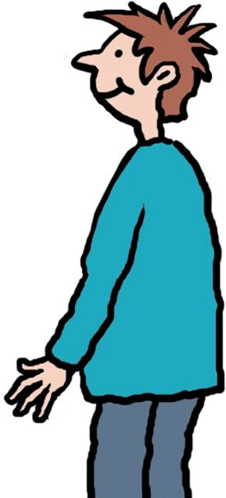
Matthew 6:16-18
“Whenever you fast, do not look dismal, like the hypocrites, for they disfigure their faces to show others that they are fasting. Truly I tell you, they have received their reward.
But when you fast, put oil on your head and wash your face, so that your fasting may be seen not by others but by your Father who is in secret; and your Father who sees in secret will reward you.”
Notes:
Jesus said that his followers would fast, and he described what that should be like:
Ask students to find Matthew 6:16-18. Then invite a volunteer to read it out.

Slide 7
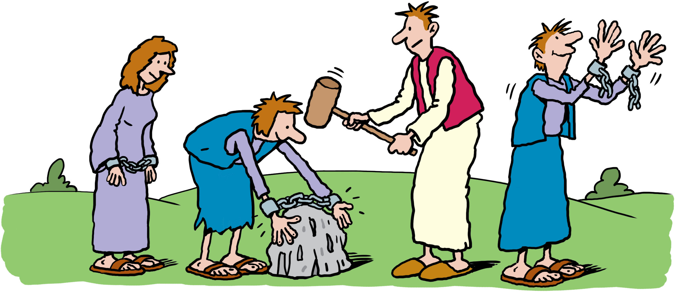
Isaiah 58:6-7
“Is not this the fast that I choose: to loose the bonds of injustice, to undo the thongs of the yoke, to let the oppressed go free, and to break every yoke? Is it not to share your bread with the hungry, and bring the homeless poor into your house; when you see the naked, to cover them, and not to hide yourself from your own kin?”
Notes:
Jesus also would have known the Old Testament very well. And the prophet Isaiah said:
[for an illustrated PowerPoint of the following passage, go to CAFOD website and search “Isaiah 58”, or read out Isaiah 58:6-7].
So, according to scripture and Catholic tradition, fasting is not to be boasted about, nor is it focused in on the individual who is fasting.
It is about freeing one’s heart to be more open to God and reach out to others.

Slide 8


Story of CAFOD
Notes:
Fasting in action (10 mins)
How do Catholics put this practice of fasting into action?
In monasteries, fasting is a regular part of the lives of nuns or monks. Many are vegetarian and eat even simpler food during Lent.
But ordinary Catholics fast too, in different ways. For example, they are called to do some form of self-denial on Fridays – the day that Jesus died. And, during Lent, Catholics are called to abstain from meat on Fridays, and to also eat less on Good Friday and Ash Wednesday.
Let’s watch a video that tells the story of something that happened during Lent 60 years ago. Look out for what the women did and for what motivated them (why they did this).
[Show the Story of CAFOD video (2:30) at https://vimeo.com/486345947/cd114b189a ]
Discuss – What did the women do? What motivated them? The video does not say this, but their actions took place during Lent – what impact might that have had on the number of people who took part? (Catholics were fasting during Lent. Family Fast Day gave a way for them to fast together and, together, to help their global family by ‘almsgiving’).

Slide 9
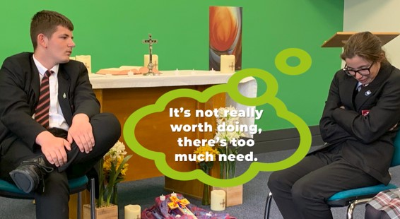
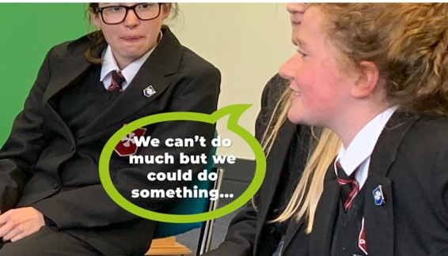
“At any point doubt could have crept in: ‘It’s not really worth doing - there’s too much need’.”
Why do you think, as Catholics, the women carried on despite global poverty being so huge a problem?
Notes:
The video says, “At any point (while the women were fundraising) doubt could have crept in: ‘It’s not really worth doing - there’s too much need’.” Why do you think, as Catholics, the women carried on despite global poverty being so huge a problem? (Take answers. These may include: The women’s actions influenced others to act. In Matthew 25, Jesus said, “Whatever you did to the least of these… you did it to me.” The Catholic Social Teaching principle ‘Preferential option for the poor’ calls Catholics to prioritise the poorest and most vulnerable. Catholics are called to act as God would act).
Yes, as the video also says:
[CLICK}
“We can’t do much, but we could do something”.

Slide 10
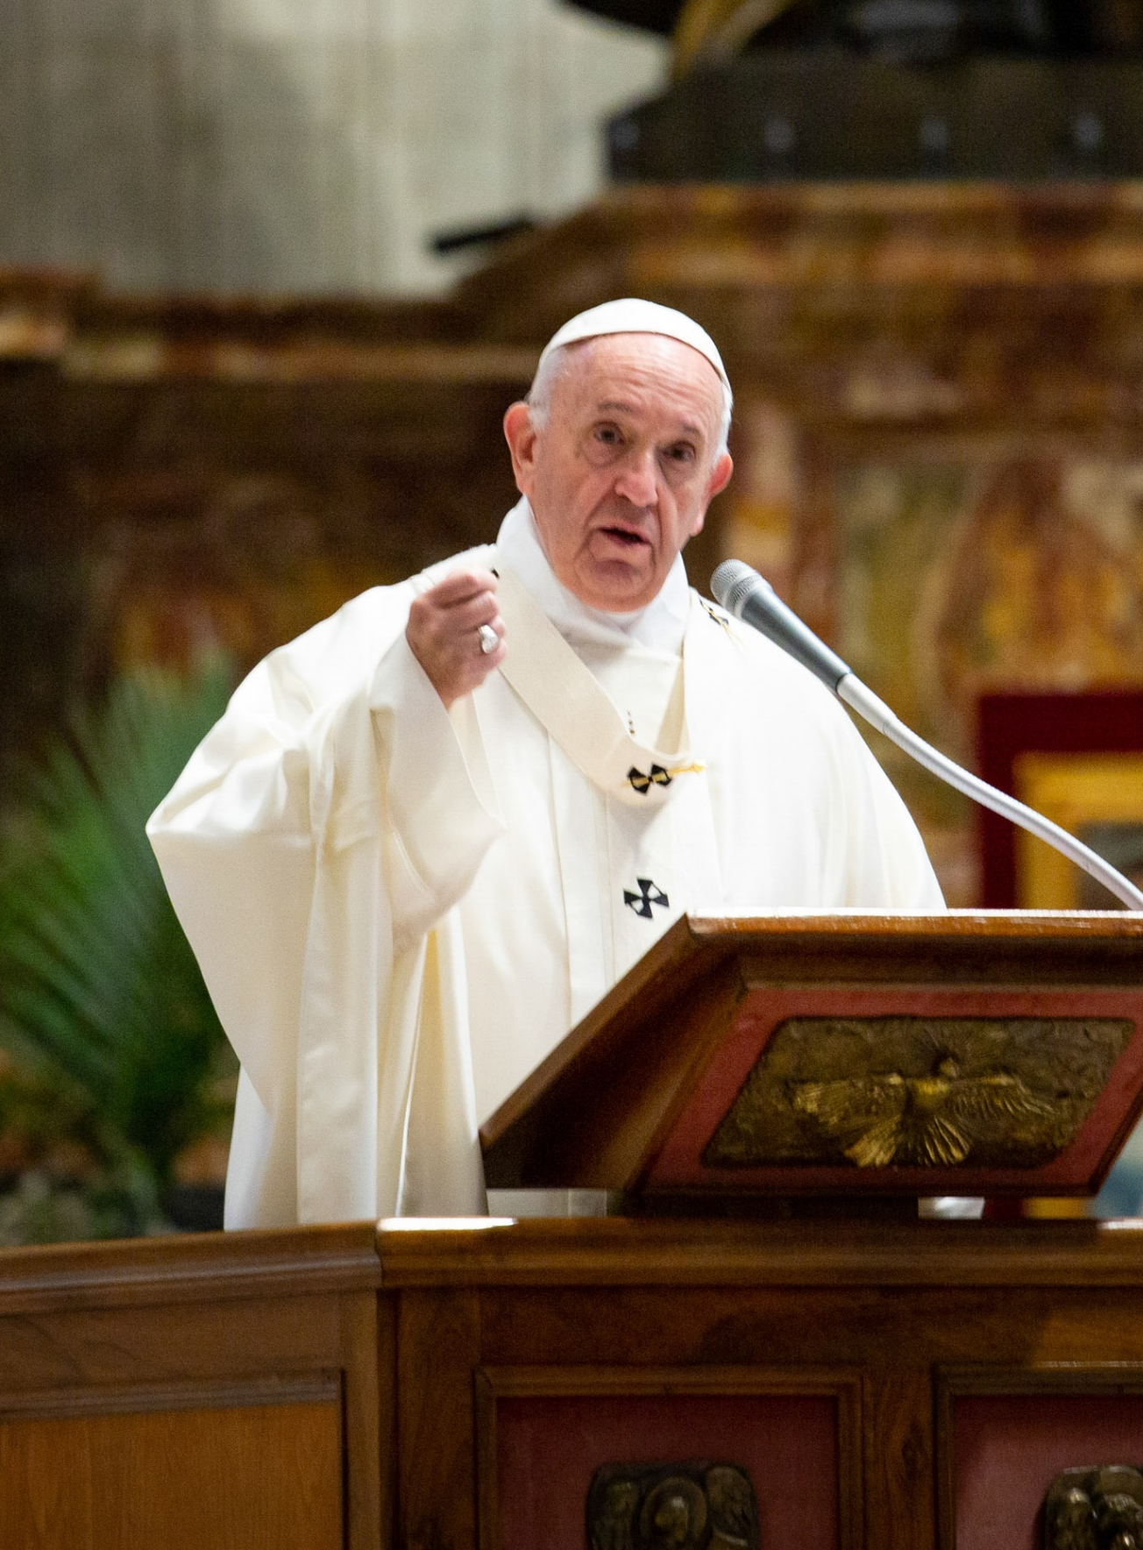
“
Some claim you need a healthy dose of ‘So-whatism’ to get through life, because if you start worrying about what you see, how are you ever going to relax?
…The attitude of the Lord is completely different, at the opposite pole. God is never indifferent… That’s why we must become aware of this so-whatism and open ourselves to the blows that reach us now from every corner of the globe.
Notes:
Pope Francis writes that we can get into the habit of saying “So what?” when we see suffering.

Slide 11
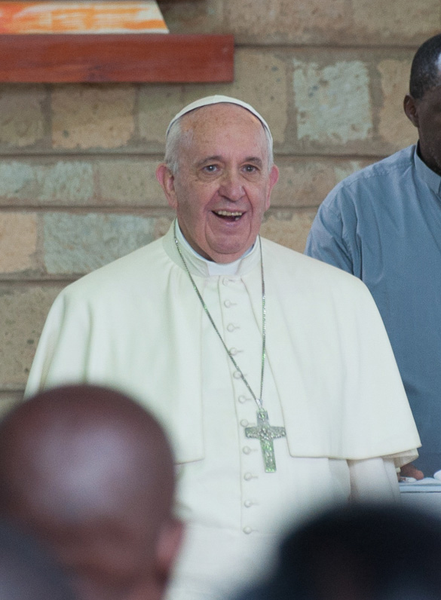
…What can we do? How can I help? What is God asking of us at this time? In asking these questions – perhaps before a lit candle – we open ourselves to the action of the Spirit. We can start to discern, to see new possibilities, at least in the little things that surround us.
…As we commit to these small things, we start to imagine another way of living together… We can begin to dream of real change, change that is possible.
“
Pope Francis,
Let Us Dream, pp.19-20.

Slide 12
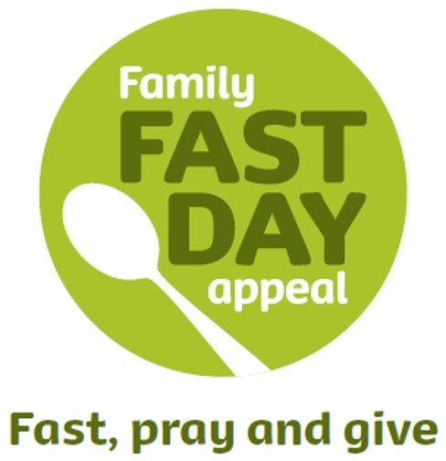
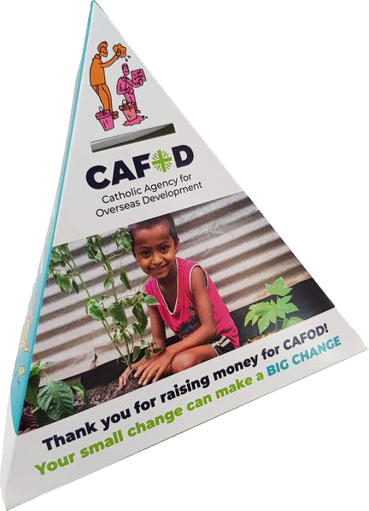
CAFOD Family Fast Day
Harvest Fast Day
first Friday in October
Lent Fast Day
Friday in the week following Ash Wednesday
Notes:
Family Fast Day still happens twice a year, once in Lent and once at Harvest, when every Catholic parish in England and Wales is asked to fast and donate to CAFOD.
Many Catholic schools fundraise too.
CAFOD uses the donations to work in solidarity alongside communities around the world that are tackling poverty and injustice.

Slide 13

Choose one activity:
Adapt CAFOD Lent assembly materials to prepare your own assembly for another class in school. (cafod.org.uk/secondary/lent)
Prepare a set of corridor posters that explain and encourage participation in our school’s Fast Day activities.
Write an insert for the school website or newsletter to explain and encourage participation in our school’s Fast Day activities.

Slide 14
Illustrations: Ellis Nadler
Photographs: CAFOD
Notes:
(Review the learning objectives on slide 3)

