Slide 1

Walking Together

Slide 2
Learning Intentions
Understand
Understand what Church means.
Know about
Know about the ‘Synodal’/Listening Event that is happening in our Diocese.
Listen
Listen to Bishop Martin’s message about the Listening Event
Understand
Understand how you can contribute.
Complete
Complete a survey

Slide 3

Lesson starter

Slide 4

What is the question….
Can you think of a question where the answer is Church!

Slide 5

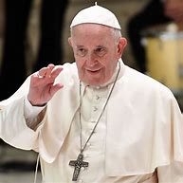


Is Church?

Slide 6
Church is more than a building…
Everybody makes up the Church and we need to work together in the future to make the Church a place where all are included and can have their voice heard
It is also important that we give back to the Church and think of ways that we can help make the Church a place for all.
But

Slide 7

There is a Listening process taking place
A two-year listening and conversation experience is taking place in the Catholic Church from October 2021 and ends with a meeting of Bishops in Rome in October 2023.
The overall theme is Communion, Participation, Mission".

Slide 8

It’s an invitation for us, as Catholics, to ‘walk together’ and every member of the Church has the right to speak.

Slide 9
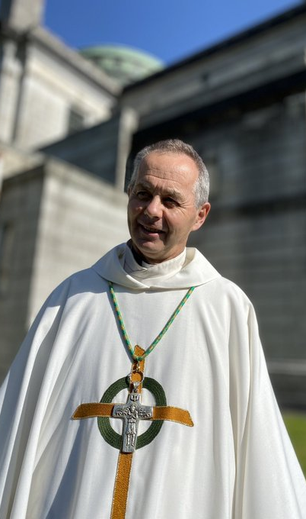
Let’s Listen to Bishop Martin talking about the experience https://www.dropbox.com/sh/f6atxj91y8ibefp/AAAuMk1Ouwr2h4FqvHyj_yvya?dl=0

Slide 10

Give me 5
What 5 key points (or more) can you remember from the video

Slide 11

Let’s Complete the survey

Slide 12
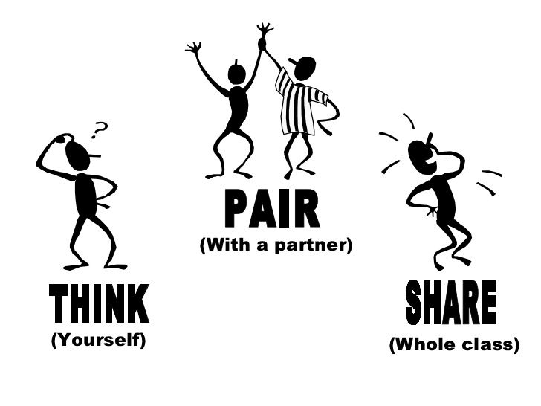
Let's have a look at the questions – what are they asking us?

Slide 13

How has faith helped you in your life?

Slide 14
How can the Church support and encourage more active participation in parish life?

Slide 15

How can the opinions of the laity, especially women and young people, be listened to?

Slide 16
How can we Christians address the issues that trouble our society?

Slide 17
What is the Holy Spirit asking of us now?

