Slide 1
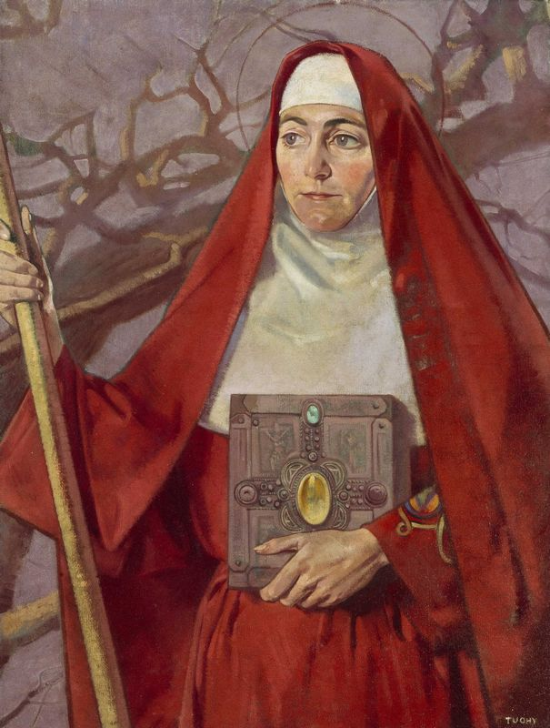
Prayer Service
Feast of St Brigid

Slide 2
Saint Brigid of Kildare
Reflection:
Reader 1. It is the beginning of spring, the 1st of February. The birds are beginning to gather material for their nests; there is a promise of new light and new life in nature. Become aware now of this promise of new growth and life. Put yourself in some outdoor scene, somewhere in the country. See the hills, the bare trees, which shortly will have some little growth as evidence of spring. See the grass, the sun, the sky, and the clouds against the blue of the distant mountains. Spring is a time of hope and a time of promise. Feel that hope and that promise deep within you.
Today, the 1st of February we celebrate the Feast of St. Brigid, “Mary of the Gaels”.

Slide 3
Reader 2. Today we give thanks for all the good things in nature, for the rain that keeps the land fertile, for the grass that grows lush and feeds the herds, for the fruits and vegetables that grow so bountifully, for the soil that nourishes them, for the frost that breaks the clay and helps aerate it, for the fresh air we breathe that sustains our life, for the fruits we eat from the branches and bushes, for the milk we drink, for the flour that comes from the grain and for the bread that we eat. For all this we are thankful. Without the bounty of nature we would be unable to survive.

Slide 4
Reader 3. “Anois teacht an earraig
beidh an lá ‘dul chun sineadh,
is tar éis na féile Bríde
ardóidh mé mo sheol.”
Raftery’s famous poem shows the importance of St. Brigid in our country’s ancient tradition. The Feast of St. Brigid, at the beginning of spring, was the start of the farmer’s year. St. Brigid was connected with everything relating to the provision of food, especially where cattle and milk were concerned. In Scotland, women had great devotion to her during pregnancy.

Slide 5
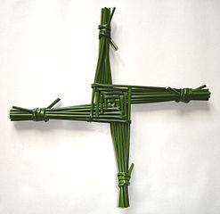
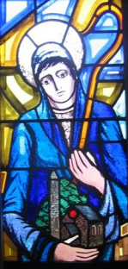
Place the St. Brigid’s Cross on the table.

Slide 6
Blessing of St Brigid’s Cross.
We gather today on this feast of St Brigid, our ancestor in the faith of Ireland to bless this cross of reeds which we have fashioned in an age-old manner to remind us of your love for the world shown so especially in the ministry of your Son.
As we sprinkle this cross with blessed water, we ask you to bless it along with all those gathered here this evening and we pray that through the intercession of St Brigid we may be always faithful disciples of your Son. In the name of the Father who creates all life, and the name of the Son who showed us how much you love us, and in the name of the Holy Spirit who prays in our hearts always. Amen.

Slide 7
Litany to St Brigid for her Feast Day
St Brigid, faithful disciple of Jesus, pray for us
R/ Brigid Mhuire na ngael bring our prayer to God.
Woman of compassion and mercy
R/ Brigid Mhuire na ngael bring our prayer to God.
Daughter of Faughart and servant of the poor.
R/ Brigid Mhuire na ngael bring our prayer to God.
Abbess and founder of the Monastery of Kildare, leader of Christ’s broken ones
R/ Brigid Mhuire na ngael bring our prayer to God.
Lover of nature, one with the whole of creation.
R/ Brigid Mhuire na ngael bring our prayer to God.

Slide 8
Woman of deep faith and courage
R/ Brigid Mhuire na ngael bring our prayer to God.
Flame of Justice
R/ Brigid Mhuire na ngael bring our prayer to God.
Healer of the sick and infirm
R/ Brigid Mhuire na ngael bring our prayer to God.
Teacher of prayer and reflection
R/ Brigid Mhuire na ngael bring our prayer to God.
Model of holiness and good living
R/ Brigid Mhuire na ngael bring our prayer to God.

Slide 9
Lover of Christ and servant of outcasts
R/ Brigid Mhuire na ngael bring our prayer to God.
Patron of our Land and its peoples
R/ Brigid Mhuire na ngael bring our prayer to God.
All / St Brigid, Mary of the Irish, May we be with you in God’s Kingdom amen.

Slide 10
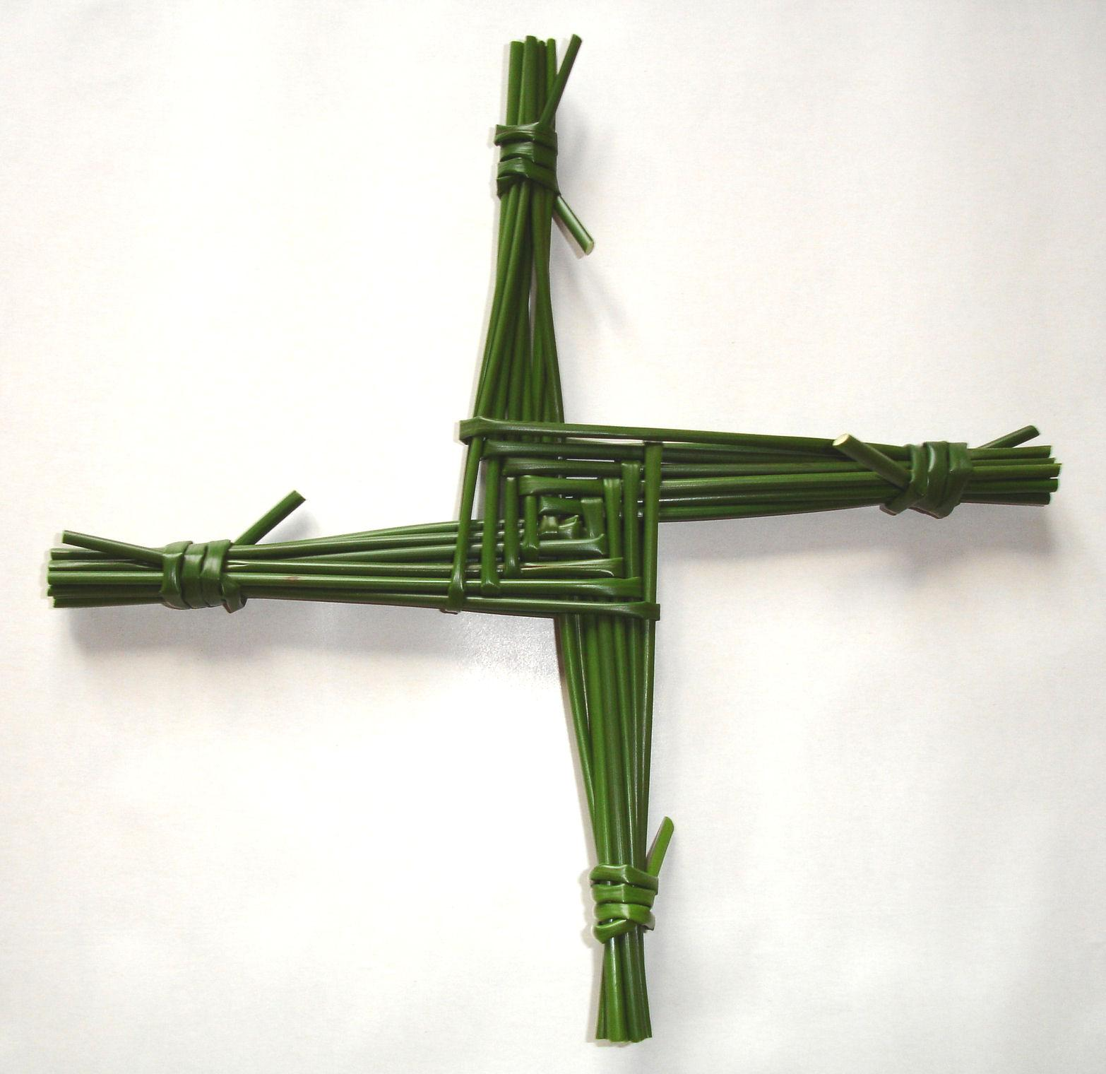
Reader 4. May the blessing of the Father, Son and Holy Spirit
be on this Cross and on the home in which it is found
and on every person who looks upon it.
Then the St. Brigid’s Cross is hung on the wall or over the door.

Slide 11
All: We are under the protection of Brigid each day.
We are under the protection of Brigid each night.
Brigid is our companion, our musician, our helper,
our chosen one.
May we be under the protection of God and St. Brigid.
May we have her protection, since this is her day.

Slide 12
Reader 5. Scriptural Reflection:
(Luke 8:5-8)
A sower went out to sow seed. As he sowed, some fell on the edge of the path and was trampled on; and the birds of the air ate it up. Some seed fell on rock and when it came up, it withered away, having no moisture. Some seed fell amongst thorns and the thorns grew with it and choked it. And some seed fell into rich soil and grew and produced its crop a hundredfold. Saying this Jesus cried, “Listen anyone who has ears to hear!”
Imbolc: Ode to Brigid

Slide 13
Conclusion:
Prayer to St. Brigid
You were a girl of generous spirit.
R. Brigid, give us generosity.
You were a woman of courage.
R. Brigid, give us courage.
You were nurse to the sick.
R. Brigid, give us tenderness.
You were comfort to the aged.
R. Brigid, give us loyalty.
You were a leader of men and women.
R. Brigid, give us energy.
You lit a fire that never quenched.
R. Brigid, give us welcome.
You built a church with finest oak.
R. Brigid, give us prayer.

Slide 14
As once you took in hand the wild rushes of the field and folded them in the manner of a cross, so now inspire us to be creative and to take things of daily life and mould them into something beautiful for God.
Blessing:
May the Lord bless us with his Peace,
May He lead us to live our life to the full. Amen
An Irish Blessing

