Slide 1

Advent

Slide 2
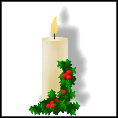
Advent is a season which prepares the
Christian church for the celebration of the
birth of Jesus Christ.
Advent begins on the Sunday nearest to
30th November.
The word 'advent' come from the Latin word
‘adventus', which means ‘coming’ or ‘arrival.’
Christians regard this time as one of
reflection and penitence in preparation for
Christmas.

Slide 3
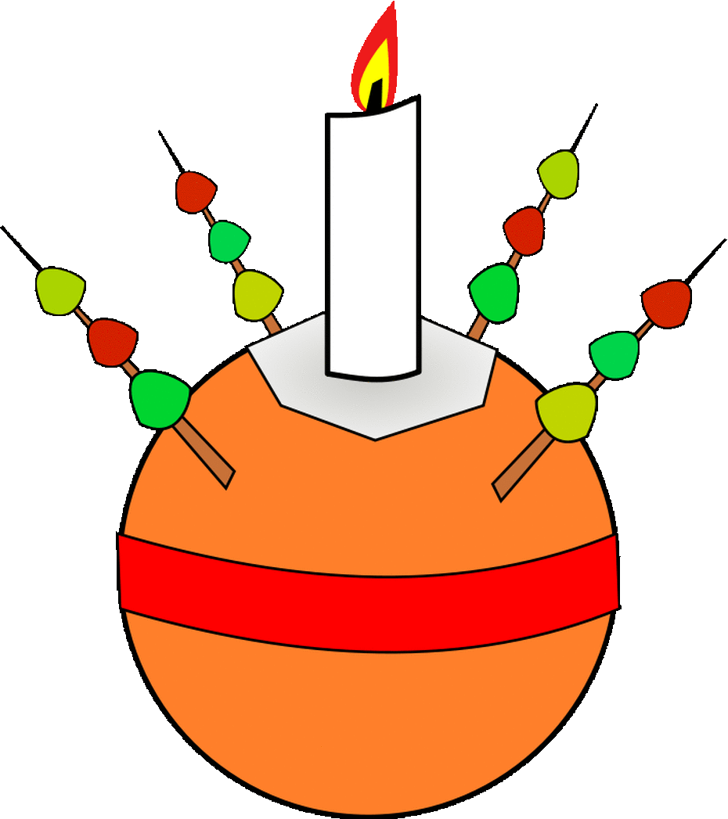
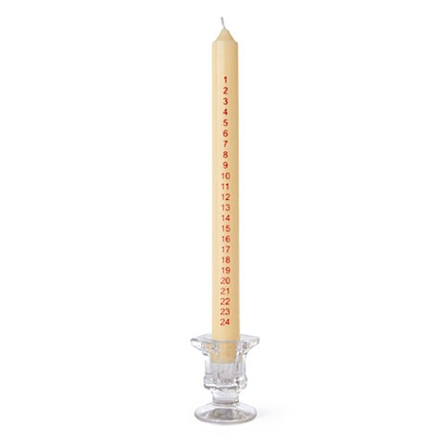
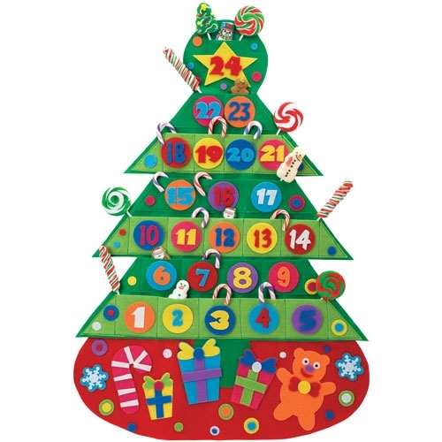
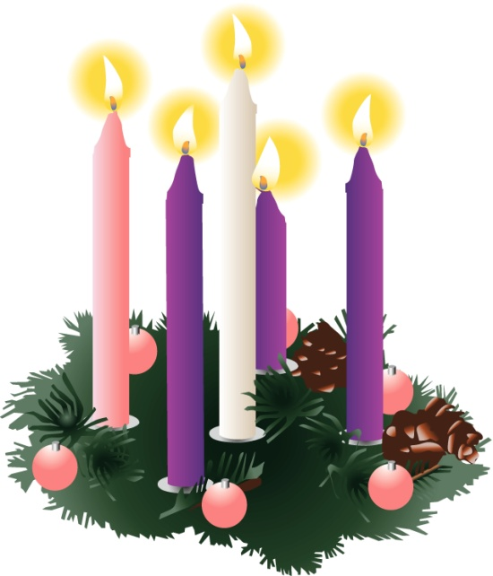
There are lots of different ways of observing Advent:
Christingles
Advent calendars
Advent candles
Advent wreaths/rings

Slide 4
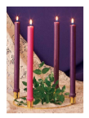
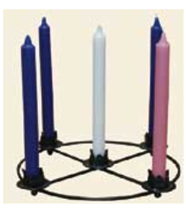
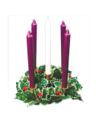
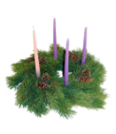
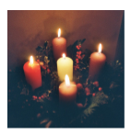
There are lots of different Advent Rings:
The different colours are very important.
What do you think they
might mean?

Slide 5
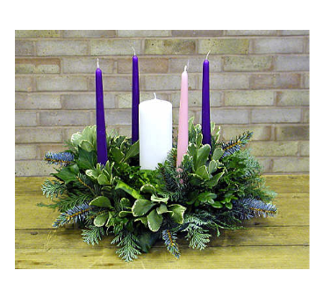
Each part of the Advent Ring has a different meaning.
Fifth Candle
This candle represent Jesus Christ. It is lit on Christmas Day to show that Christians believe that Jesus is the light of the world.
First Candle
The first candle is called the candle of HOPE. This candle symbolises the hope Christians have in Jesus Christ.
Fourth Candle
The fourth candle is called the candle of LOVE. This candle symbolises the love Christians have for Jesus Christ.
Second Candle
The second candle is called the candle of PEACE. This candle symbolises the peace Christians feel by having Jesus in their lives.
Third Candle
This candle is called the candle of JOY. This candle symbolises the joy Christians feel by having Jesus in their lives.
The Wreath
It is a circle made of evergreen leaves and branches. It symbolises life, hope and the eternity of God.

Slide 6
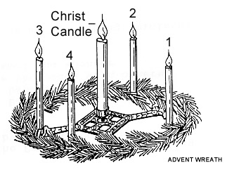
LO: To understand and explain the symbolism of the Advent Ring.

