Slide 1
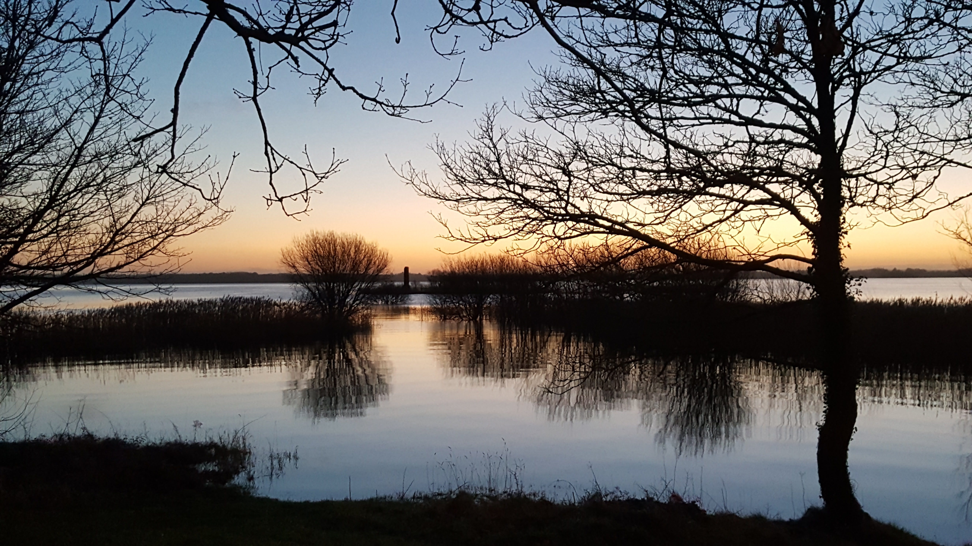
We Remember Them
November 2021

Slide 2
Learning Intention
To examine the role that remembrance has played and continues to play for us as we journey through the COVID-19 global pandemic and to explore the power of memories for each of us.

Slide 3
Success Criteria

Slide 4
Keywords
Remembrance
Global Pandemic

Slide 5
Global Pandemic
Everyone had to re-evaluate the things that were important
People started to remember ‘the good old days’
People remembered the people that were most important to them

Slide 6
Reflective Exercise
Of all the people you couldn’t visit during the COVID-19 lockdowns, who did you think of or remember most often?
What did you miss about them?
How did you let them know that you were thinking about them?

Slide 7
Watch

Slide 8
Write in your copy…

Slide 9
20th Anniversary of 9/11

Slide 10

Sean
Serena

