Slide 1

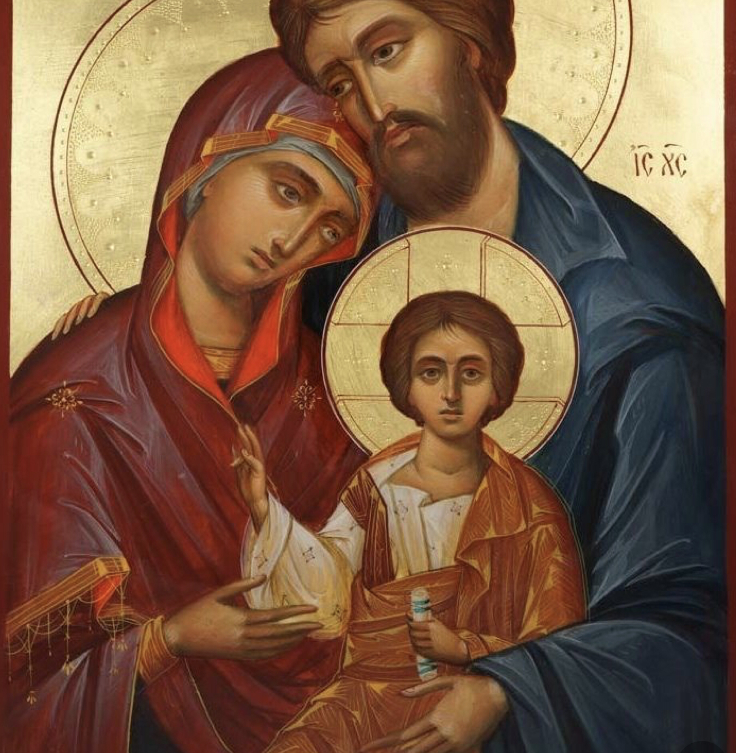
The year of st joseph
Learning intentions:
Pupils will be able to –
Know who st Joseph was
Understand the importance of Joseph in the life of the church
Show reverence for st Joseph through participation in liturgy

Slide 2
Why has Pope Francis announced the year of St Joseph?
On January 16th 2015 Pope Francis gave a speech about his devotion to St Francis.
With the Apostolic Letter “Patris corde” (“With a Father’s Heart”), Pope Francis recalled the 150th anniversary of the declaration of Saint Joseph as Patron of the Universal Church.
To mark the occasion, the Holy Father proclaimed a “Year of Saint Joseph” from 8 December 2020, to 8 December 2021.
March 19th Is the Feast of St Joseph, and it held special importance in 2021. There is not just a feast day to remember to St Joseph – but an entire year to reflect and give thanks to St Joseph for all he did to support Our Lady and Christ.

Slide 3
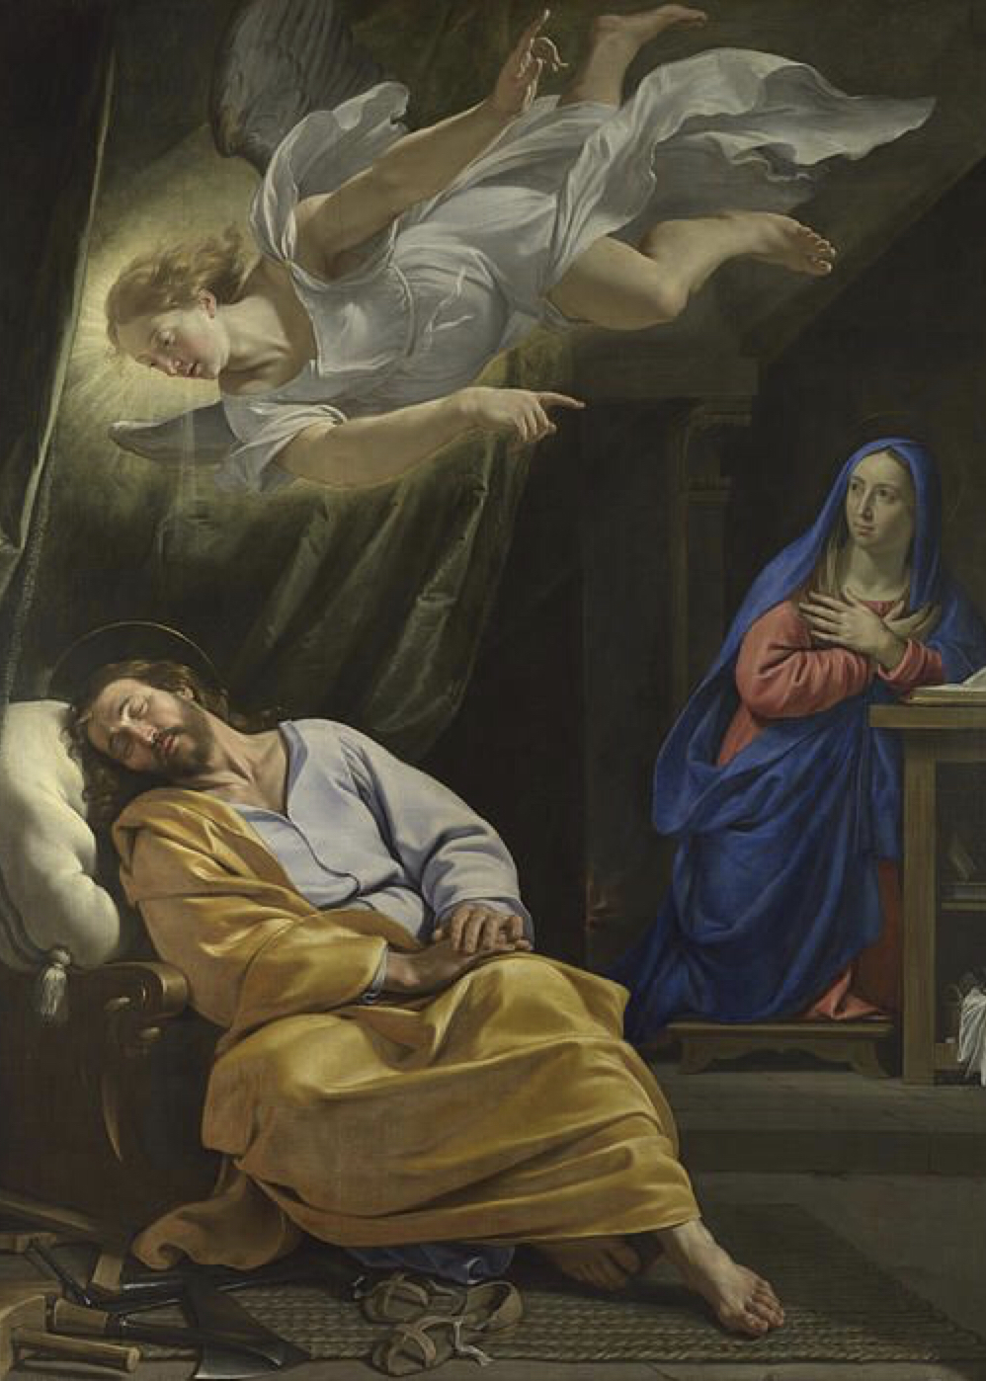
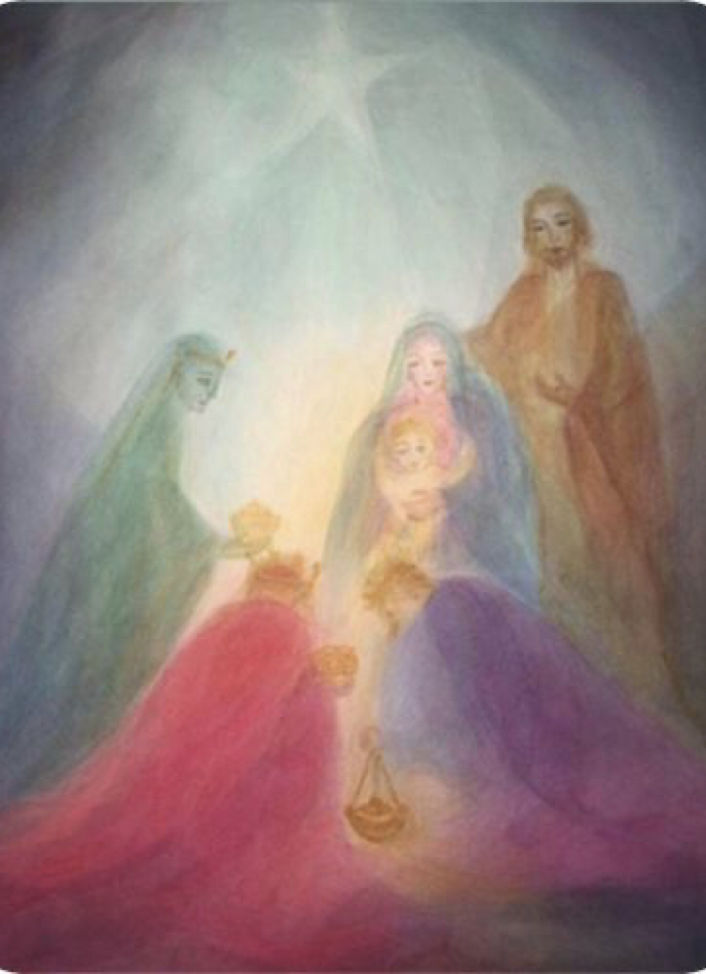
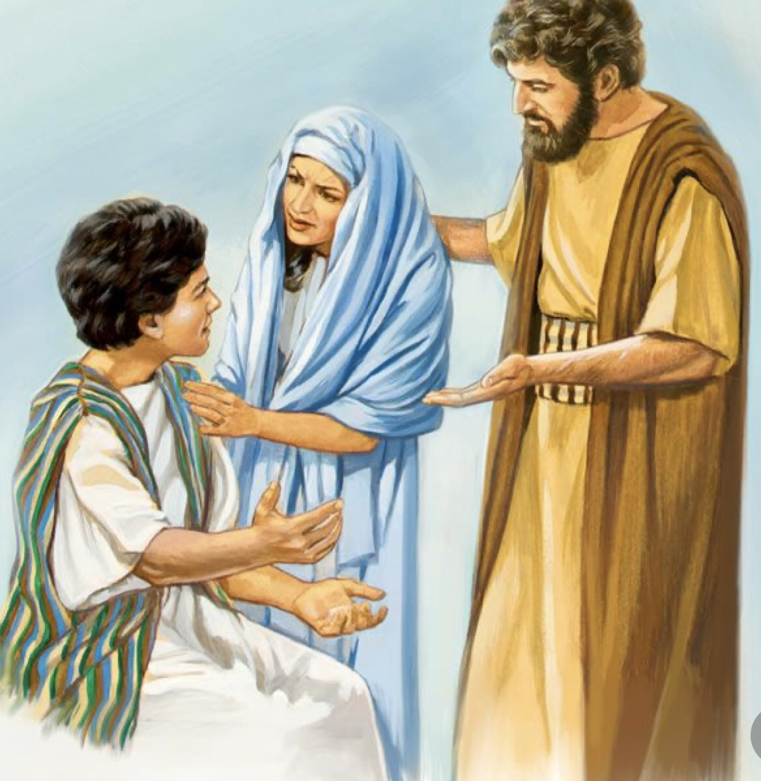
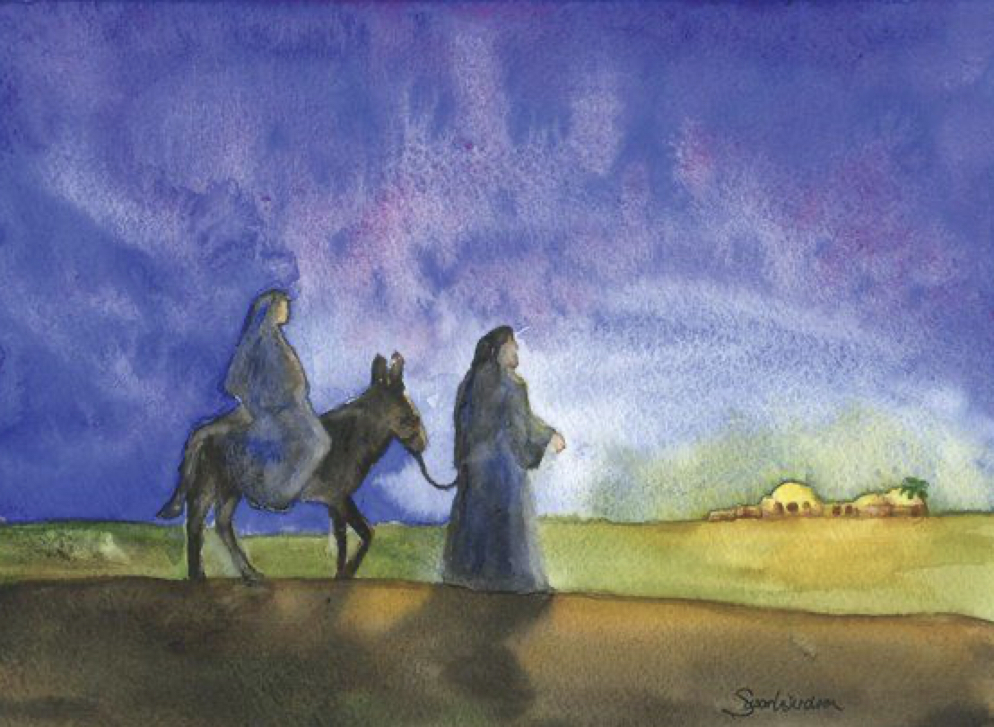
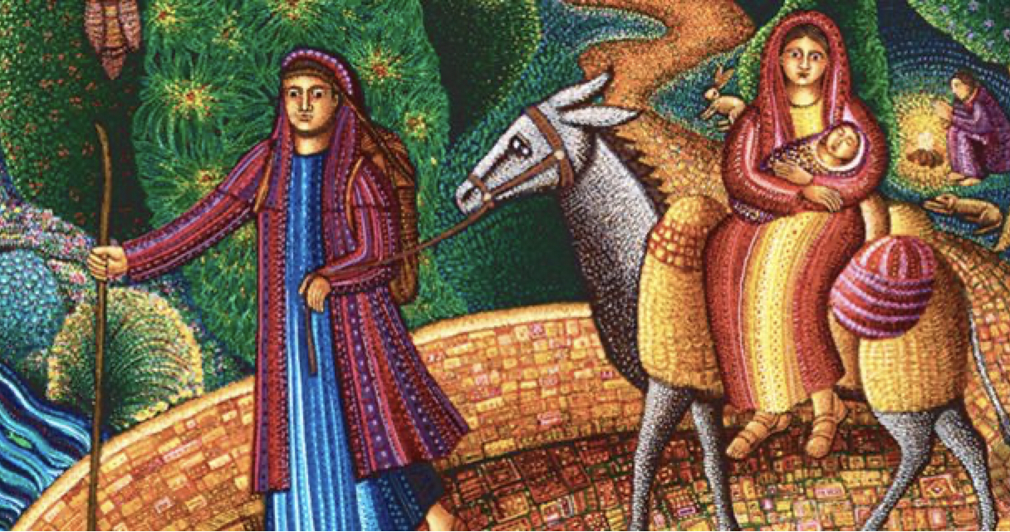
What does the Bible tell us about st Joseph?

Slide 4
For you to do!
Go to the worksheet entitled “What does the Bible tell us about St Joseph?” and complete the tasks.

Slide 5
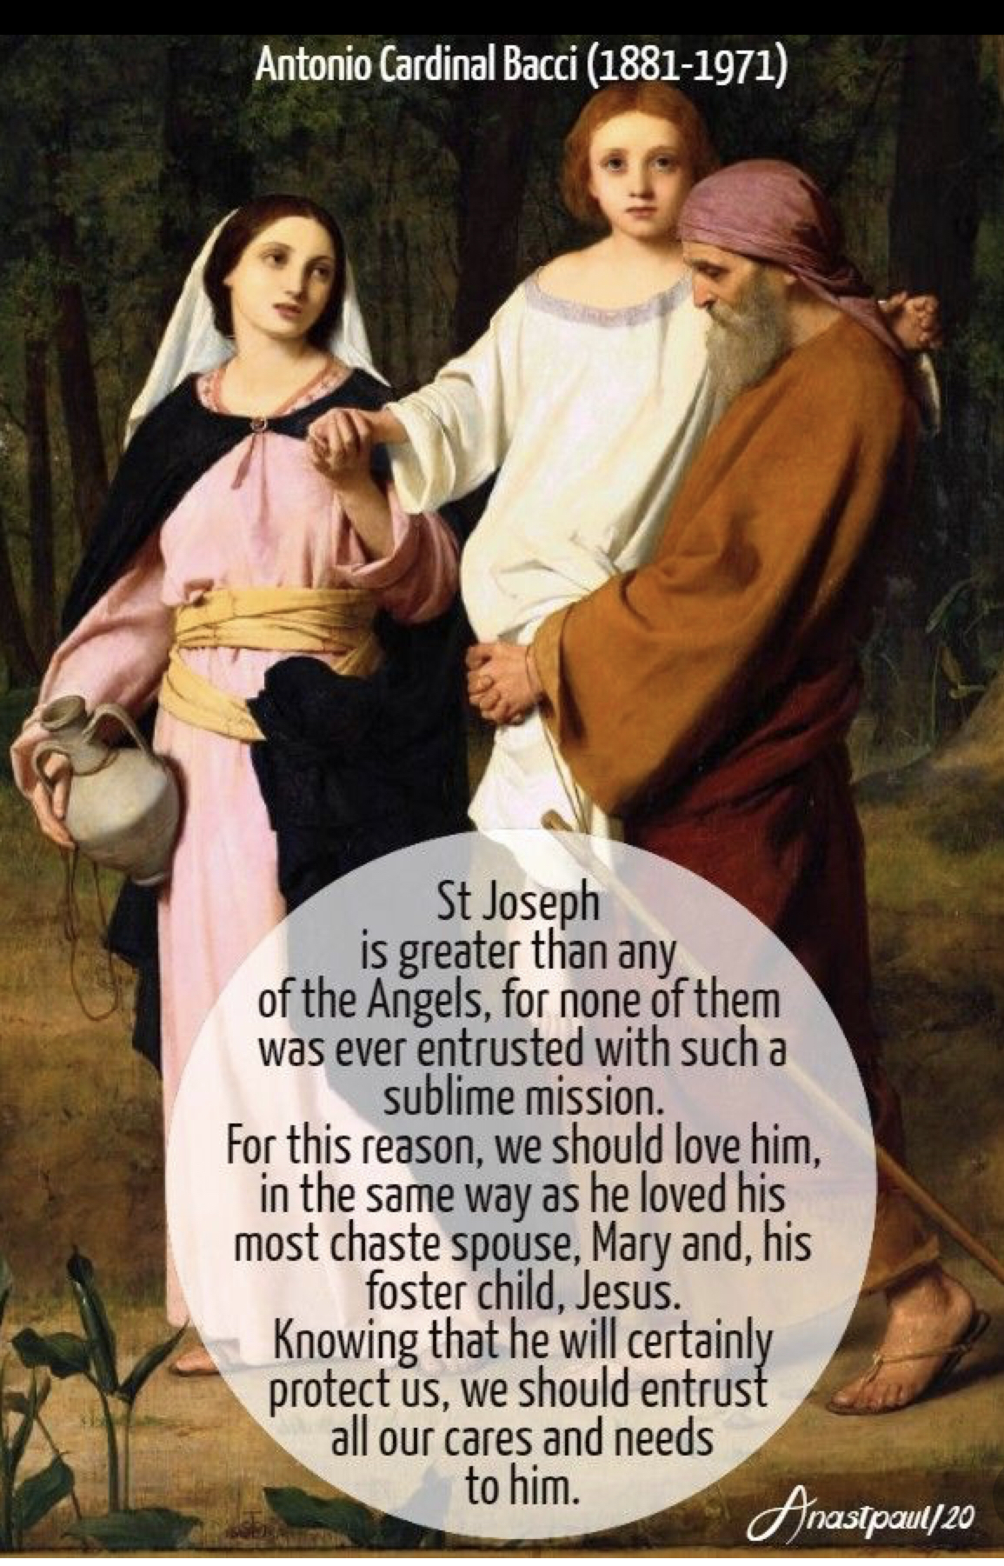
The church and st joseph

Slide 6
Some Facts about st joseph
Born in Bethlehem (exact date unknown). He is believed to have been a descendent of King David. This is very important as the Messiah that the Jews were waiting on was to be from the royal line of David.
Died in Nazareth, July 20, AD 18 (Church tradition). There is no mention of Joseph in the Gospels after the account of Jesus being lost in the Temple, aged 12.
Saint’s Day March 19 – Saint Joseph, Husband of Mary (Western Christianity), May 1 – St Joseph the Worker (Roman Catholic Church),
Images associated with St Joseph: Carpenter’s square or tools, the infant Jesus, staff with lily blossoms, two turtle doves, rod of spikenard.
Patron Saint of: Universal Church, unborn children, fathers, immigrants, workers, employment, travellers, carpenters, realtors, against doubt and hesitation, and of a happy death, Canada, Croatia, Korea, Zapotlan, Vietnam, Mandaue City, Cebu, Philippines, and many others.

Slide 7
For you to do!
Complete a factfile on St Joseph.

Slide 8
What does Pope Francis say?
The Holy Father wrote Patris corde against the backdrop of the Covid-19 pandemic, which, he says, has helped us see more clearly the importance of “ordinary” people who, though far from the limelight, exercise patience and offer hope every day.
In this, they resemble Saint Joseph, “the man who goes unnoticed, a daily, discreet and hidden presence,” who nonetheless played “an incomparable role in the history of salvation.”

Slide 9
For you to do!
In the Roman Cathoilic Church we use images and prayers to show devotion to Saints.
A triptych is a work of art that is divided into three sections.
Use the worksheets provided to create your own St Joseph triptych.

Slide 10
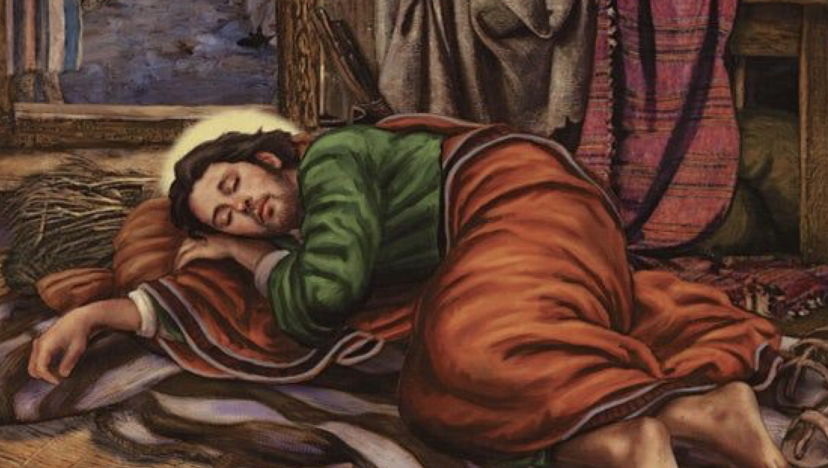
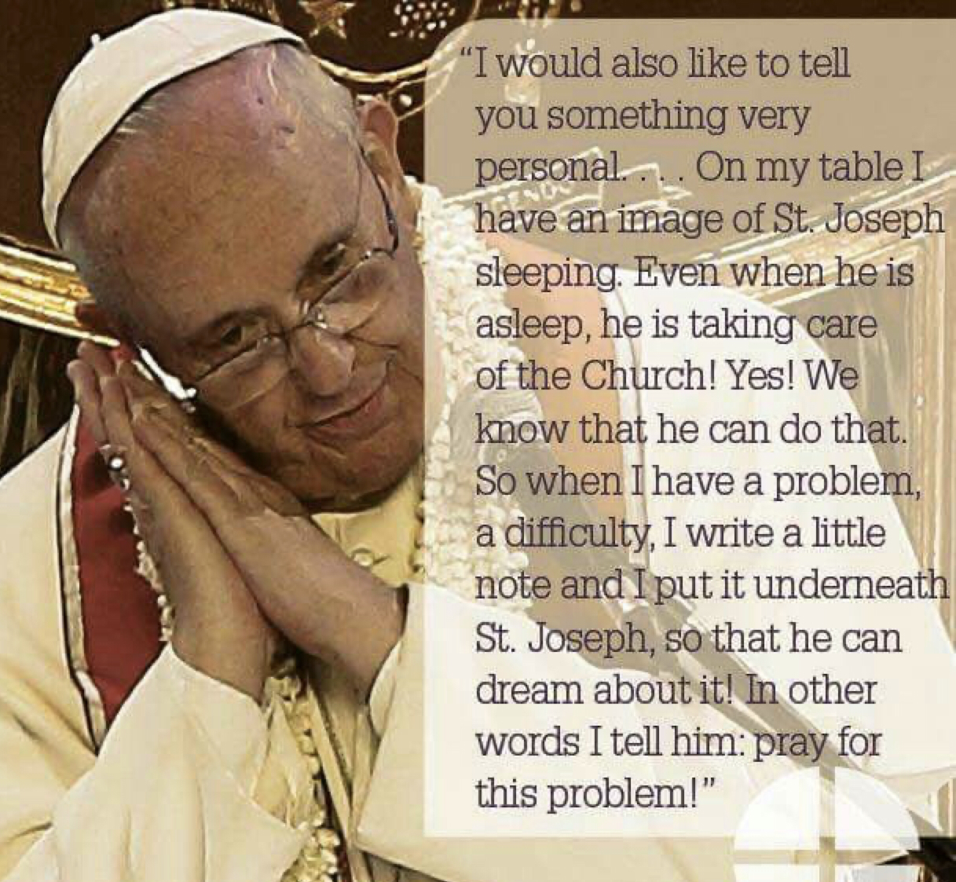
The sleeping st joseph

Slide 11
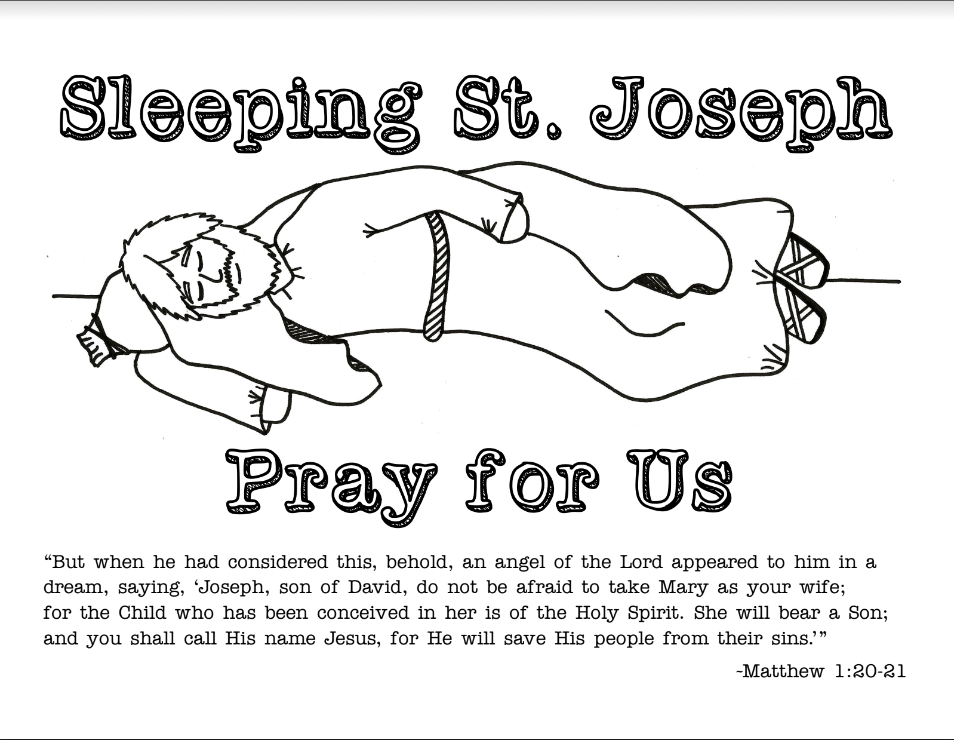
For You To Do!
Colour, fold and tape the sleeping st joseph image to create a prayer pillow.

Slide 12
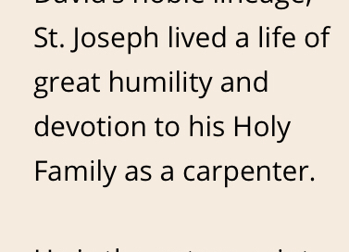
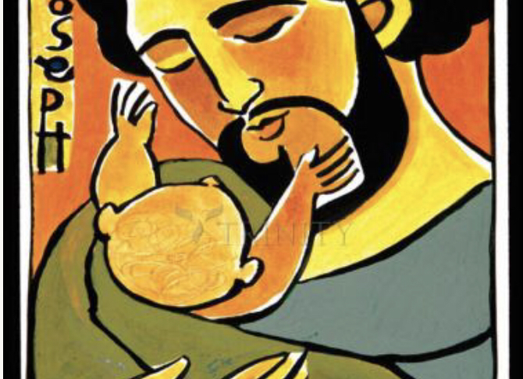
St Joseph: an example of true faith.

Slide 13
How did St Joseph Show His Faith in God?
Obedience
When Joseph learned that Mary was to give birth to the Son of God, he faithfully obeyed God and married Mary. He listened to God’s Angel and believed that Mary had been given the task of being the Mother of God’s Son.
Fatherhood
Faith
Joseph was an faithful Jew. In the Gospels we learn that he followed the Jewish laws, for example when he presented Jesus in the Temple, and when he brought Jesus to the Temple at the age of 12
Protector
St Joseph raised Jesus as his own Son, and made sure both Mary and Jesus were looked after and provided for throughout his lifetime. He taught Jesus how to be a carpenter. The Gospel’s do not record Joseph actually speaking. This shows he was a good husband and father, as he let Mary make all the important decisions.
After the Annunciation, Joseph kept Mary safe when he married her. He also kept both Mary and Jesus safe when he followed the Angel’s instructions to flee into Egypt to avoid Herod’s plans to kill all new born baby boys in Bethlehem.

Slide 14
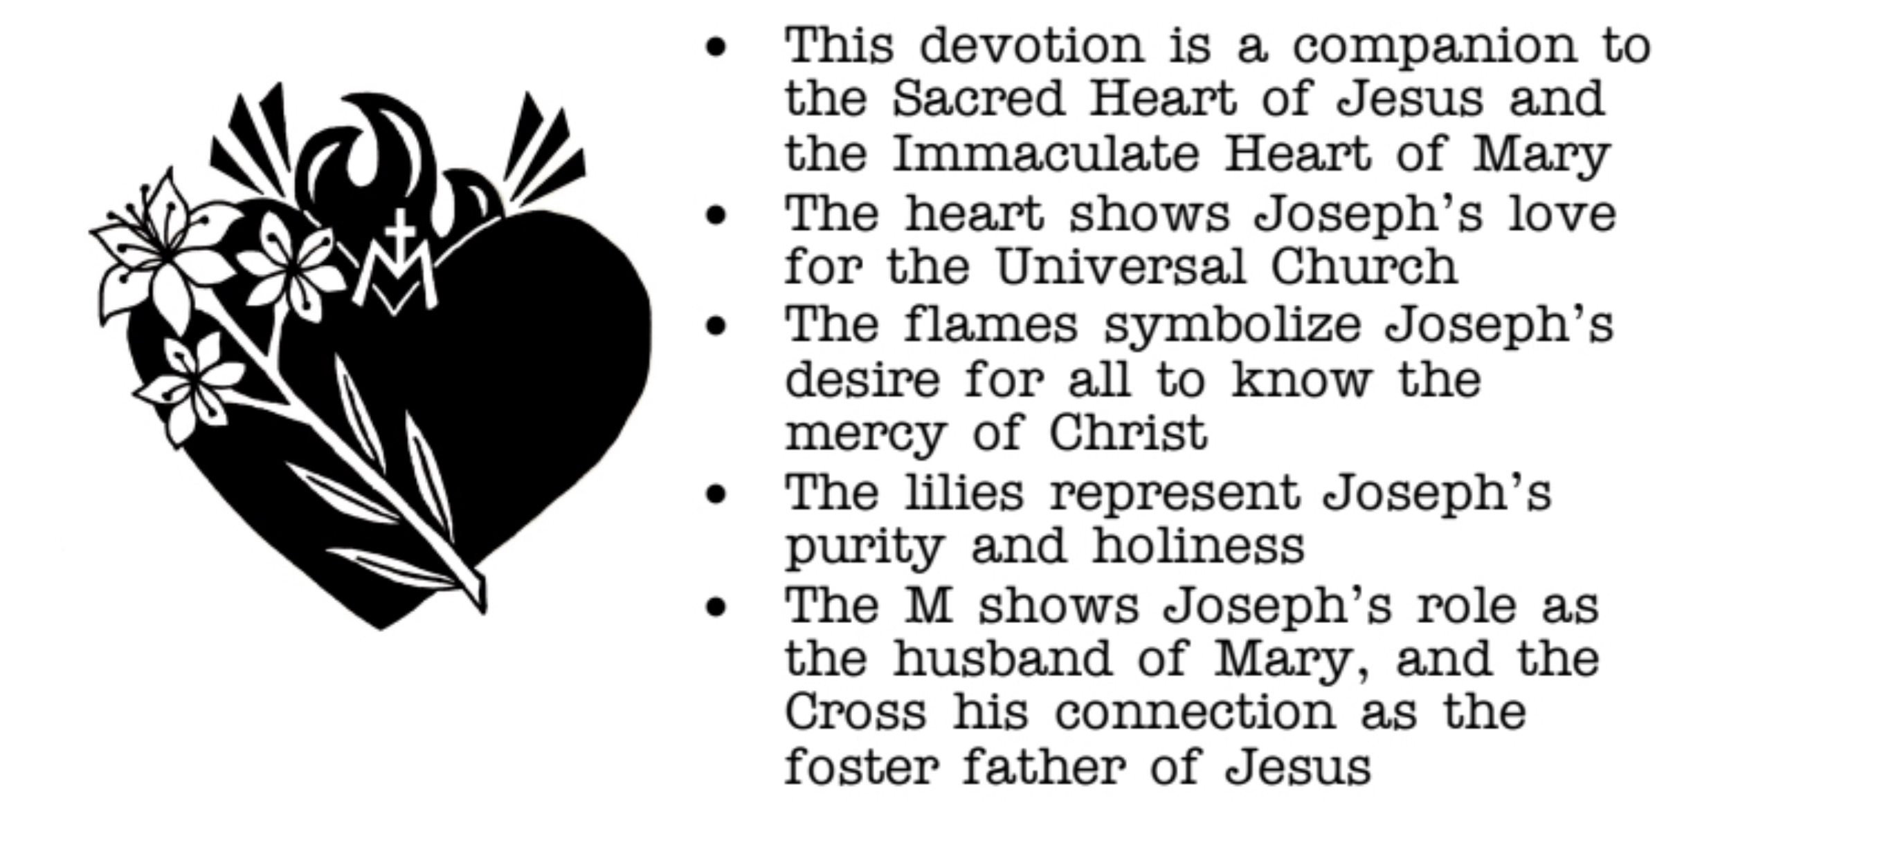
Symbols of the Pure Heart of St Joseph

Slide 15
For You To Do!!
Show your understanding of the meaning of the symbols of the pure heart of St Joseph by labelling the diagram in the worksheet.

