Slide 1
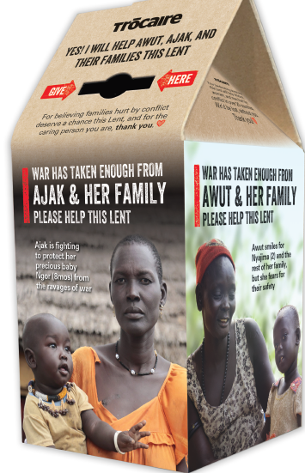
Trócaire Lent Campaign 2021

Slide 2
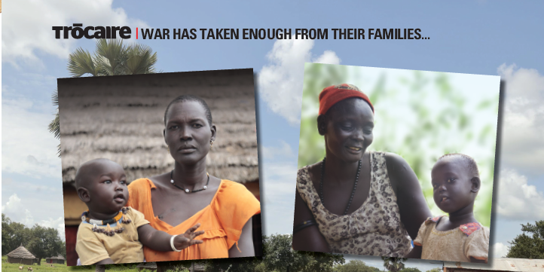
Ajak and her precious baby Ngor (8 months), Awut and her sweet granddaughter Nyajima (2)
Notes:
Awut and her family fled brutal armed conflict in South Sudan, running for their lives for days without food and water. They lost nearly everything. Then Awut met another mother with even less. Awut welcomed Ajak and her children. The two mothers forged a friendship and work hard to keep their families safe. But they are caught in poverty. Covid lingers, and the awful violence continues.

Slide 3
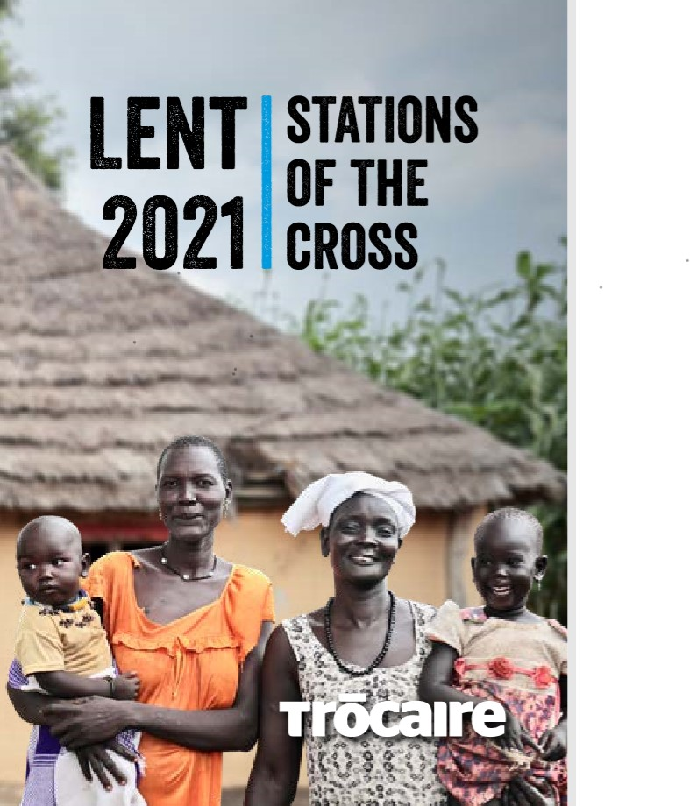
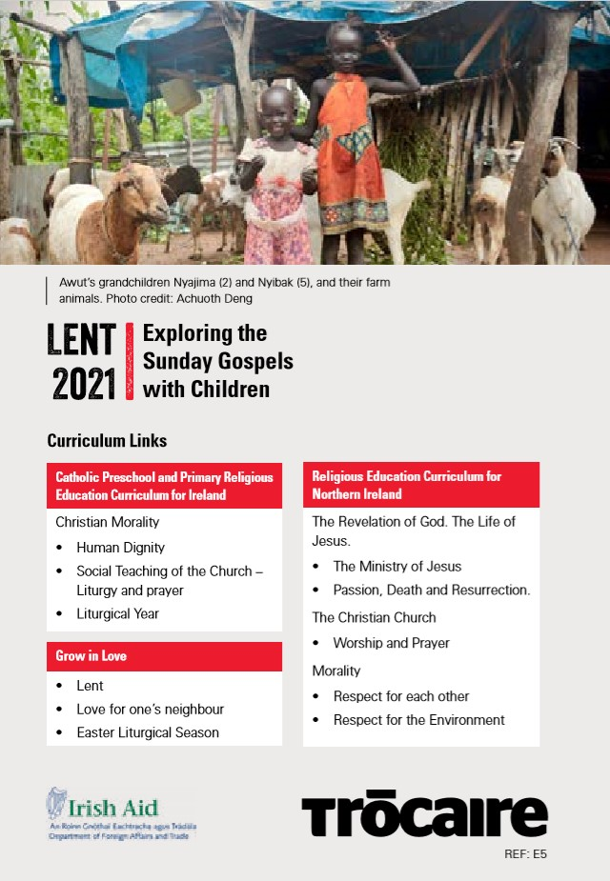
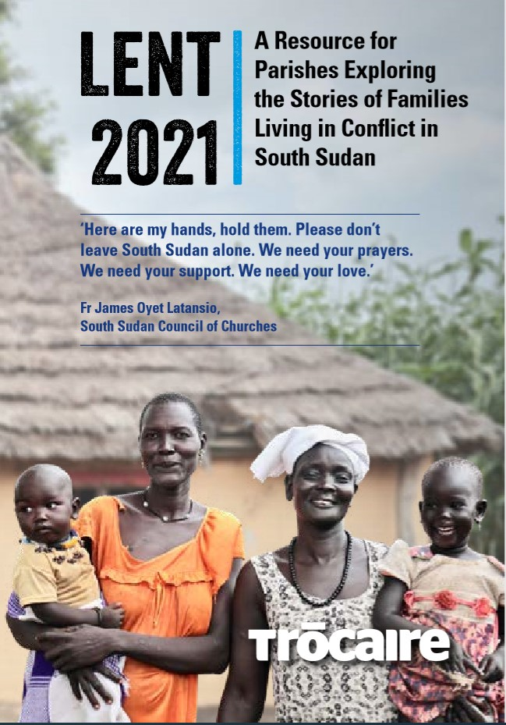
Trócaire Parish Resources-available on our website-trocaire.org

Slide 4
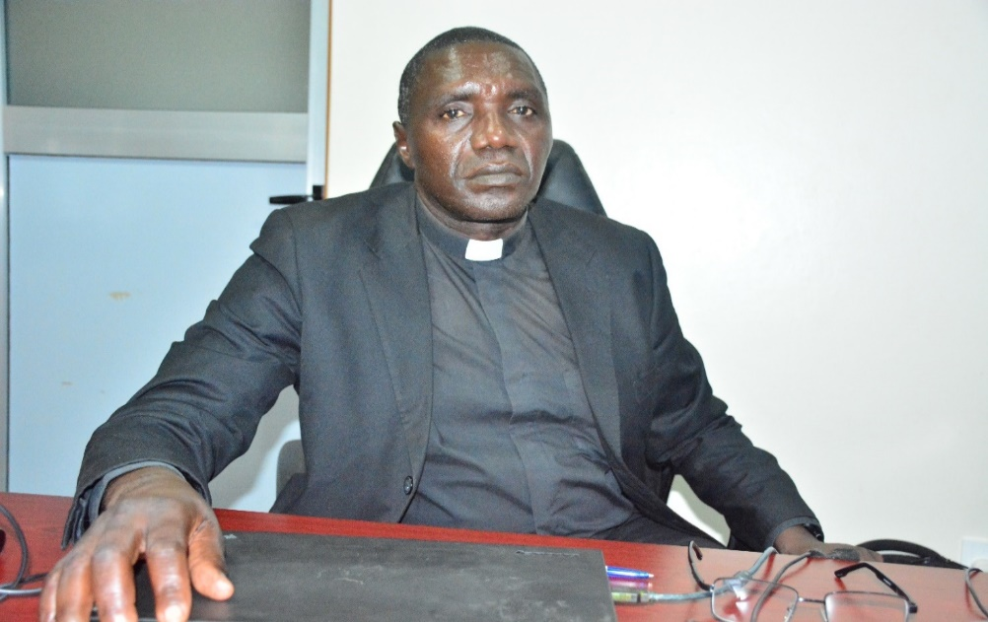
Fr.James Oyet Latansio General Secretary, South Sudan Council of Churches (SSCC) Photo Credit: Achuoth Deng
Photo credit:Achuoth Deng
Here are my hands, hold them. Please don’t leave South Sudan alone. We need your prayers. We need your support. We need your love.”

Slide 5
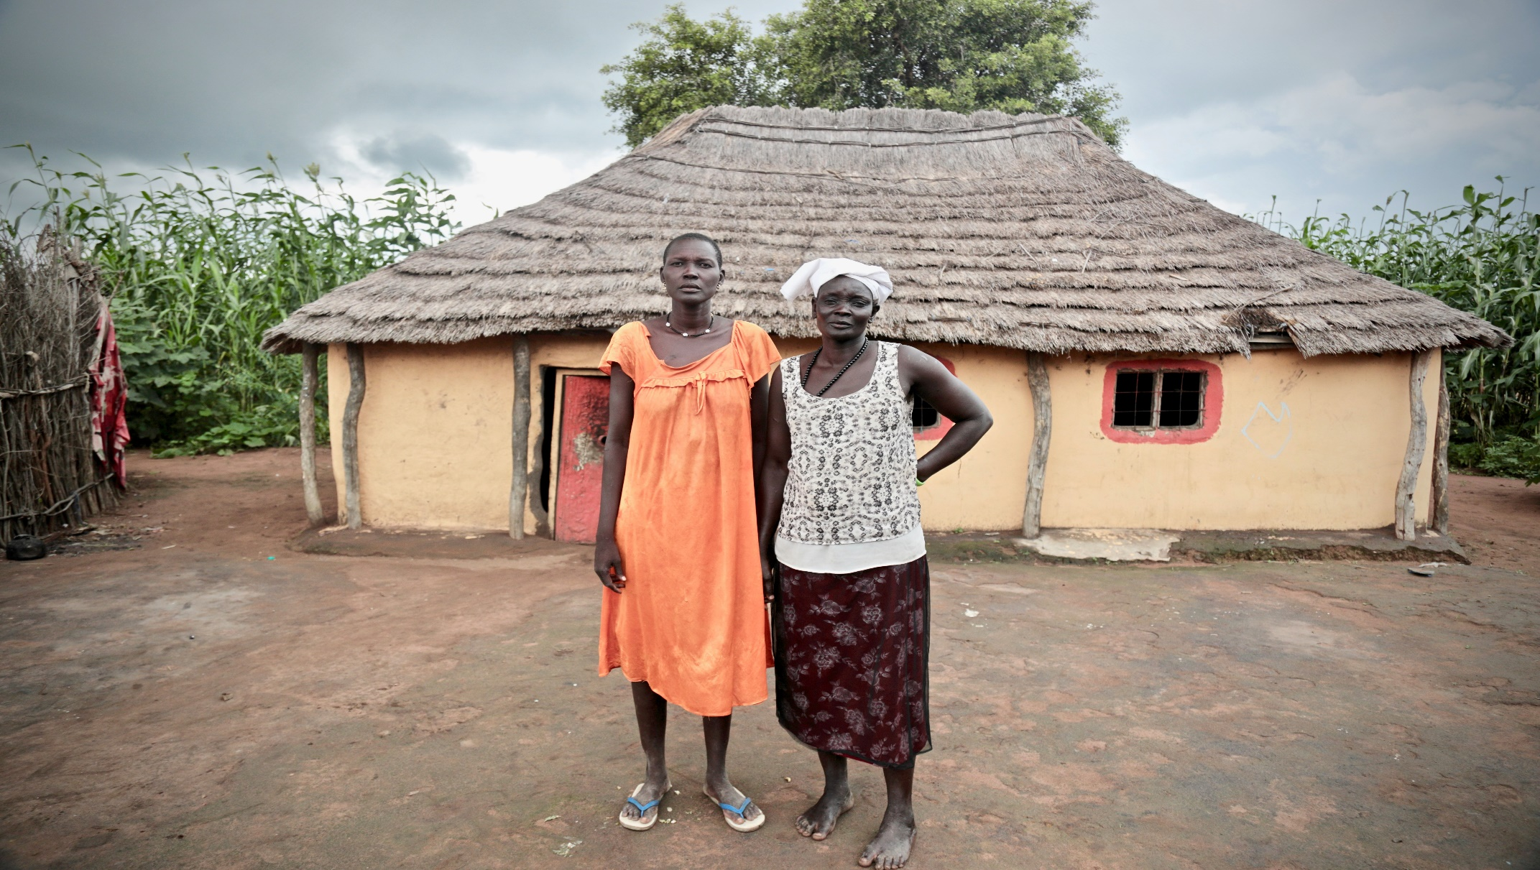
Ajak and Awut in their village community, helping each other and working together for their families
Photo credit: Achuoth Deng

Slide 6
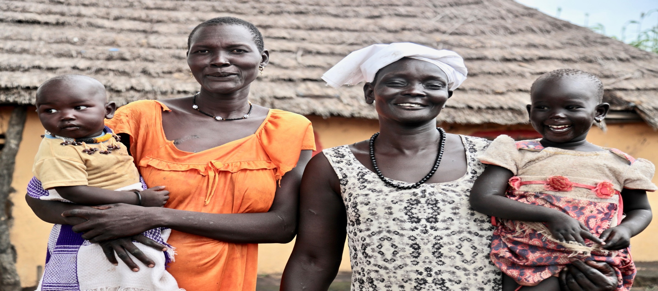
Ajak with her son Ngor(8months) and Awut with her granddaughter Nyajima(2)
Photo credit: Achuoth Deng

Slide 7
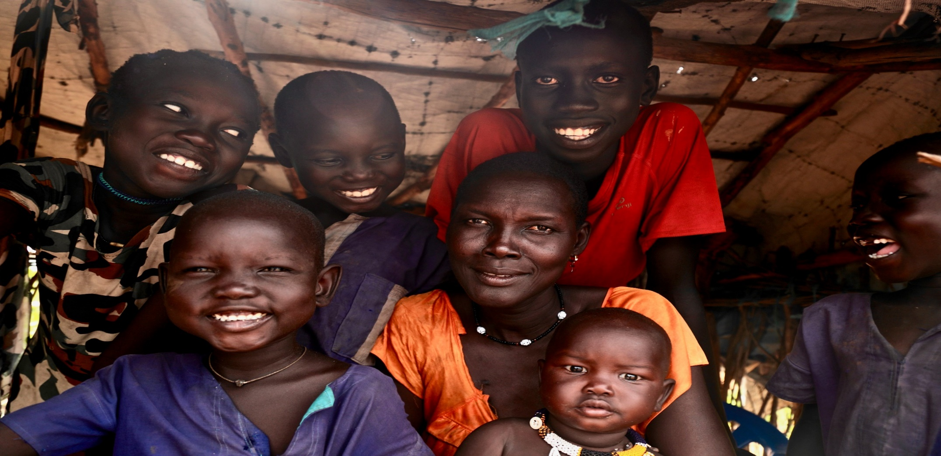
Yojima(11), Pawany(7),Majak(4),Chiech(6),Malong(14) and Ngor(8 months) with their mother Ajak
Photo credit: Achuoth Deng

Slide 8

UK Aid Match, NI region
This year, the Lent campaign is part of UK Aid Match, meaning public donations given by 16 May 2021 will be doubled by the UK government, up to £2m.
Furthermore, if a donor signs up for a monthly gift, or increases their monthly gift, before the 16th May 2021, up to three of their instalments will be matched!
Donations must be returned to Trócaire by 1st July in order to qualify for matched funding.

Slide 9
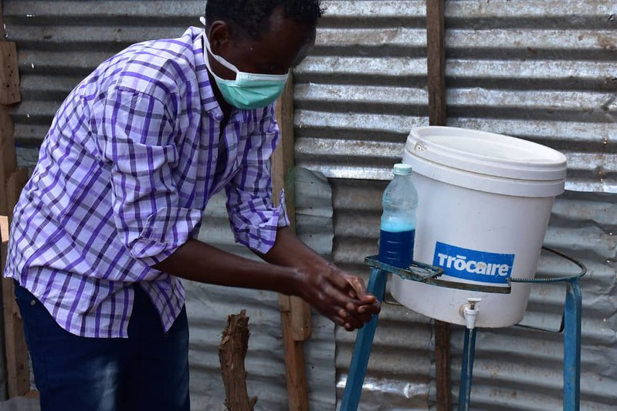

TRÓCAIRE THANKS IRISH AID FOR VITAL COVID-19 SUPPORT
Irish Aid has provided Trócaire with €230,000 to support this work. Over half of this grant - €125,000 – will fund our health programmes in Somalia. In Mynamar,Ethopia,Uganda, South Sudan ,DRC and Syria, where Irish Aid funds will support Trócaire, our response is focused on preventing the spread of the virus:
Trócaire is the only healthcare provider in a region of Somalia the size of Ireland. Our health clinics treat thousands of patients every day. These clinics are now being scaled-up to deal with the likelihood of a Coronavirus outbreak.
Handwashing at Akara Health Centre in Somalia as part of COVID-19 prevention activities
Notes:
Trócaire is proud to be partnering with Irish Aid, the overseas development and humanitarian programme of the Irish Government, to reduce the risks to some of the world’s poorest and most vulnerable people.
Trócaire’s programmes around the world are helping to stop the spread of the virus, as well as providing support to people who are infected.
Irish Aid has provided Trócaire with €230,000 to support this work. Over half of this grant - €125,000 – will fund our health programmes in Somalia. The remaining €105,000 will be used to fund COVID-19 programmes in Myanmar, Ethiopia, Uganda, South Sudan, Syria and the Democratic Republic of Congo.
Trócaire is the only healthcare provider in a region of Somalia the size of Ireland. Our health clinics treat thousands of patients every day. These clinics are now being scaled-up to deal with the likelihood of a Coronavirus outbreak.
“We have built isolation wards to treat patients with Coronavirus symptoms, as well as purchasing protective equipment for our doctors and oxygen supplies for patients,” explains Paul Healy, Trócaire’s Country Director for Somalia. “This additional funding from Irish Aid will greatly help our response. The people we treat every day are malnourished and living in camps. They are so vulnerable to this virus.”

Slide 10
Find out more.....
Resources available at
https://www.trocaire.org/our-work/working-in-ireland/parishes/resources/
Videos, photos, resources
Tuesday 9th March – Annual Trócaire and St Patricks's College Lent Lecture – Cardinal Tagle will deliver the keynote address
Keep up to date with our work and the Lent 2021 campaign
www.trocaire.org

Slide 11
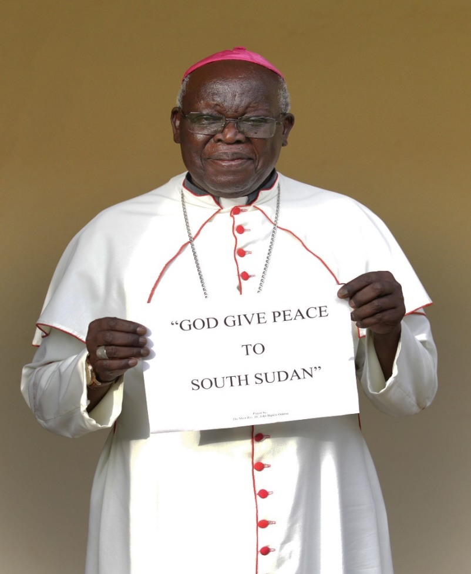
Please pray for peace in South Sudan and an end to conflict and war in this beautiful country.
As we move through the Lenten time,
the time when we contemplate Jesus in the desert,
pray for us the people of South Sudan and pray for peace here.
Accompany us, hold our hands,
hold the hands of the church in South Sudan.
Hold the hands of our brothers and sisters in South Sudan,
walk with us during this Lenten time.
Through Christ our Lord, Amen. (written by Fr. James Oyet Latansio)
Archbishop John Baptist Odama of the Roman Catholic Archdiocese of Gulu, in Uganda Photo: Mark Stedman

