Slide 1


Catholic Schools Week 2021.
24th January – 31st January
Focus : FAITH, LEARNING, LOVE, RESILIENCE & HOPE

Slide 2

What is
Catholic
Schools
Week?
Catholics Schools Week is an annual All-Ireland celebration which invites schools to give expression to the ethos of catholic education.
It acknowledges the contribution that Catholic post-primary schools make, not just to the Irish society, but also to the mission of the church.

Slide 3
What does Catholic Schools Week mean for us?
Unprecedented times of challenge and uncertainty
Our Faith and our resilience are being tested
When will we return to normal? When will I see my friends? Will I have exams? Where is God ?
Catholic schools are communities of faith and resilience
Our school is our community, and in it we aim to foster the holistic development of all our students, and to ensure safety, well being, to support your faith and to encourage you to foster resilience.
In our school we support each other. This support for each other is bound in faith and is more resilient than any virus.

Slide 4
Each day of Catholic Schools Week we are asked to reflect on the
Key Words:
Monday - Our focus is Faith
Tuesday – Our focus is Community
Wednesday – Our focus is Love and especially
Intergenerational Love
Thursday – Our focus is Challenge
Friday – Our focus is Hope

Slide 5



Monday – We reflect on : Faith
Our humanity, and our community response, our Faith, and our dedication towards each other has been a beacon of light for many during the darkness and difficulties of the last few months.
Let us pray: Lord we pray that the torch of goodwill will continue to shine brightly and make sure that no one is left alone as we forge a new normal in our lives.
Lord hear us …..

Slide 6

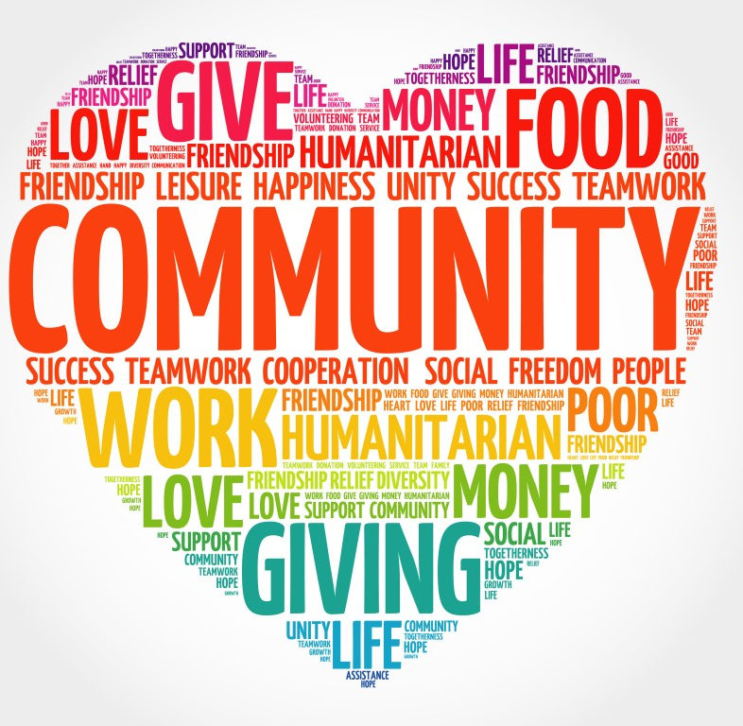
Tuesday – We reflect on: Community
Q: What is Community ?
A community is a group of people that care about each other, and feel connected to each other.
Q:What Community do you belong to ?
Family, extended family, St. Mark’s, your neighbourhood, parish/diocese, humanity etc….
Community is vital because it helps us to make connections.
We all have to play our part in working together. Remote learning, taking part in live lessons etc.
Let us pray: Lord remind us that alone we can do little, but together we can do so much. Lord hear us…..

Slide 7
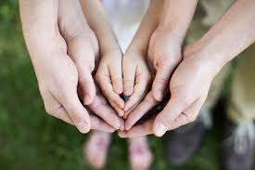
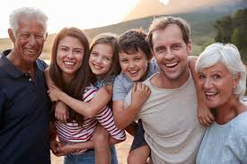
Wednesday – We reflect on :
Love & Intergenerational Love
In the midst of this global pandemic – we see obvious signs of intergenerational love. The love between young and old.
Have you ?
Shown your parents or grandparents how to access Mass on youtube/social media ?
Have you done anything for an elderly member of your family, or an elderly member of your community which demonstrates love?
Have to seen the 70 Million Tik Tok followers of young Lewis Leigh from Wales, who taught his 70 year old grandmother a Tik Tok dance after delivering her groceries during the first lockdown.
  https://youtu.be/XbgO-bOxOoI
Let us pray: St Mark we pray for all our elderly, that they are blessed with good health and that they continue to be examples of Christian living for all they love and meet. Lord hear us…..

Slide 8


Thursday – We reflect on : Challenges
On Thursday we are reminded to keep on going despite the challenges that surround us at the minute.
Some of you have mastered the art of not giving up, whilst others need more support to be productive and to cope under pressure.
Q: What challenges are we facing at the minute?
Getting up and getting motivated to learn, remote learning, I.T, deadlines & demands, mental and physical health, no face to face contact with friends, no social life, sickness, loneliness, bereavement & loss etc.
We have to overcome these challenges, and we have to have faith and believe that things will get better. We need to be positive, and remember to be kind to yourself and those around you. Everyone is doing their best!
Let us pray: Lord help us to remember that : Life is about accepting challenges, we have to choose to keep moving forward and be mindful of the lessons we learnt on the journey. Lord hear us….

Slide 9

Friday – We reflect on : Hope
Hope brings all sort of good things with it. With hope we have optimism, positivity, enthusiasm, courage, resilience and motivation.
Hope is the gift that keeps on giving. Hope is not always easy, but with practice we can work on it, develop it, pray for it, spread it, show it in the way we relate to others.
Hope encourages us to be positive and passionate about the future and about what is possible. Once you choose to be hopeful anything is possible.
“You may not always have a comfortable life, and you will not always be able to solve all the world’s problems at once, but don’t underestimate the importance you can have on the world, because history has shown us that courage can be contagious and HOPE can take on a life of its own” Michelle Obama
Finally we pray : God in Heaven hear my hopeful prayer, keep me in thy loving care. Be my guide in all I do. Bless all those who love me too. Amen.

Slide 10

Catholic Schools Week 2021
Communities built on Faith,
Learning to Love,
Learning Resilience,
Learning what it means to Hope.

