Slide 1
Fully Alive 1 Year 8
Term One, Module One: The Bible
Lesson 9: The Dead Sea Scrolls

Slide 2
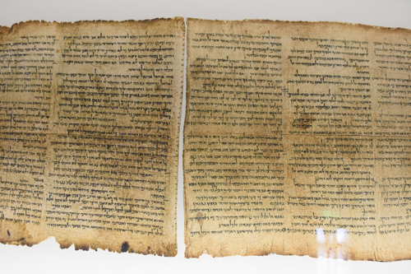
The Dead Sea Scrolls

Slide 3
Learning Intentions
In this lesson you will be learning about:
the Dead Sea Scrolls and how they were found;
the importance of the Dead Sea Scrolls.
Notes:
Learning Intentions
In this lesson you will be learning:
how different subjects help us to develop.
why studying Religious Education is important.
how religious faith can help us in our lives.

Slide 4
The Discovery of the Dead Sea Scrolls
  In 1947 a young shepherd boy was searching for a stray goat among caves near the Dead Sea, thirteen miles east of Jerusalem. He threw a stone through the opening of one of the caves to see if the goat would come out. Instead, he heard the sound of breaking pottery. He was scared and went away, but he returned the following day with his cousin.
  When they looked inside the cave, they found many old pottery jars. The jars were 21 inches high and just over 9 inches wide and they contained what looked like rolls of wallpaper. The scrolls were very fragile and broke easily into tiny pieces. When experts began to examine the pieces, they realised that they had found the oldest copies of parts of the Hebrew Scriptures (Old Testament).

Slide 5
The Dead Sea Scrolls
The Dead Sea Scrolls are the oldest handwritten copies of the Old Testament in the world, with some of them now over two thousand years old.
They were written mainly in Hebrew and Aramaic, with a few in Greek.
They were written on parchment, papyrus (made from a reed-like plant) and even copper scrolls and are in extremely good condition.
To date, almost six thousand manuscripts, fragments and pieces have been discovered and every few years more are found.
Even though some of them were written centuries apart and by many different authors, they are almost identical in content to modern versions of the Old Testament. This shows us that the Bible has remained virtually unchanged down through history.
These scrolls are considered to be accurate accounts of the biblical history of the Jewish people.

Slide 6
A time to pray…
Sign of the Cross
Teacher
The Dead Sea Scrolls are the oldest handwritten copies of the Old Testament in the world.
They were written by people who loved the Bible.
Close your eyes and imagine one of these writers working at this task.
The sheet of papyrus is spread out before them.
They write with a quill pen made from a feather.
They are careful in their work. (Pause)
We will listen now to a prayer that they might have said.
Reader
The Prayer of the Writer
I know that God loves me and is with me as I work.
These stories have been handed on so we will not forget.
I truly love these stories so I copy them with care,
For others need to hear them too and know that God is there.
Teacher
We thank God for all the people who went to such trouble to tell and copy out the Bible stories. Because of them, we know more about God’s love today.
All
Glory be to the Father …
Sign of the Cross

