Slide 1
Fully Alive 1 Year 8
Term One, Module One: The Bible
Lesson 11: The Evangelists

Slide 2
Learning Intentions
In this lesson you will be learning:
The writers of the four Gospels are called the Evangelists.
Each Evangelist is represented by a symbol.
Each Evangelist wrote at different times, using different sources, and for different people.
Notes:
Learning Intentions
In this lesson you will be learning:
how different subjects help us to develop.
why studying Religious Education is important.
how religious faith can help us in our lives.

Slide 3
The Evangelists
The first four books of the New Testament are called the Gospels.
They are the Gospel according to Matthew, the Gospel according to Mark, the Gospel according to Luke and the Gospel according to John.
Matthew, Mark, Luke and John are known collectively as the Evangelists. The word ‘evangelist’ means ‘one who announces good news’. The Evangelists told the Good News about Jesus Christ.
Through their Gospels, the Evangelists wanted to help people to understand the meaning of Jesus’ life, death and resurrection.

Slide 4
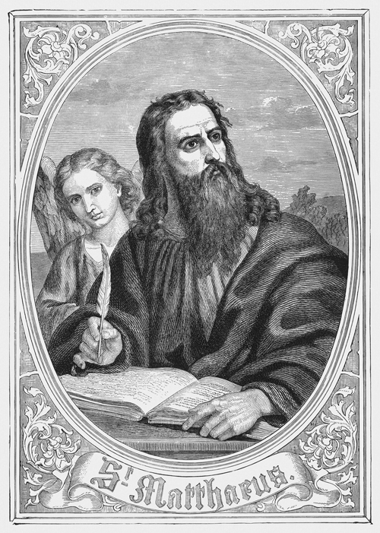
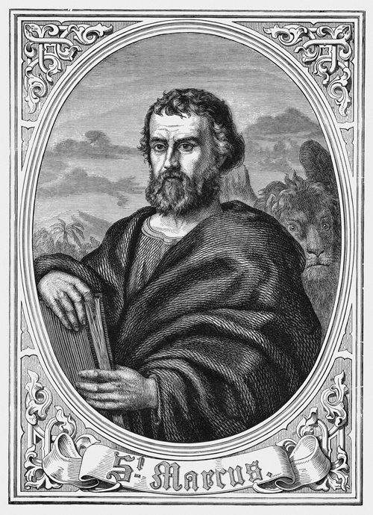
Symbols of the Evangelists
The early Christian Church used four symbols to represent the four Gospel writers.
Matthew is represented as a man – perhaps because his Gospel begins by tracing the human ancestry (family tree) of Jesus.
Mark is represented as a lion – an animal that is associated with strength and bravery. Perhaps this symbol was chosen to reflect Mark’s faith and courage in writing his Gospel for persecuted Christians in Rome.

Slide 5
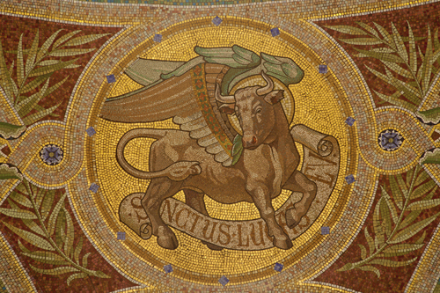
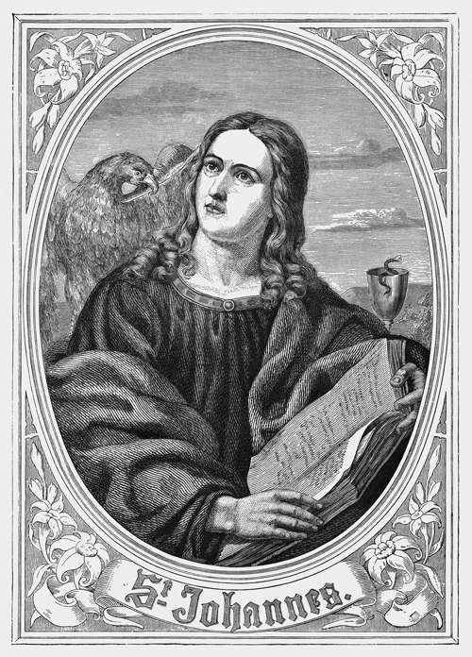
Symbols of the Evangelists (continued)
Luke is represented as an ox – an animal that is regarded as calm and peaceful. Perhaps this symbol was chosen because Luke’s Gospel portrays Jesus’ gentleness and patience, particularly with the poor and the oppressed.
John is represented as an eagle – a beautiful bird with huge wings that can swoop upwards faster than any other birds. This symbol reflects the way John’s Gospel seeks to give its readers a deeper and higher level of understanding of the meaning of the life and the teaching of Jesus.

Slide 6
Key Points about the Evangelists
The Evangelists wrote at different times and for different communities.
All four Evangelists told the story of Jesus. They based what they wrote on eyewitness information. Most likely, they did not see these things themselves.
They got their information from different sources. This explains why there are sometimes differences in the details within the four Gospel accounts.
The first Gospel to be written was the Gospel according to Mark, which scholars think was written some time between AD 65 and 75. Mark wrote his Gospel for Christians who were suffering persecution in Rome.

Slide 7
Key Points about the Evangelists (continued)
The Gospel according to Matthew and the Gospel according to Luke were written next, probably between AD 80 and 90. Matthew wrote for Jews who had become Christians. Luke wrote for Gentiles who had become Christians.
The Gospel according to John was the last of the four Gospels to be written. It was probably finished between AD 90 and 100.
The Gospels contained an important message for the communities of faith for whom they were written. For example, Mark was writing at a time when many Christians were facing persecution or suffering for their faith. It is for this reason that Mark emphasises the suffering of Jesus and the reward that awaits those who remain faithful to the teachings of Jesus.

Slide 8
A time to pray…
Sign of the Cross
Four students carry the symbols of the Evangelists.
Teacher
There are four Gospels:
The Gospel according to Matthew (student holds up the ‘man’ symbol for Matthew)
The Gospel according to Mark (student holds up the ‘lion’ symbol for Mark)
The Gospel according to Luke (student holds up the ‘ox’ symbol for Luke)
The Gospel according to John (student holds up the ‘eagle’ symbol for John)
Students lower their symbols. Each symbol will be raised in turn during the reading of the passage from the corresponding Gospel.
Teacher
We remember Matthew’s stories about Jesus as teacher. We remember how Jesus taught the crowds in the Sermon on the Mount.

Slide 9
A time to pray (continued)
Reader 1
A reading from the holy Gospel according to Matthew.
Happy are those whose greatest desire is to do what God requires; …
Happy are those who are merciful to others; …
Happy are those who work for peace; …
Happy are those who are persecuted because they do what God requires;
the Kingdom of heaven belongs to them! (Matthew 5:6-10)
Teacher
We remember Mark’s stories about Jesus’ compassion for those who were sick and in need.
Reader 2
A reading from the holy Gospel according to Mark.
A man suffering from a dreaded skin disease came to Jesus, knelt down, and begged him for help. ‘If you want to,’ he said, ‘you can make me clean.’
Jesus was filled with pity, and reached out and touched him. ‘I do want to,’ he answered. ‘Be clean!’ At once the disease left the man, and he was clean. (Mark 1:40-42)

Slide 10
A time to pray (continued)
Teacher
We remember Luke’s stories about Jesus praying. Jesus often went away by himself to ask God for guidance and strength.
Reader 3
A reading from the holy Gospel according to Luke.
At that time Jesus went up a hill to pray and spent the whole night there praying to God. When day came, he called his disciples to him and chose twelve of them, whom he named apostles. (Luke 6:12-13)
Teacher
We remember how John revealed Jesus to be ‘the light of the world’.
Reader 4
A reading from the holy Gospel according to John.
‘I am the light of the world,’ [Jesus] said. ‘Whoever follows me will have the light of life and will never walk in darkness.’ (John 8:12)
Teacher
The Gospel of the Lord.
All
Praise to you, Lord Jesus Christ.
Sign of the Cross

