Slide 1
Fully Alive 1 Year 8
Term One, Module One: The Bible
Lesson 4: The Bible

Slide 2
Learning Intentions
In this lesson you will be learning:
The Bible tells the story of God’s love for all people.
The Bible was written by many different authors over many centuries.
The Bible contains a library of books.
The first part of the Bible is called the Old Testament or the Hebrew Scriptures.
The second part of the Bible is called the New Testament or the Christian Scriptures.
Notes:
Learning Intentions
In this lesson you will be learning:
how different subjects help us to develop.
why studying Religious Education is important.
how religious faith can help us in our lives.

Slide 3
The Bible – A Library of Books
The word ‘Bible’ comes from the Greek word biblia, meaning books.
The Bible was written over many centuries and by many different people.
Among its authors we find Amos who was a farmer, Matthew who was a tax-collector, and Paul who was a tent-maker.
The Bible is not, in fact, a single book but a library of seventy-three books.
All the books are closely linked because, when put together, they tell a single story – the story of God’s unconditional love and plan for humankind.

Slide 4
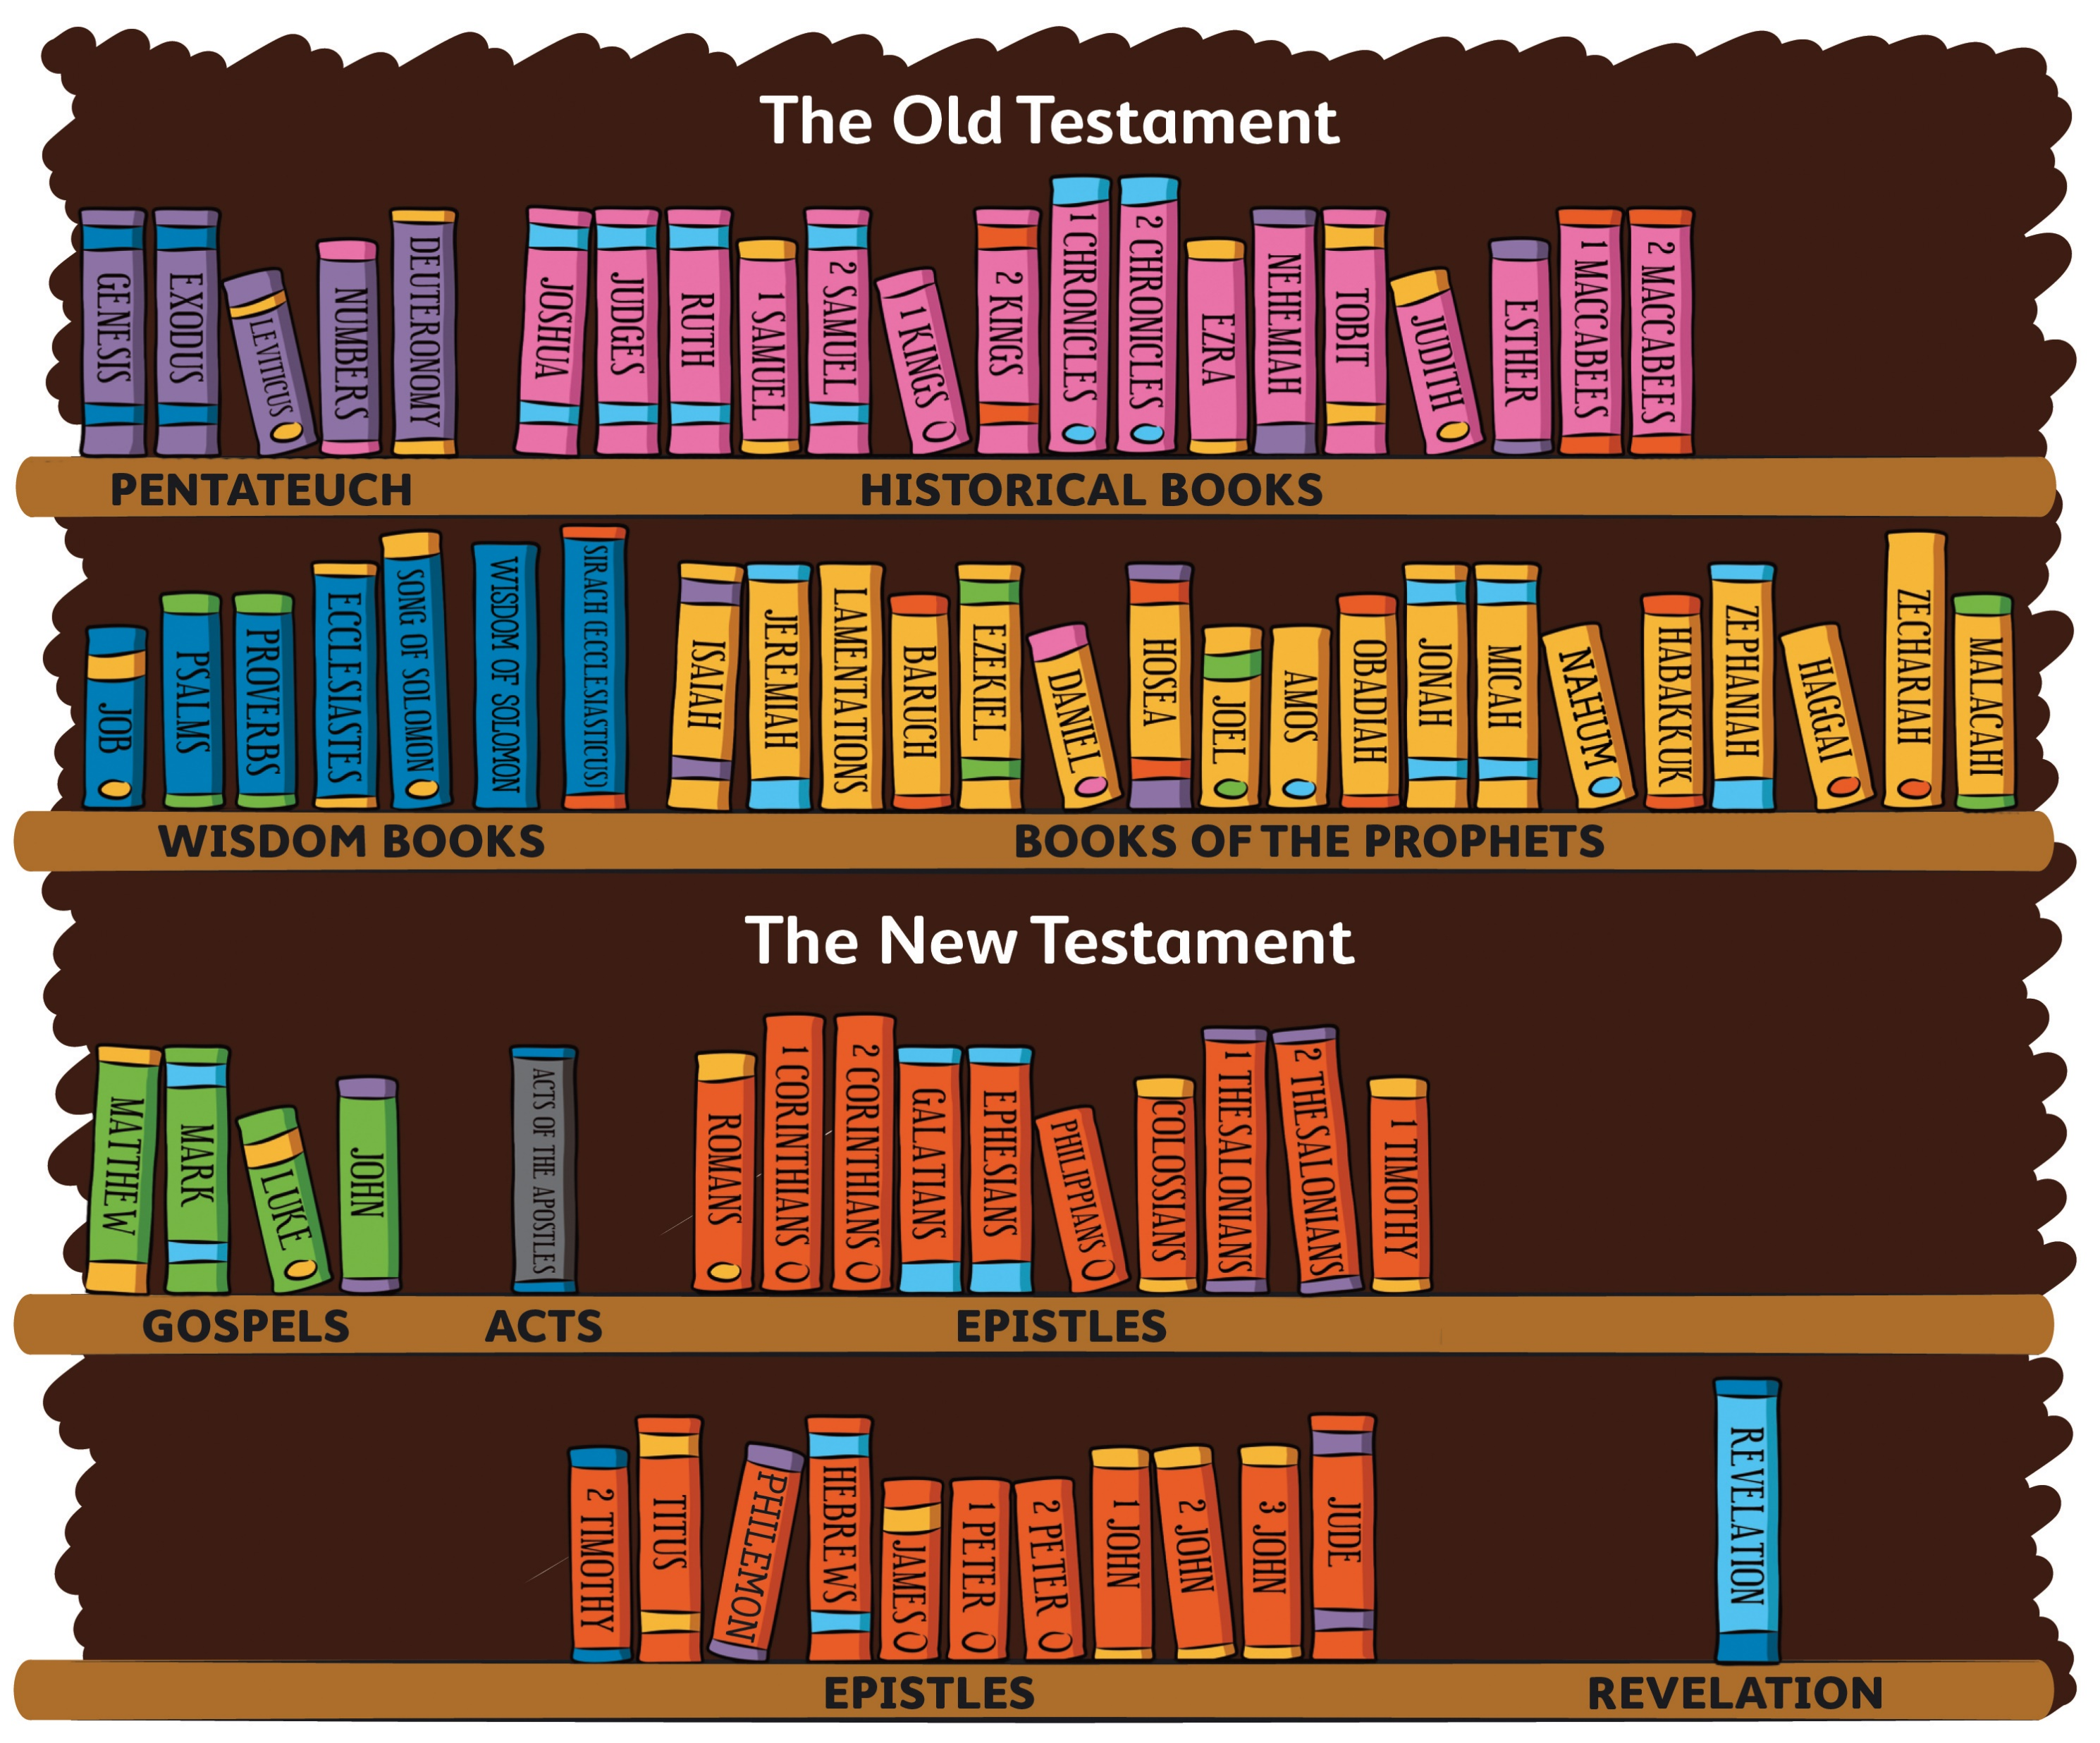
The Books of the Bible

Slide 5
The Old Testament and the New Testament
The Bible is divided into two parts. The first part is known as the Old Testament or the Hebrew Scriptures. This part of the Bible has forty-six books which tell us about God’s relationship with the people of Ancient Israel. These books were mostly written in Hebrew, a language that is still spoken by people in Israel today.
The second part of the Bible is known as the New Testament or the Christian Scriptures. The New Testament has twenty-seven books. They tell us the story of Jesus and his followers. The New Testament was written in Greek, a language that many people used and knew at the time of Jesus.

Slide 6
What the Church teaches about the relationship between the Old Testament and the New Testament …
The Catechism of the Catholic Church states:
The unity of the two Testaments proceeds from the unity of God’s plan and his Revelation. The Old Testament prepares for the New and the New Testament fulfils the Old; the two shed light on each other; both are true Word of God. (paragraph no. 140)
The Old Testament is an indispensable part of Sacred Scripture. (paragraph no. 121)

Slide 7
Why Christians read the Bible …
Christians consider the Bible to be a very special book. They believe it is one of the main ways by which God speaks to them. Christians believe that the Bible is the Word of God.
Christians read the Bible when they need guidance, comfort or encouragement.
‘The Bible is not meant to be placed on a shelf, but to be in your hands, to read often – every day, both on your own and together with others…’ (Pope Francis)

Slide 8
A time to pray…
Sign of the Cross
Teacher
The Bible is full of stories about God’s love for his people. These stories also tell us of how people placed their trust in God. They looked back and saw that God was with people from the beginning of time.
The writer of Psalm 90 says:
O Lord, you have been our home.
Before you created the hills or brought the world into being,
you were eternally God,
and you will be God forever.
So, like the people who wrote the Bible, we take a moment to praise and thank God.
First of all, we become quiet and still. (Pause)
We become aware of our breathing. (Pause)
We remember that God is with us. (Pause)
Now that we are quiet and still, we repeat the phrase from the psalm:
O Lord, in all generations you have been our home.
All
O Lord, in all generations you have been our home. (x3)
Teacher
Repeat this phrase silently in your hearts. (Pause)
Sign of the Cross

