Slide 1
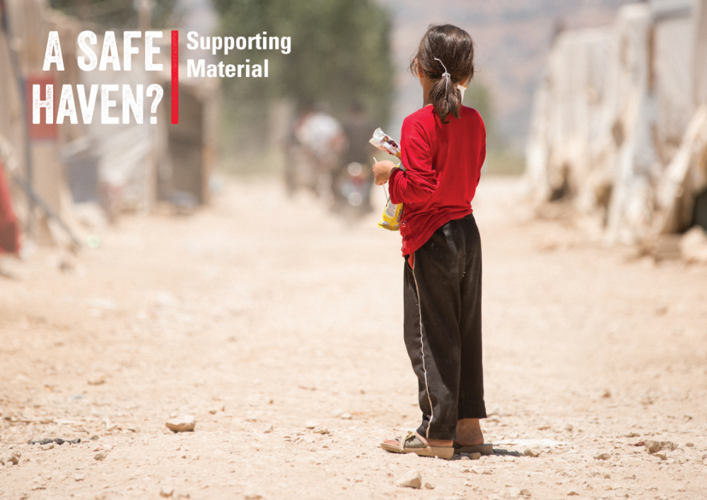
01

Slide 2
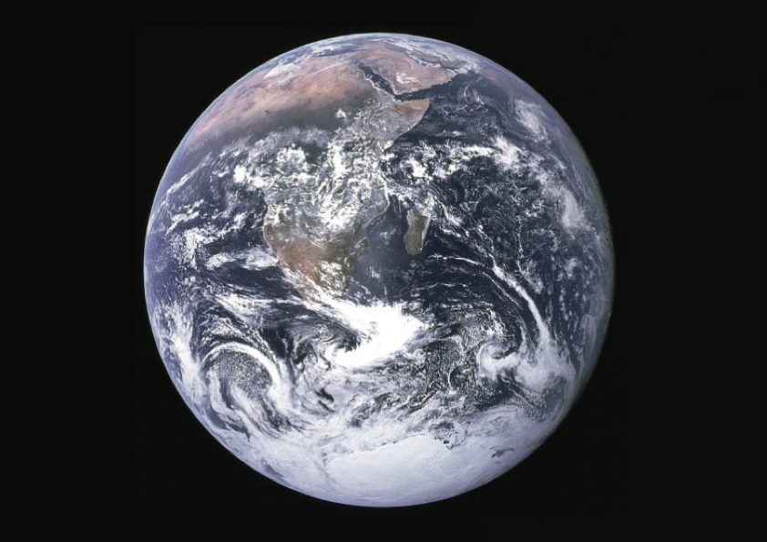
02
Notes:
This picture is known as ‘The Blue Marble’. It was taken by the crew of the Apollo 17 spacecraft travelling toward the moon. This was the second ever photograph taken that captures the whole planet in the frame, and the first to show the Southern polar region. It is however, the most iconic photo ever taken of our planet, and is credited with making humans reconsider the importance of the planet to humans, and our place in the universe. It became a rallying cry for the environmental movement, who pointed out its fragile nature against the dull, black void behind.

Slide 3
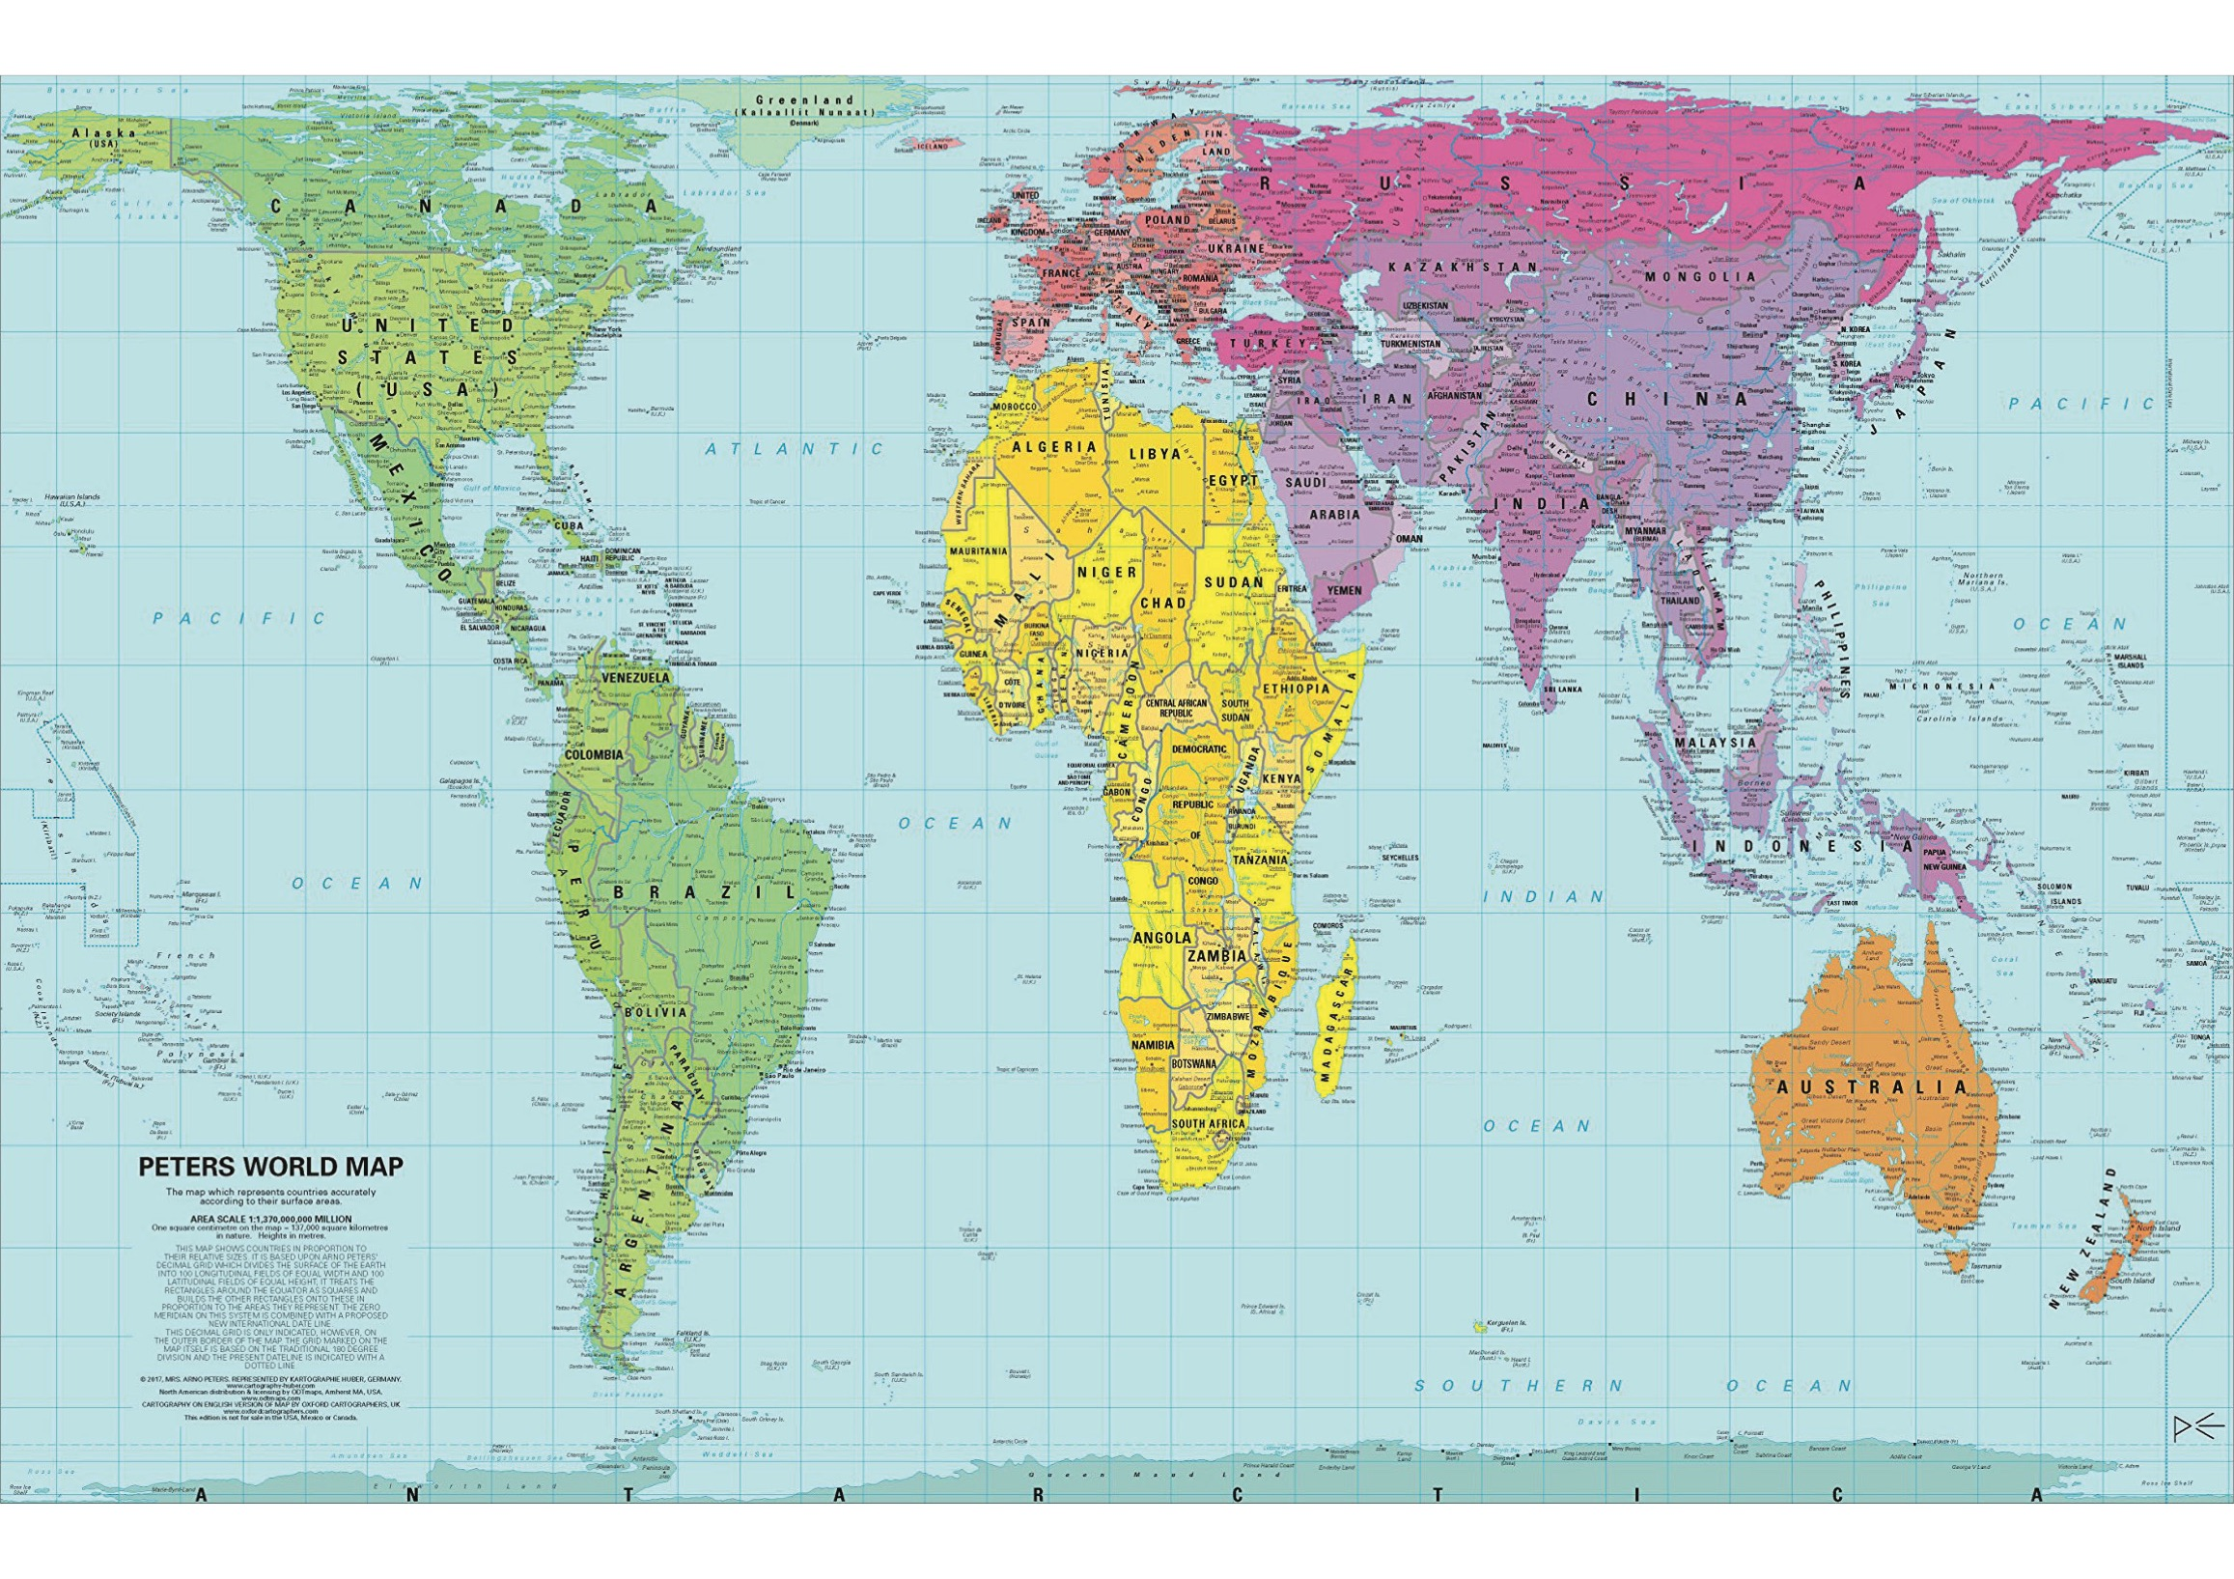
03
Notes:
This map is known as the Peters World Map, also the Peters Projection. It is a map that attempts to show the correct sizes of the continents relative to each other. One benefit of this is that the developing world, which is mostly found around the equator, is now shown in more or less the correct scale, whereas in other popular maps, this area of the world appeared smaller. It has its flaws, as all maps do, but this version has gained in popularity, and can be found in many schools in Ireland.

Slide 4
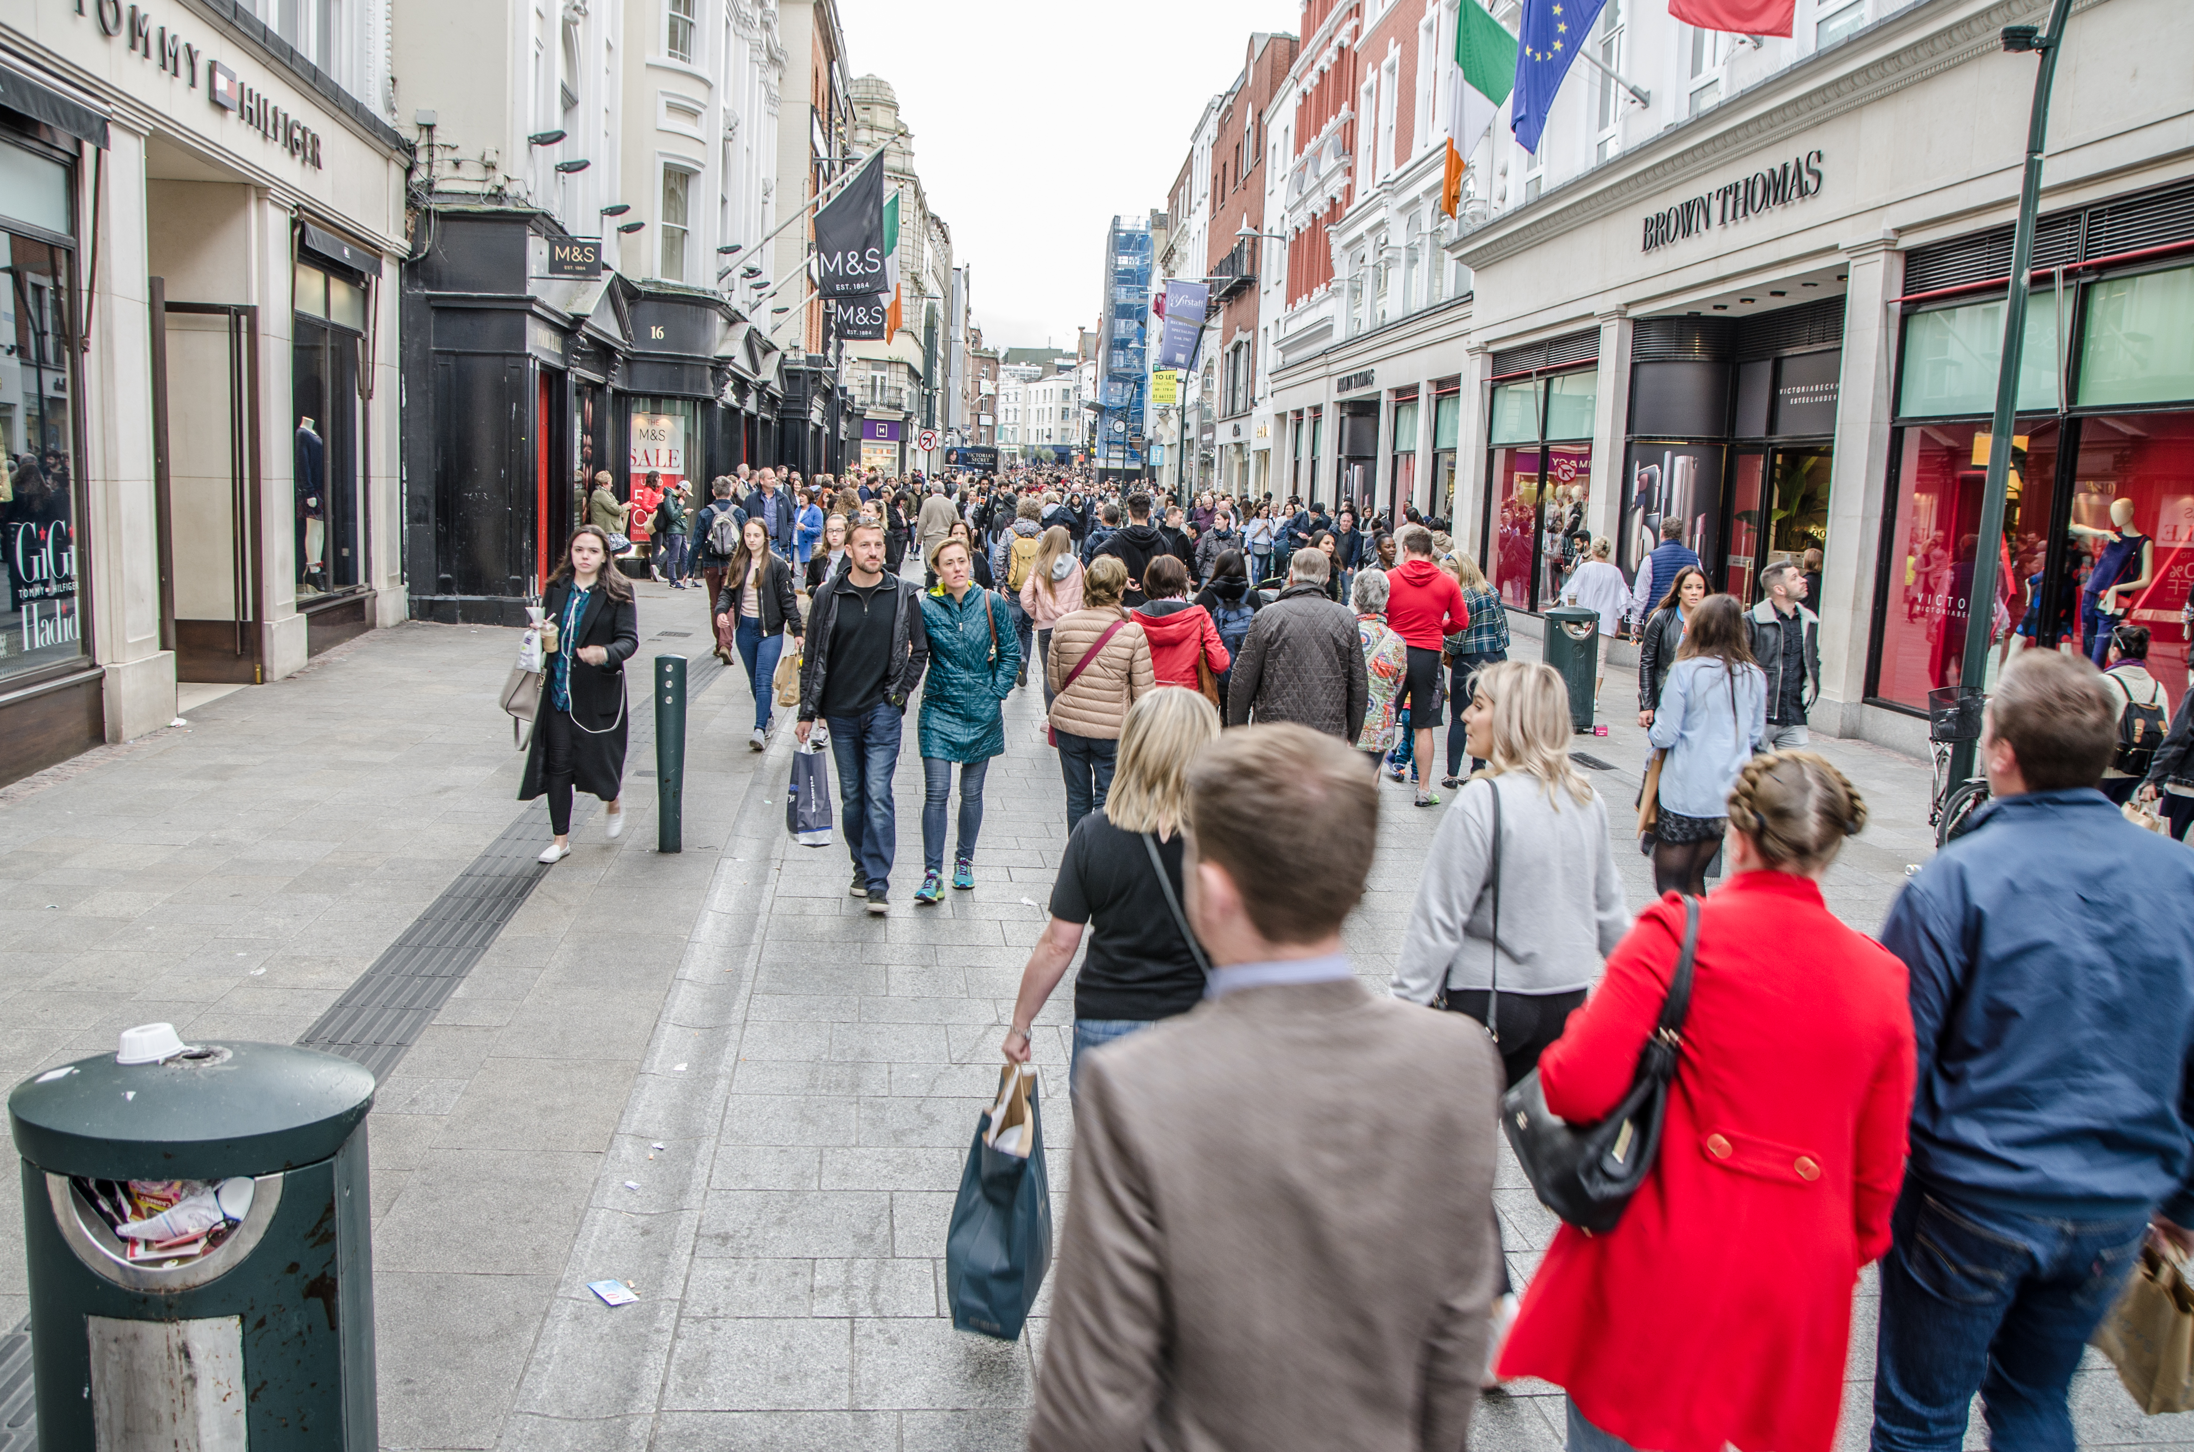
04
Notes:
Grafton Street is the most expensive retail street in Ireland, with prime retail rents costing €6500 per square metre, according to the CBRE Ireland and their latest Retail Market View publication available here: news.cbre.ie/Irelands-retail-sector-continues-to-buck-the-trend/
Ask students to consider the overall issues in Ireland with land and property, in particular rent levels in the big cities like Dublin and Cork. How do they feel about this? Do they think it will cause them problems down the line if they want to go to college or find work in the cities?
According to Daft.ie, in November 2018 the average rent in Dublin is now €1,968 per month, which is up 10.9% on 2017. In fact, national rents are 30% higher than the 2008 peak during the Celtic Tiger years. Source - lovindublin.com/news/rent-dublin-average

Slide 5
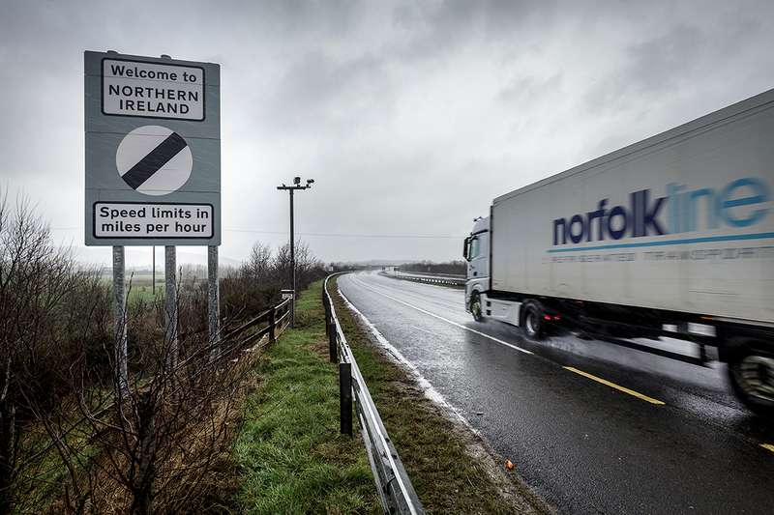
05
Notes:
A border crossing point between the Republic of Ireland (ROI) and Northern Ireland (NI). Currently, vehicles are able to cross the border without any checks on either side due to both the ROI and the UK being members of the European Union (EU). However, on March 29 2019, this could all change. If a deal is not struck between the EU and the UK before this date, border checks may have to be put in place after the UK leaves the EU, and crossing the border from NI into the ROI could become a very different experience, especially for lorry drivers carrying goods.

Slide 6
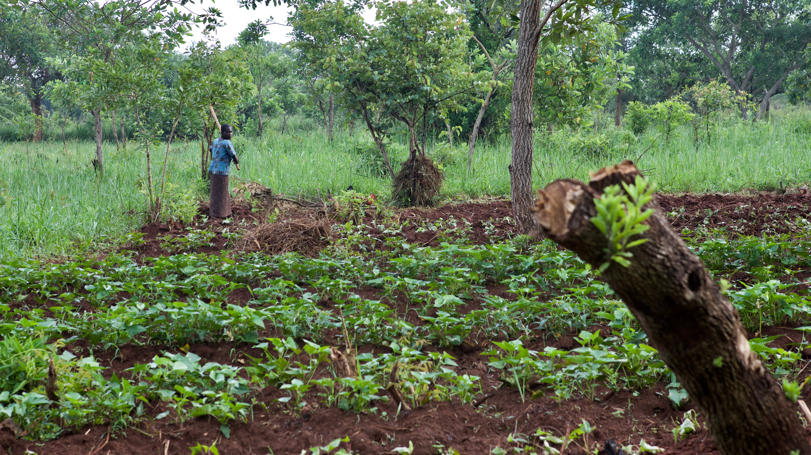
06
Notes:
Evelyn lives in Northern Uganda. Since the death of her husband, her family is slowly being pushed off their land by a clan member. Trócaire’s partner, Acholi Religious Peace Initiative, is facilitating a mediation process between the two parties to keep Evelyn’s family on the land. Evelyn is not considered legally married, because the dowry set by her family was not paid in full by her late husband before he died. Without full payment of the dowry the marriage is not considered official, which puts Evelyn in a precarious position, as she has no rights over the land that she lives on.
Photo credit: Gary Moore

Slide 7
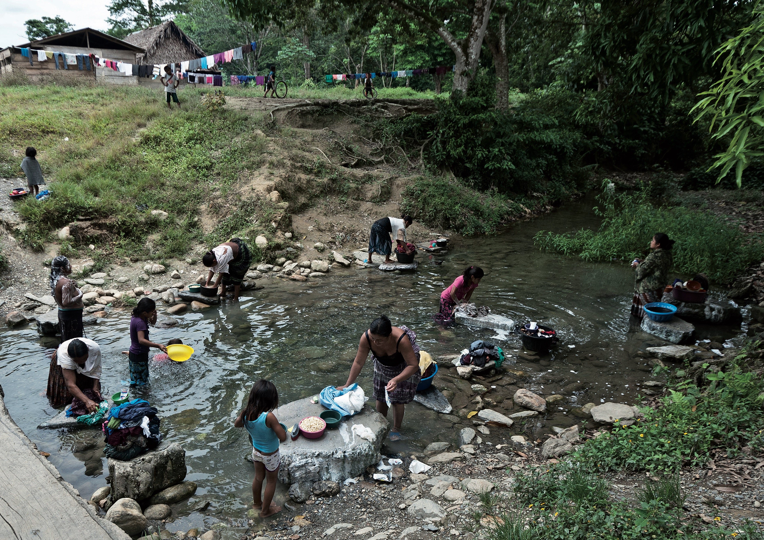
07
Notes:
The river in the photo is a focal point for women completing some work tasks, and also for socialising. They are part of the Mayan Q’eqchi people who live in the Polochic Valley in eastern Guatemala. The Q’eqchi people have suffered from evictions by wealthy plantation owners, who then grew sugar cane for biofuels for a few years. The land was then left idle, and 72 families have returned to try and build a life in the only place they can imagine doing so with dignity. However, they have faced constant threats and intimidation since their return, and live in constant fear of further attack.
Photo credit: Manuel Morillo

Slide 8
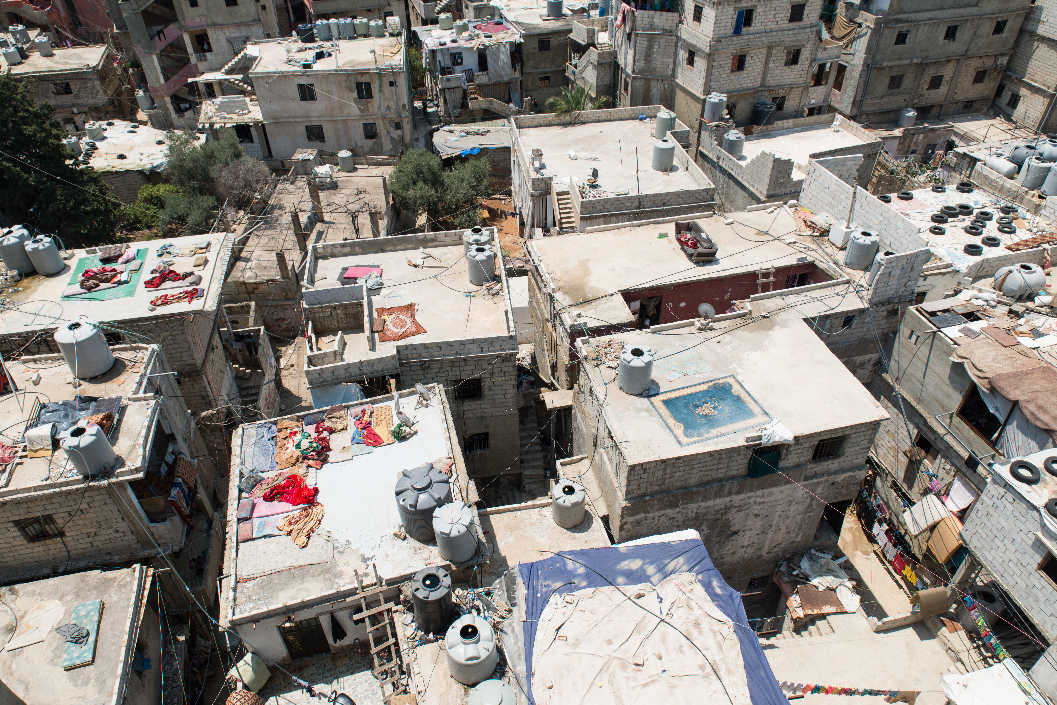
08
Notes:
Shatila refugee camp in Beirut, Lebanon. The camp was originally set up for Palestinian refugees, but the camp has become swollen with Syrian refugees since the outbreak of fighting in 2011.
Photo credit: Simon Walsh

Slide 9
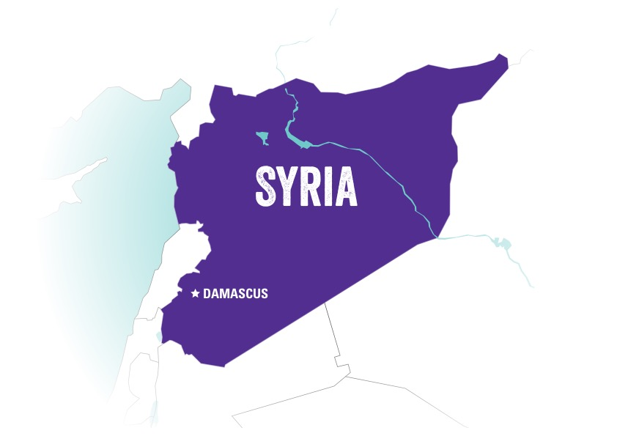
09

Slide 10
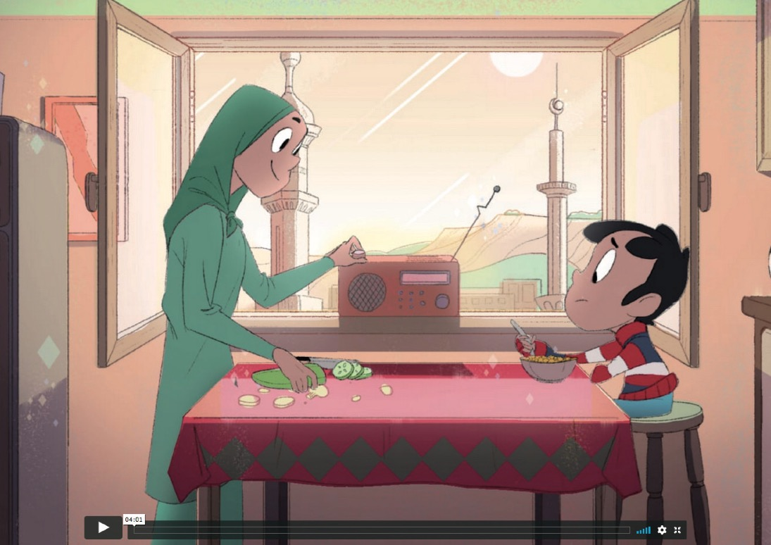
10
Notes:
The Brigit and Sami animation can be found on the post-primary page of our 2019 Land Rights microsite, or is available on Vimeo, found here: vimeo.com/235509432

Slide 11
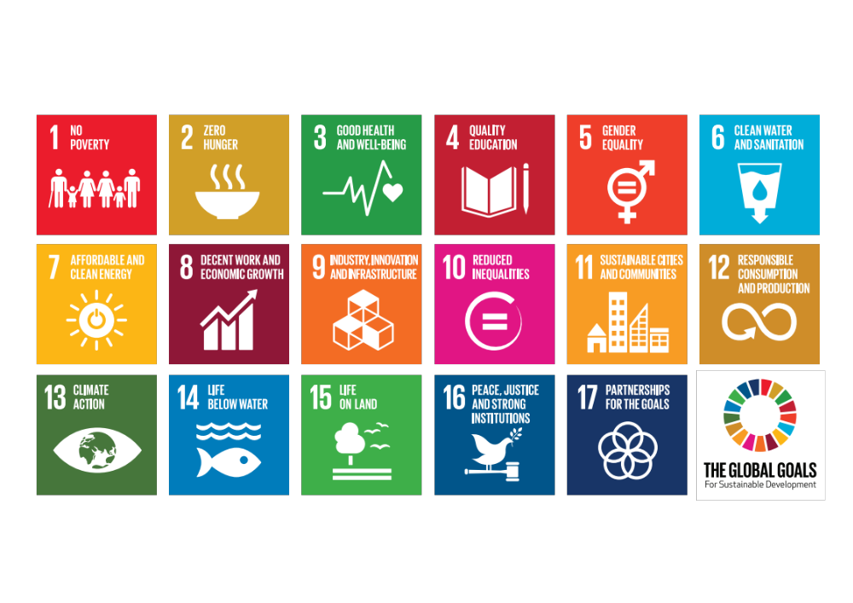
11

Slide 12





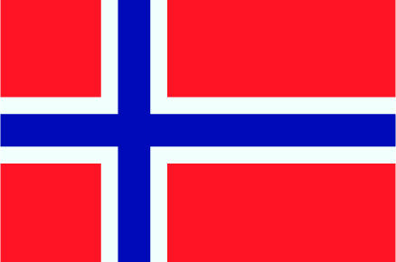




1
6
2
7
3
8
4
9
5
10
12

Slide 13
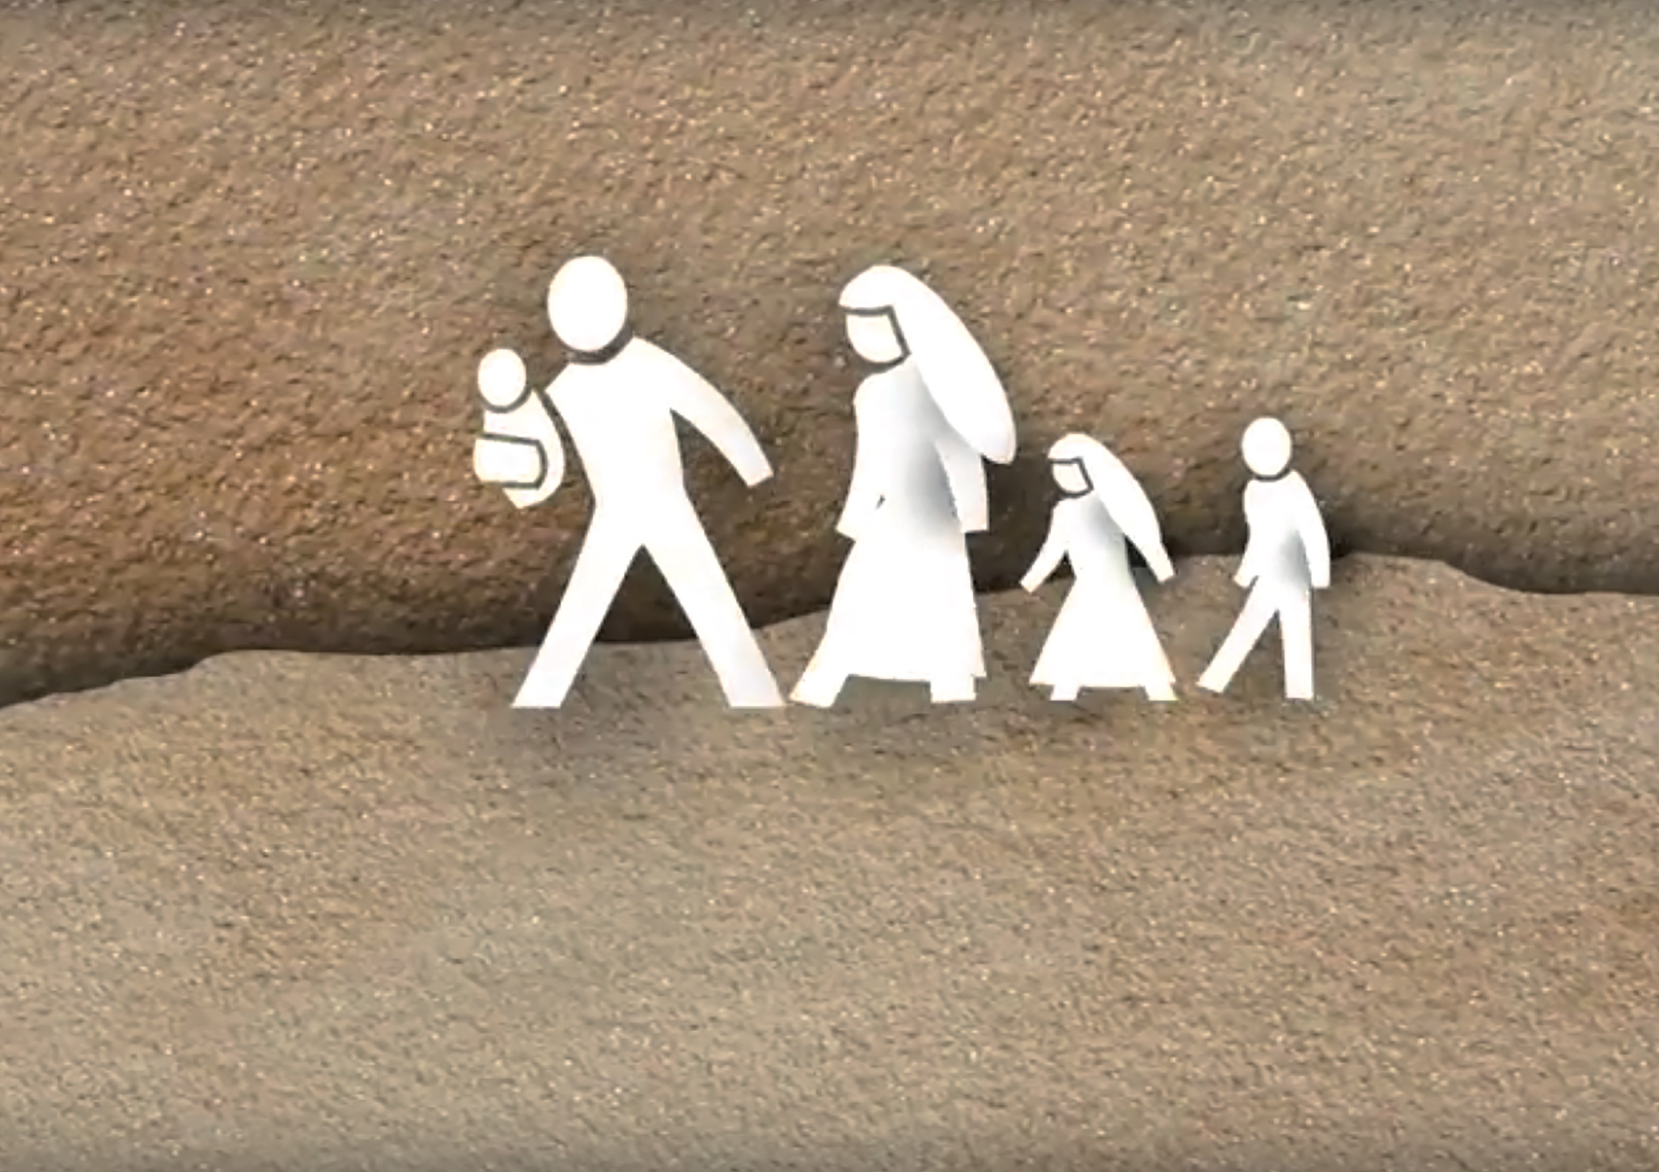
13
Notes:
This animation on the UN Refugee Convention of 1951 was created by the JustNow strategic partnership as part of a toolbox for teaching Human Rights. For more information on this project, check out their website here: http://teachjustnow.eu/
The animation is also available on YouTube here: youtu.be/i5fnRd2_gB4

Slide 14
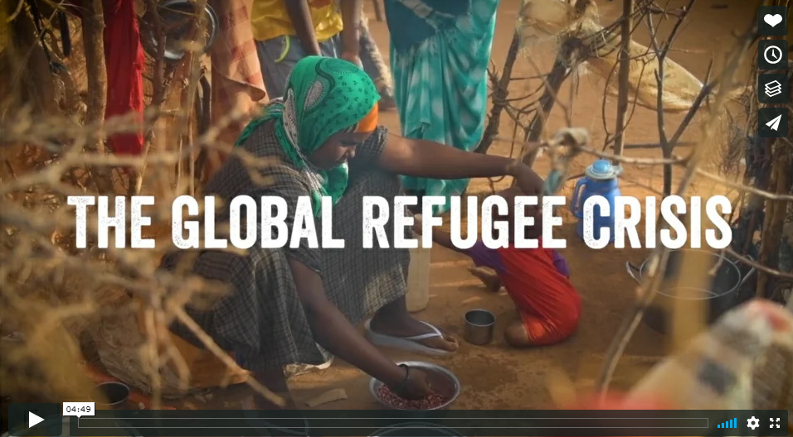
14
Notes:
Check out our Lent Post Primary video here: https://vimeo.com/311181072
This video explores Trócaire’s humanitarian work around the world, including a closer look at how Trócaire supports our partner Sawa to provide services and facilities for Syrian refugees like Maya and her family.

Slide 15
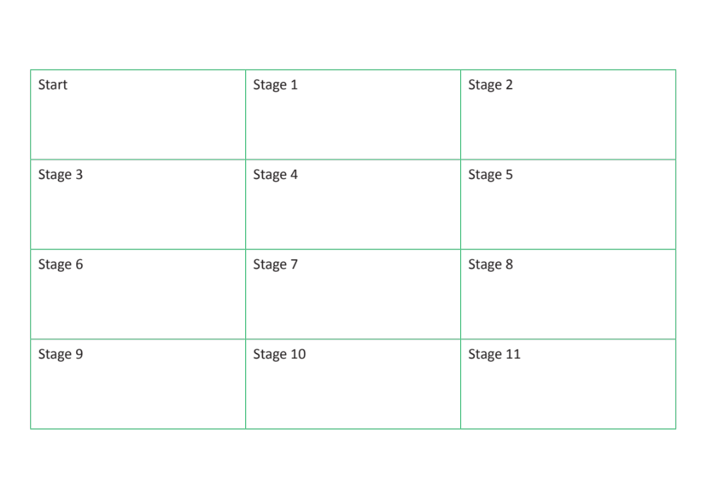
15

Slide 16
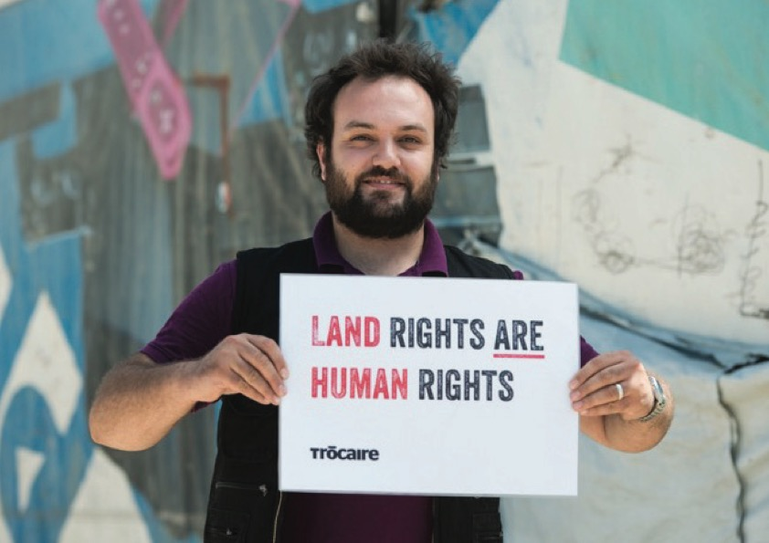
16

