Slide 1
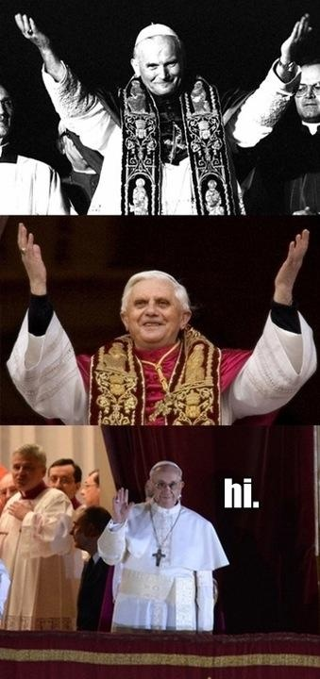
EVERY PICTURE TELLS A STORY

Slide 2
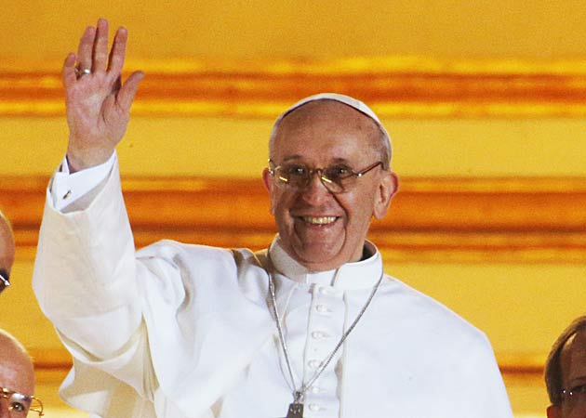
WHO IS THIS MAN?
Cardinal Jorge Mario Bergoglio was born in Buenos Aires, Argentina, on December 17, 1936. He studied Chemistry and worked as a chemical technician before becoming a Jesuit priest.

Slide 3
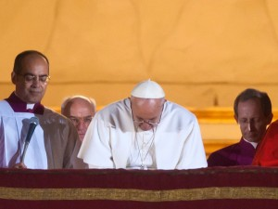
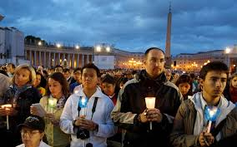
BEFORE HIS FIRST BLESSING, FRANCIS ASKED THE FAITHFUL TO PRAY FOR HIM, AS HE BOWED HIS HEAD IN SILENCE. THIS WAS THE START OF SOMETHING SPECIAL.

Slide 4
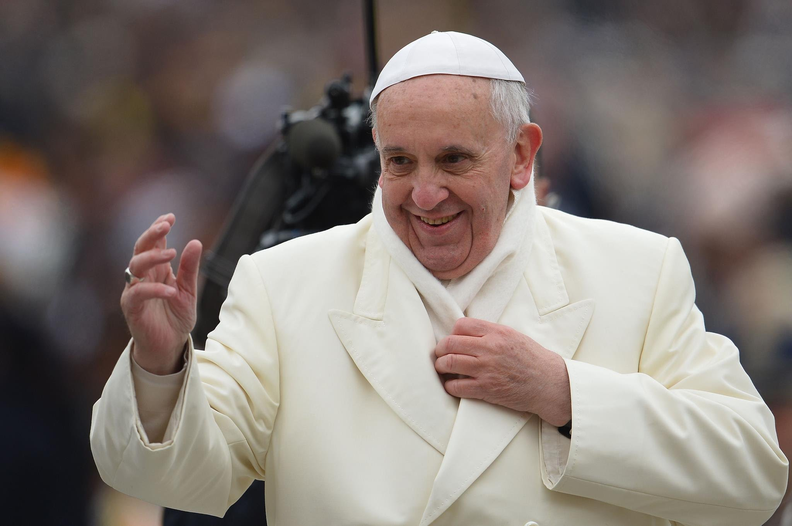
“MAY GOD FORGIVE YOU WHAT YOU'VE DONE,” WERE THE WORDS NEWLY ELECTED POPE FRANCIS USED AS HE ADDRESSED FELLOW CARDINALS AS A JOKE OVER DINNER, SOON AFTER HIS ELECTION AND DURING HIS FIRST APPEARANCE AS POPE.

Slide 5
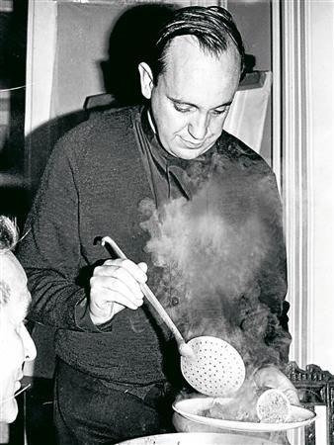
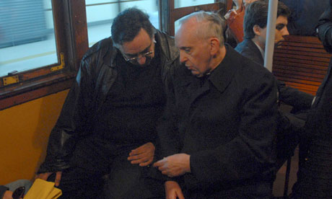
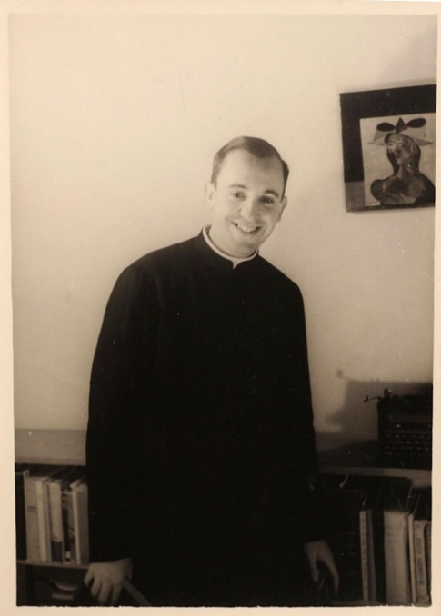
SIMPLICITY
APPROACHABILITY
TENDERNESS
SERVICE

Slide 6
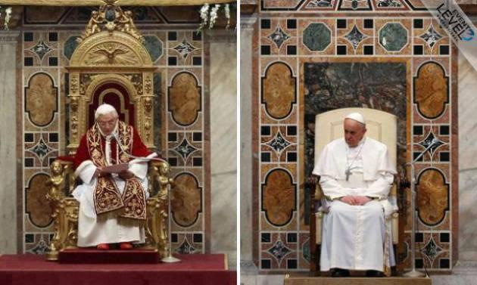

Slide 7
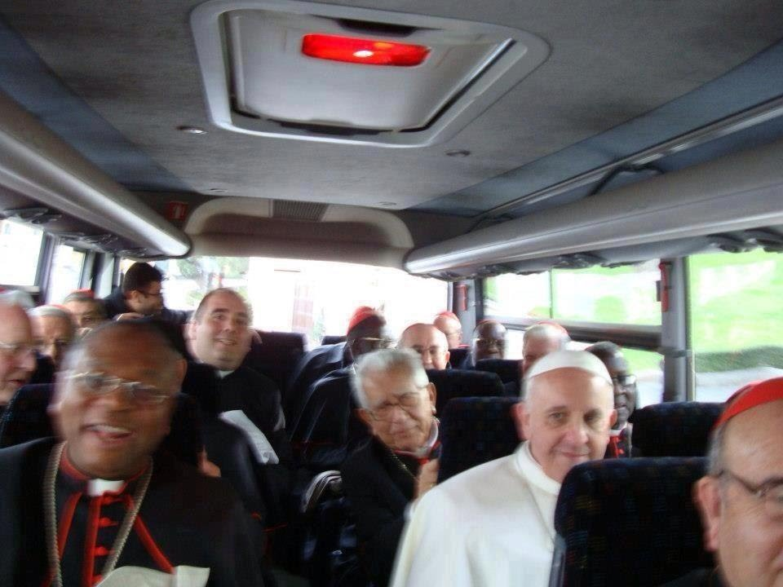
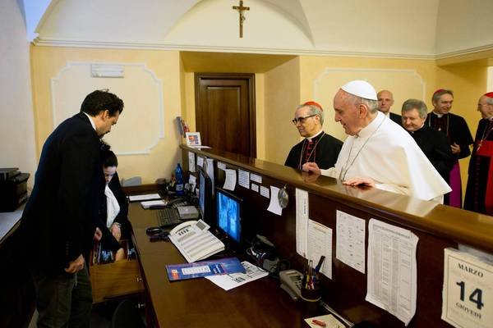
HE PAYS HIS OWN BILLS… CARRIES HIS OWN BAG

Slide 8
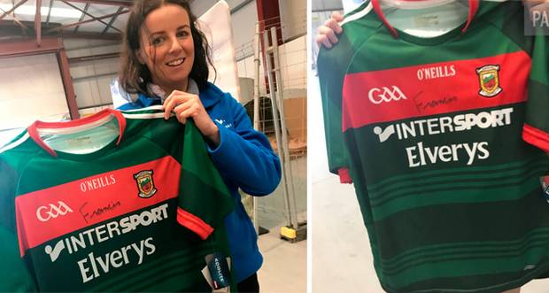
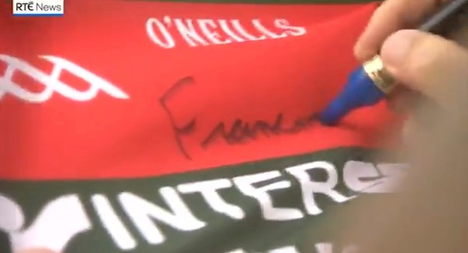
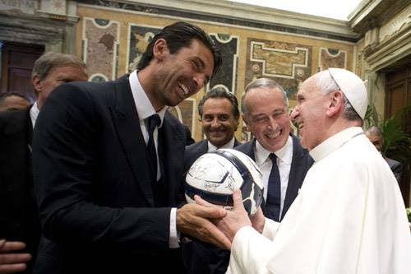
HE IS A KEEN FOOTBALL FAN!

Slide 9
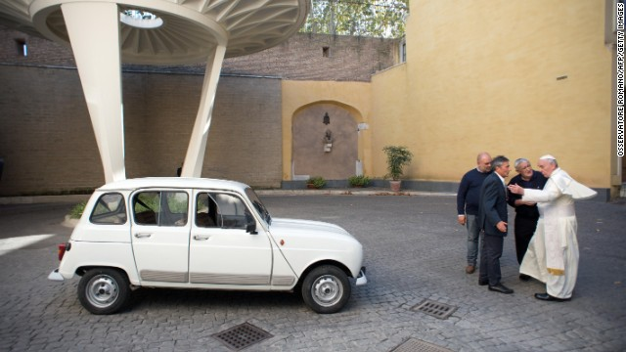
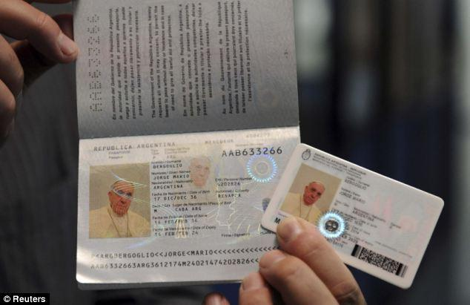
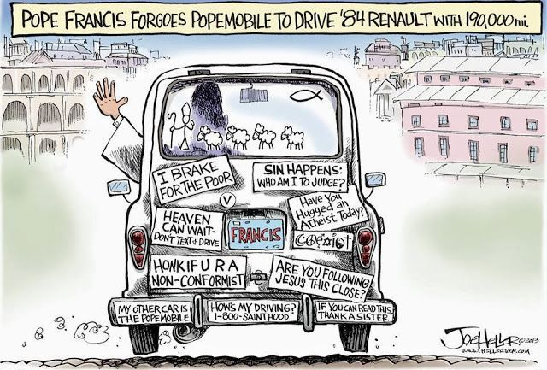
KEEPING THINGS SIMPLE…

Slide 10
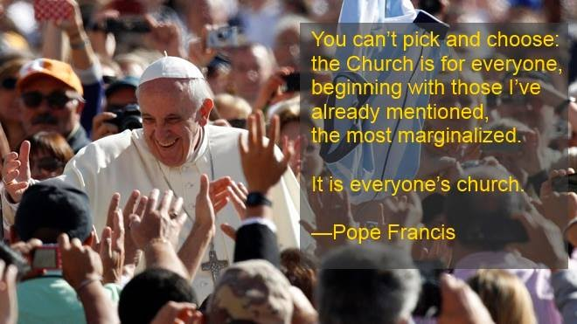

Slide 11
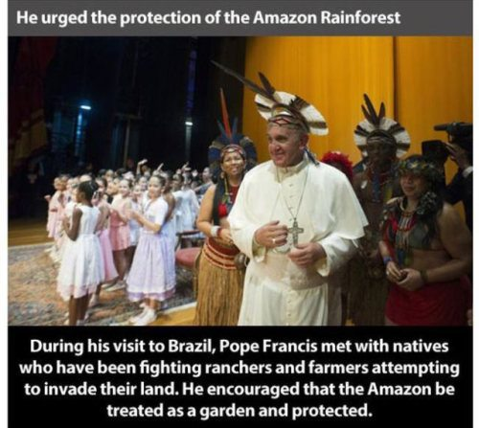
POPE FRANCIS IS PASSIONATE ABOUT ECOLOGY AND STEWARDSHIP OF THE EARTH

Slide 12
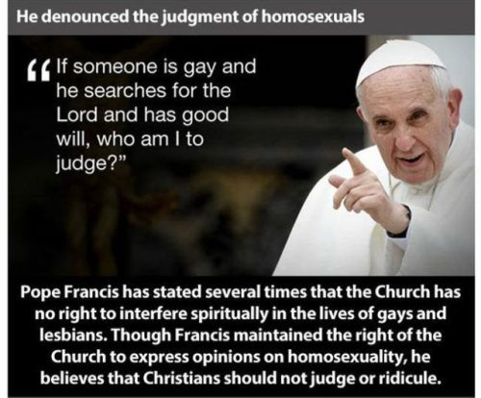

Slide 13
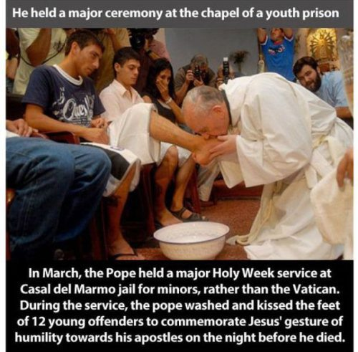
THIS IS MY NEW COMMANDMENT…

Slide 14
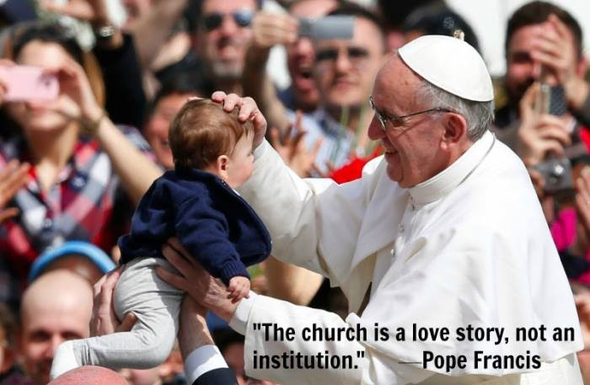
LOVE ONE ANOTHER AS I HAVE LOVED YOU

Slide 15
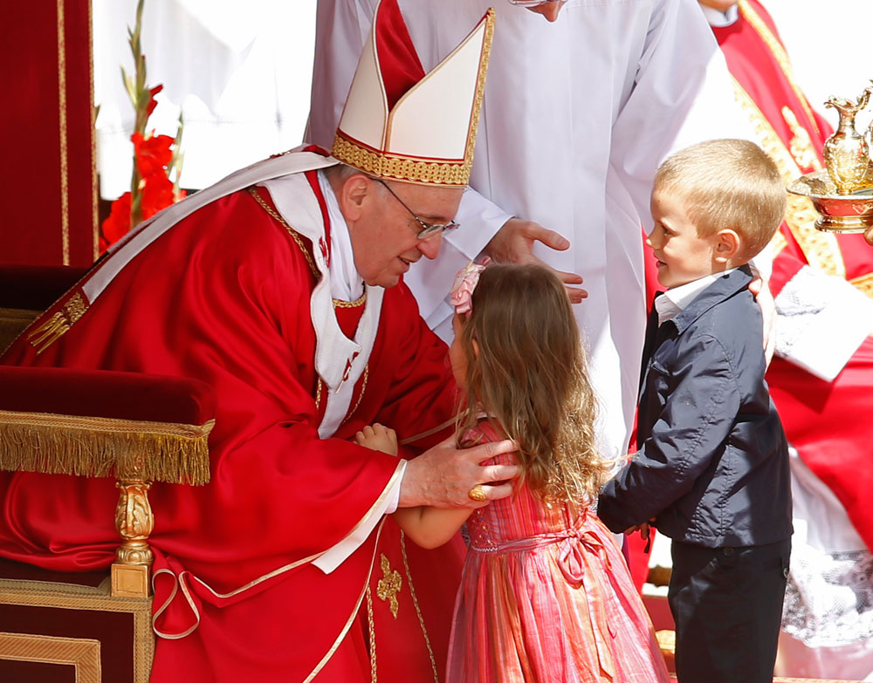
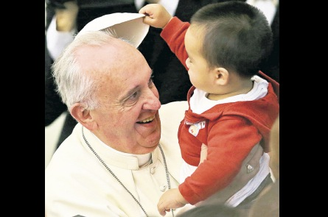
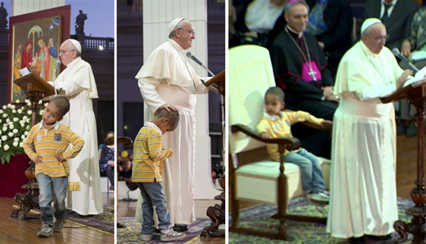
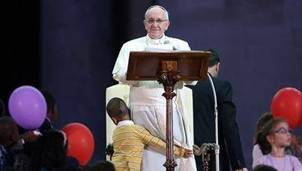
HOW OFTEN DO WE SAY 'THANK YOU' TO ONE ANOTHER IN OUR FAMILIES? THESE ARE ESSENTIAL WORDS FOR OUR DAILY LIFE: “SORRY,” “EXCUSE ME,” “THANK YOU.” IF FAMILIES CAN SAY THESE THREE THINGS, THEY WILL BE JUST FINE.”

Slide 16
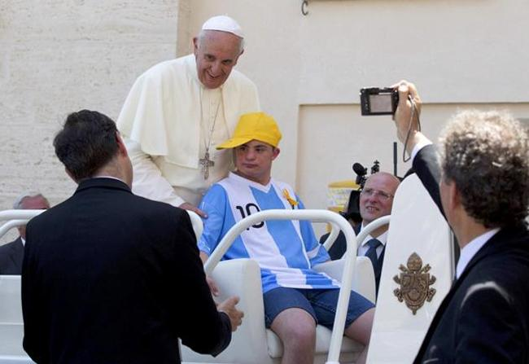
“I WANT TO ASSURE THEM THAT THEY ARE PRESENT IN MY PRAYERS BUT I ALSO WANT TO FORCEFULLY STATE THAT WE MUST ALL COMMIT OURSELVES WITH CLARITY AND COURAGE SO THAT EVERY HUMAN PERSON, ESPECIALLY CHILDREN WHO ARE AMONG THE MOST VULNERABLE, BE ALWAYS DEFENDED AND PROTECTED.”

Slide 17
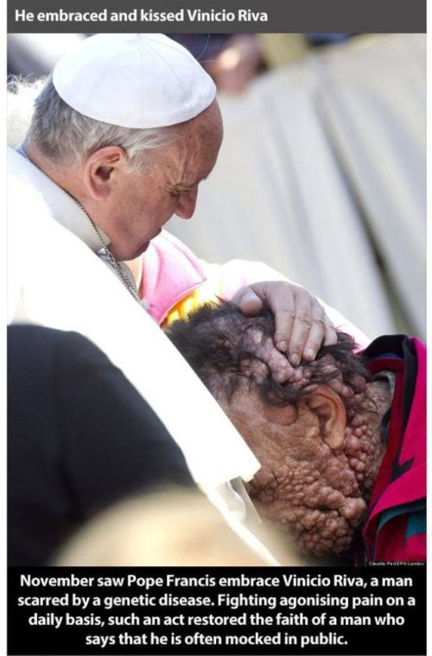
“YOUR HEART, WHEN YOU MEET WITH THOSE IN GREATEST NEED, BECOMES BIGGER, AND BIGGER, AND BIGGER! BECAUSE THESE ENCOUNTERS MULTIPLY THE CAPACITY TO LOVE. GO ON!”

Slide 18
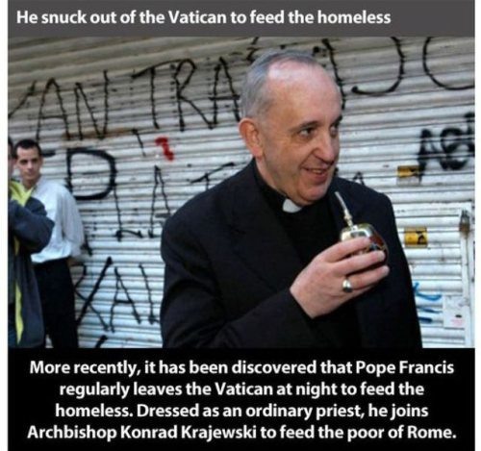
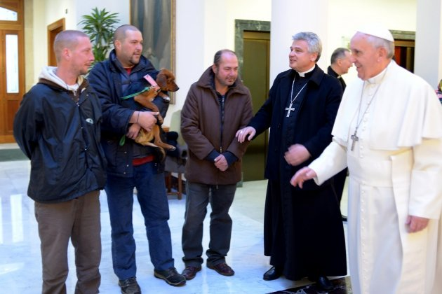

Slide 19
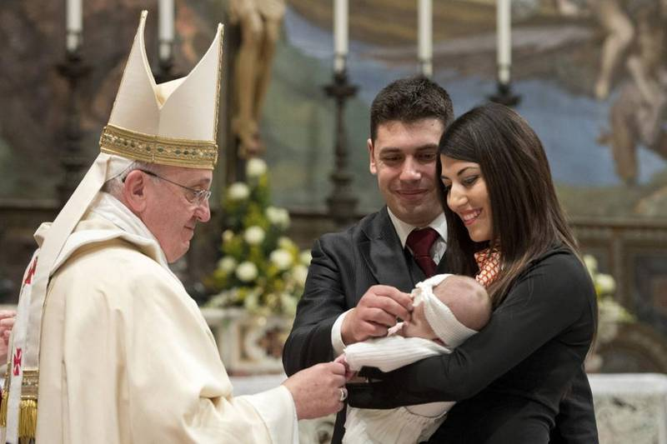
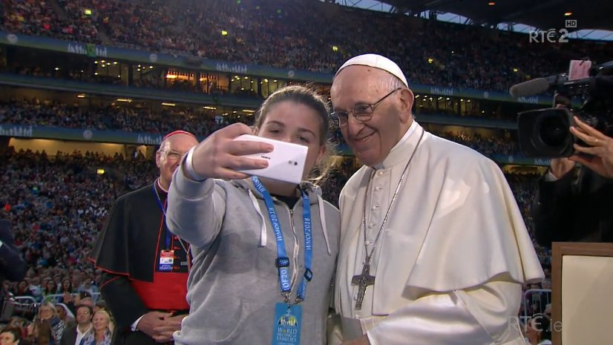
HE HAS A GREAT AFFECTION FOR THE YOUNG

Slide 20
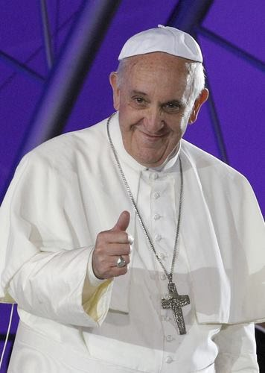
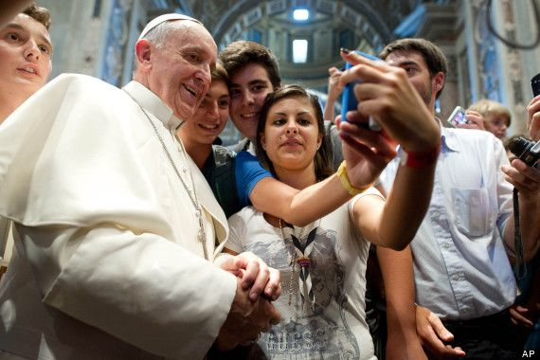
“AS YOUNG PEOPLE YOU CAN'T AND SHOULDN'T LOSE HOPE. IT'S SIMPLY PART OF YOUR NATURE. A YOUNG PERSON WITHOUT HOPE ISN'T YOUNG. IT'S SOMEONE WHO HAS AGED TOO SOON.”

Slide 21


Slide 22


Slide 23


Slide 24

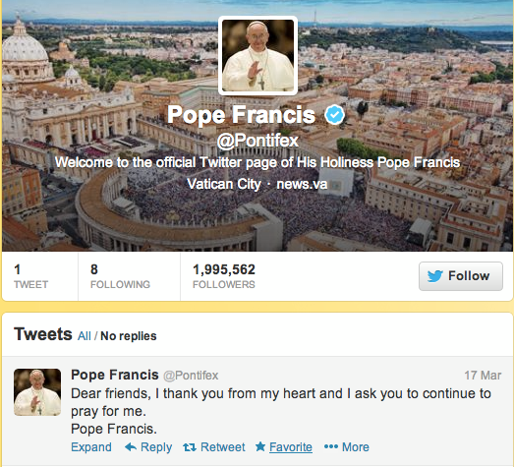
SOCIAL COMMUNICATIONS IS FOR BRINGING OTHERS TO CHRIST

Slide 25


Slide 26
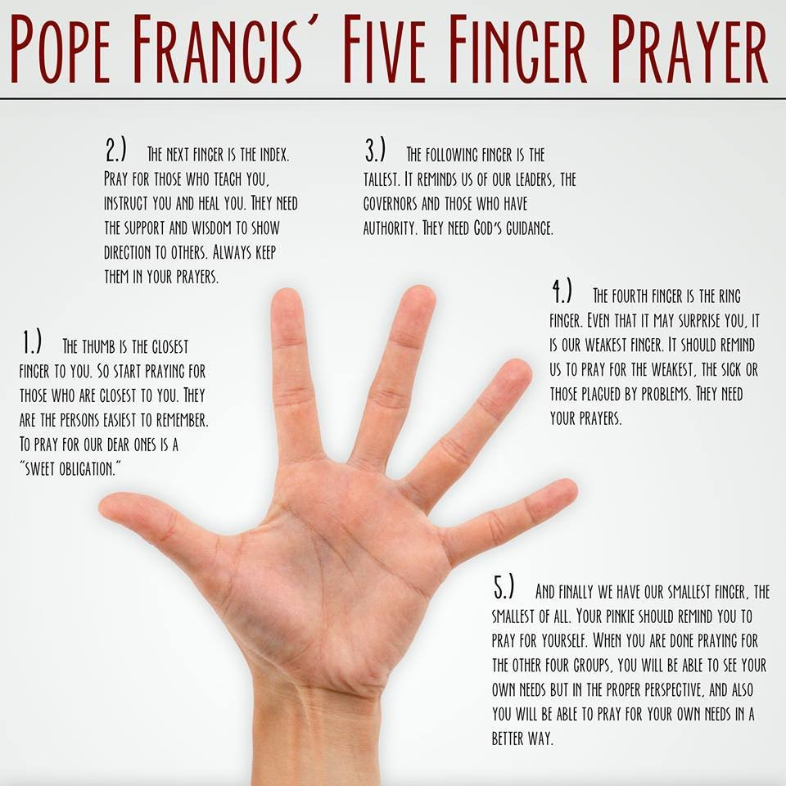
DREAM BIG THINGS THROUGH PRAYER!

